Slide 1
AGM Barcelona 2021
International
Executive Search Federation
Wednesday October 6th

Slide 2
Agenda AGM October 6th
09.00 AM IESF Marketing & Prospecting new partners Kirsten
09.25 AM Business Update from India Vivek
09.55 AM IESF China evolves from Covid Daniel
10.25 AM Coffee Break
10.45 AM IESF competitors Kirsten
11.00 AM Discussion: Why do we belong to this group Normand
11.45 PM Coffee Break
12.05 PM Survey: Interviews f2f vs. online Victor
12.35 PM Brand Building Mandrake Normand
01.20 PM Lunch
03.30 PM Bus to McLaren museum
Visit Museum
Bus to Beso Sitges
Driving Experience
Cocktail & Diner
09.30 PM Bus back to the hotel

Slide 3
Marketing & Partnership Development
AGM Barcelona – October 6th 2021
Kirsten

Slide 4
Content
Marketing facts & figures
Results 2021 looking back at goals 2021
Marketing learnings pasts 9 months
New IESF media
Targets 2022
Plans & Budget 2022
Marketing Calendar 2022
Partner engagement
Partnership Development 2022

Slide 5
Marketing Facts & Figures
Facts & figures
Results 2021
Marketing learnings
New IESF media
Targets 2022
Plans & Budget 2022
Marketing Calendar
Partner engagement
Partnership Development
Number of publications 2020: 11
Number of publications 2021 so far: 30
Number of followers Linked In Company Page from 2200 to 2517
Engagement: average 5 %
Shares (26 average per post) & Clicks (93 average per post)

Slide 6
IESF Marketing results looking back at goals 2021
Duplicate the number of publications according to the Marketing Planning for 2022 to: 30 publications minimum from various sorts
Increase number of followers LinkedIn page with 1000 members in 2021
Maintaining the level of clicks and shares around 40 a month (both organic and sponsored)
Maintaining the high engagement rates for our content around 5 – 7%
Also share and generate IESF publications with business media worldwide
Facts & figures
Results 2021
Marketing learnings
New IESF media
Targets 2022
Plans & Budget 2022
Marketing Calendar
Partner engagement
Partnership Development

Slide 7
Marketing learnings past 9 months
Facts & figures
Results 2021
Marketing learnings
New IESF media
Targets 2022
Plans & Budget 2022
Marketing Calendar
Partner engagement
Partnership Development
Frequent posts from various sorts (3/4 own posts a months seems sufficient)
Both organic (1) & sponsored (2)
Sponsoring & Google ads must become a fixed baseline in the marketing strategy to generate more online visits & engagement
Use (online) events to attract attention and maintain awareness after
Most attractive posts are: interactive & personal ones, client cases, or expert articles on leadership topic
1. Combination generate the most brand awareness in total
2. I also want to start experiment with new media, such as Downloads, Whitepapers & (animated) video and Podcasts.

Slide 8
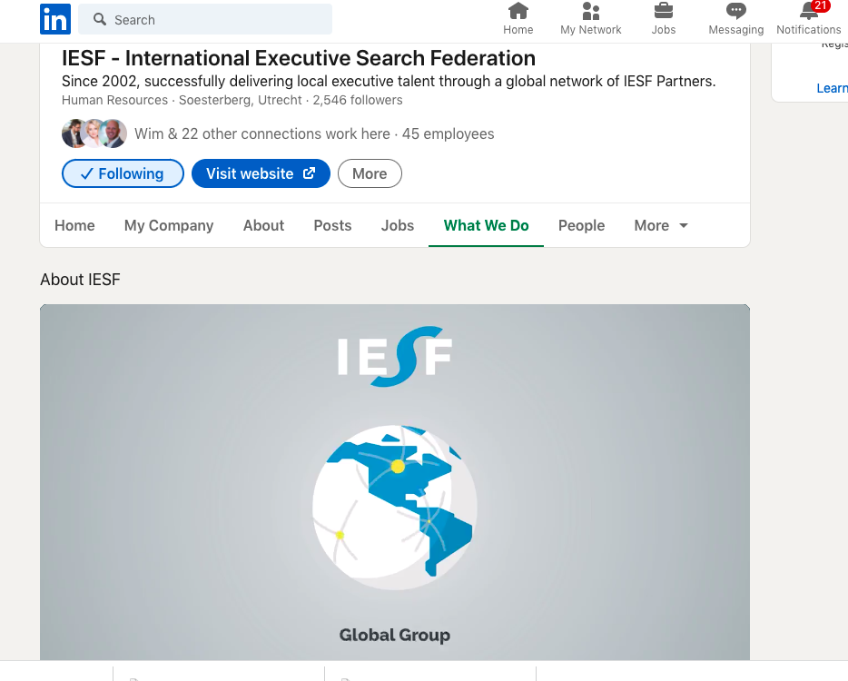
LinkedIn Company Page
Facts & figures
Results 2021
Marketing learnings
New IESF media
Targets 2022
Plans & Budget 2022
Marketing Calendar
Partner engagement
Partnership Development

Slide 9
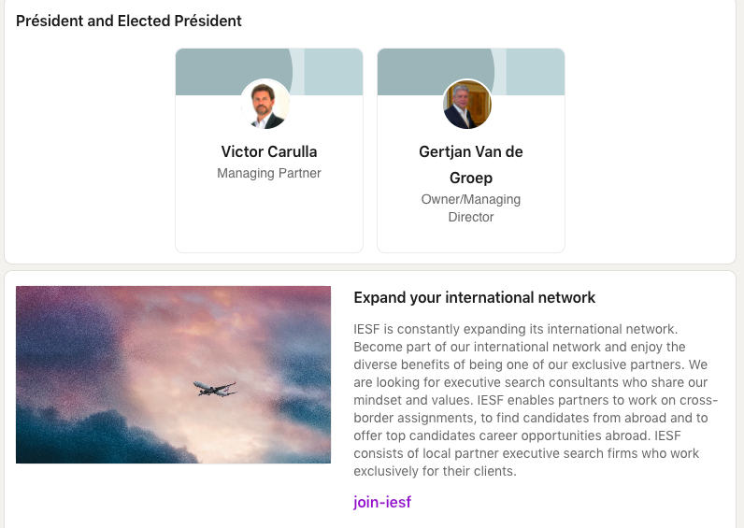
LinkedIn Company Page
Facts & figures
Results 2021
Marketing learnings
New IESF media
Targets 2022
Plans & Budget 2022
Marketing Calendar
Partner engagement
Partnership Development

Slide 10
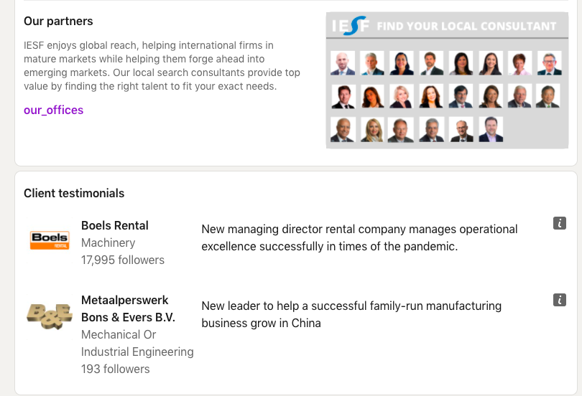
LinkedIn Company Page
Facts & figures
Results 2021
Marketing learnings
New IESF media
Targets 2022
Plans & Budget 2022
Marketing Calendar
Partner engagement
Partnership Development

Slide 11
LinkedIn Company Page
Facts & figures
Results 2021
Marketing learnings
New IESF media
Targets 2022
Plans & Budget 2022
Marketing Calendar
Partner engagement
Partnership Development

Slide 12
IESF Animated video
Facts & figures
Results 2021
Marketing learnings
New IESF media
Targets 2022
Plans & Budget 2022
Marketing Calendar
Partner engagement
Partnership Development

Slide 13
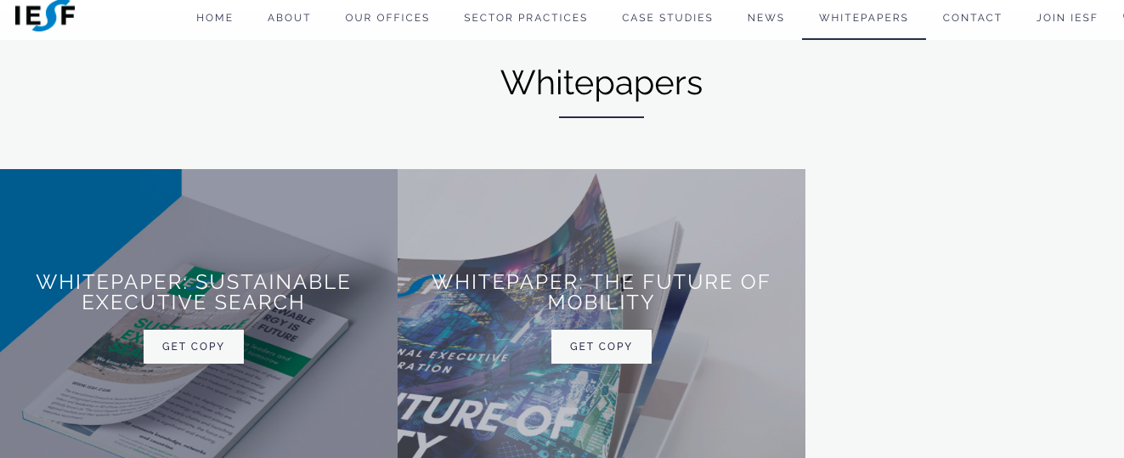
IESF Downloads
Facts & figures
Results 2021
Marketing learnings
New IESF media
Targets 2022
Plans & Budget 2022
Marketing Calendar
Partner engagement
Partnership Development

Slide 14
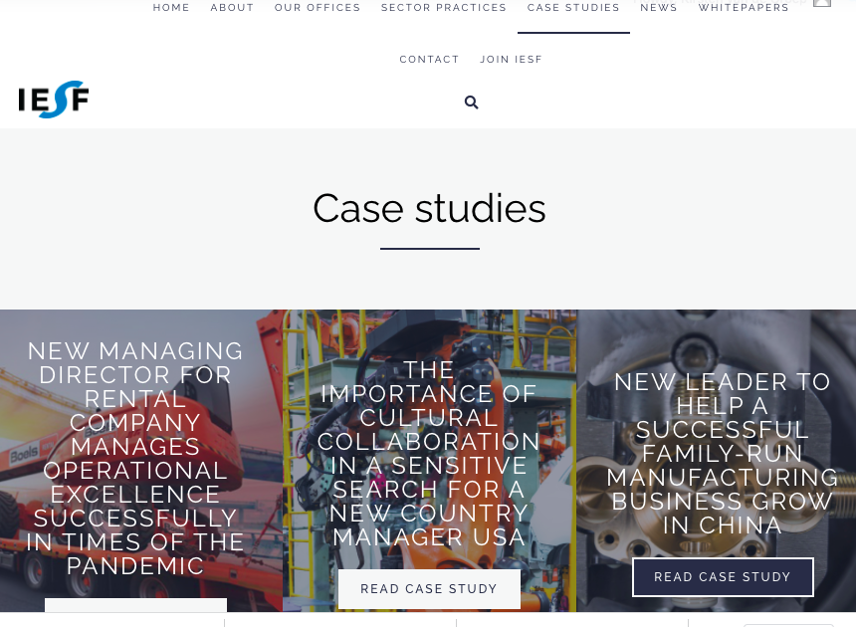
IESF Website & Case studies online
Facts & figures
Results 2021
Marketing learnings
New IESF media
Targets 2022
Plans & Budget 2022
Marketing Calendar
Partner engagement
Partnership Development

Slide 15
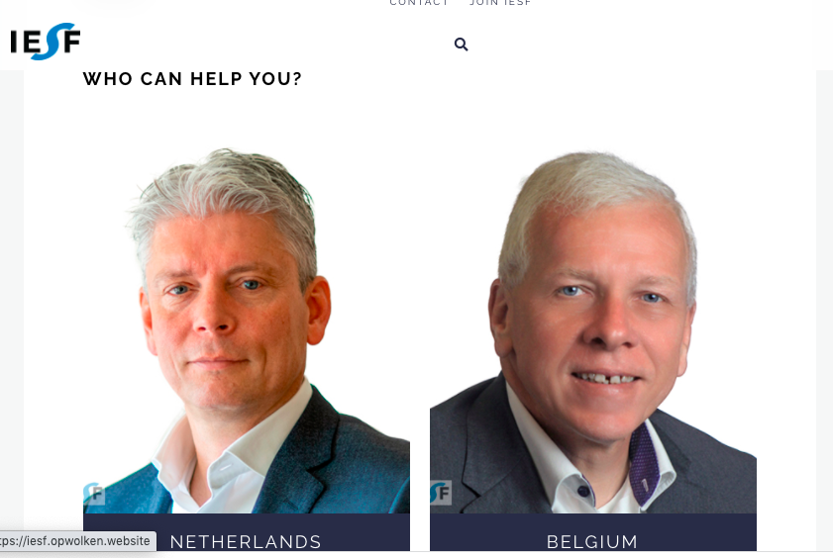
IESF Website & Case studies online
Facts & figures
Results 2021
Marketing learnings
New IESF media
Targets 2022
Plans & Budget 2022
Marketing Calendar
Partner engagement
Partnership Development

Slide 16
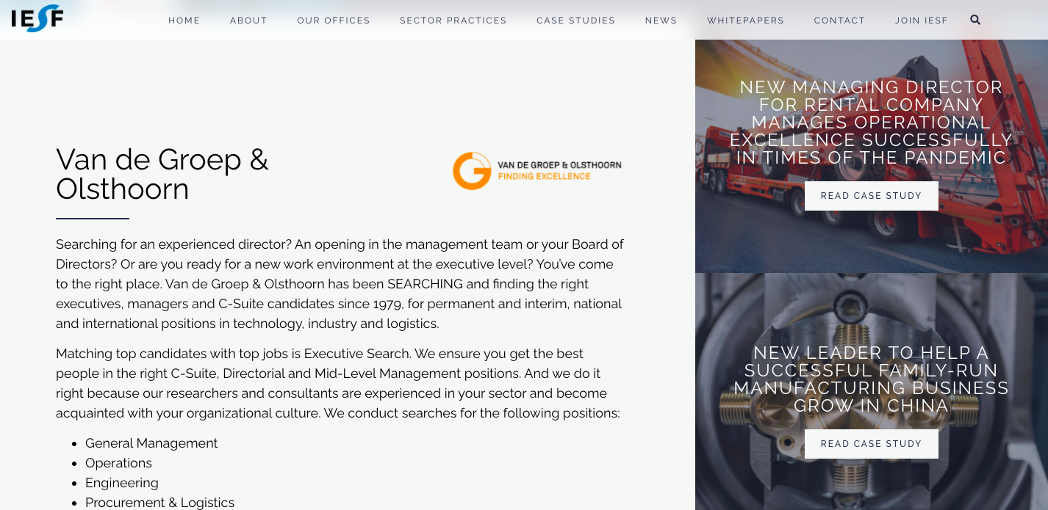
IESF Website & Case studies online
Facts & figures
Results 2021
Marketing learnings
New IESF media
Targets 2022
Plans & Budget 2022
Marketing Calendar
Partner engagement
Partnership Development

Slide 17
IESF Marketing goals 2022
Average number of publications 3 a month, total of 36 publications in 2022 from 3 sorts: Download – IESF Insights – Case Study
Increase number of followers LinkedIn page with 1000 members in 2022 to 3500
Increasing the level of clicks and shares to an average of 100 and 30 a month (both organic and sponsored)
Increasing the engagement rates for our content between 5 and 7%
Experiment with IESF Downloads online and create Download per Industry Group and setting baseline number
Experiment with IESF Newsletter (6 times a year) and building audience
Experiment with new media types, such as Executive Webinars and Podcasts
Create awareness on IESF 20th anniversary (2002 – 2022)
Facts & figures
Results 2021
Marketing learnings
New IESF media
Targets 2022
Plans & Budget 2022
Marketing Calendar
Partner engagement
Partnership Development

Slide 18
IESF Plans & Budget 2022
Facts & figures
Results 2021
Marketing learnings
New IESF media
Targets 2022
Plans & Budget 2022
Marketing Calendar
Partner engagement
Partnership Development
Media Type | Estimated Budget
LinkedIn Company Page | € 8.000,-
LinkedIn Sponsored Content (2/month) | € 2.000,-
LinkedIn Partnership Development campaigns | € 1.000,-
Industry Thought Leadership (webinar, speakers, content, podcasts) | € 1.000,-
Google Ads Partner Countries | € 1.500,-
Advertising / Bannering Executive Search portals | € 1.500,-
Total Marketing Budget | € 15.000

Slide 19
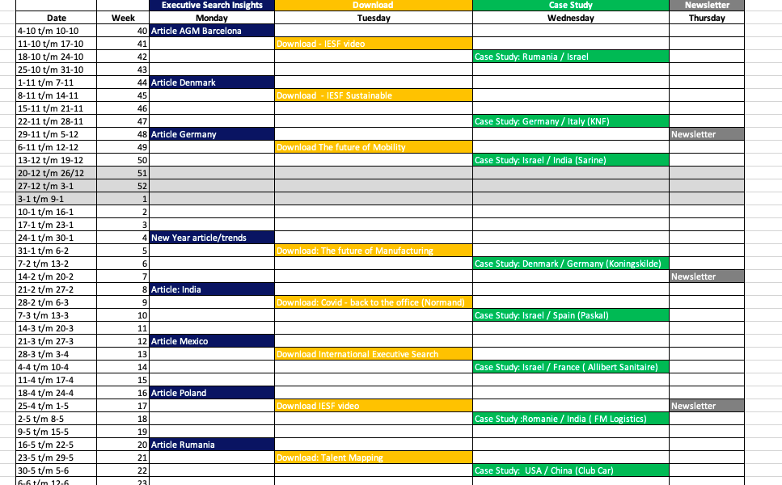
Marketing Planning 2022 preview
Facts & figures
Results 2021
Marketing learnings
New IESF media
Targets 2022
Plans & Budget 2022
Marketing Calendar
Partner engagement
Partnership Development

Slide 20
Partner Engagement
Share your ideas
Share your existing content
Share your local business media titles
Share & Like IESF updates with your network
The global calendar is being shared with you via e-mail & Kirsten will contact each partner upfront if your content is coming up
Facts & figures
Results 2021
Marketing learnings
New IESF media
Targets 2022
Plans & Budget 2022
Marketing Calendar
Partner engagement
Partnership Development

Slide 21
Any comments or suggestions?
Next: Partnership Development

Slide 22
AMERICAS – EMEA – ASIAPAC
Partnership Development
Facts & figures
Results 2021
Marketing learnings
New IESF media
Targets 2022
Plans & Budget 2022
Marketing Calendar
Partner engagement
Partnership Development
“Since 2002, successfully delivering
local executive talent through a global network of IESF partners”

Slide 23
Search areas for 2022 and forward
1. UK
2. UAE
3. Australia
4. South Korea
5. Columbia
Approach – targeted search and additional focused Linked In campaign If you know potential partners, please share with Kirsten

Slide 24
Our search
UK
UAE
Australia
Prospects
16
Prospects
11
Prospects
11
Interviews
3
Interviews
1
Interviews
Shortlisted
1
Shortlisted
Shortlisted
Success
Success
Success

Slide 25
Our search
South Korea
Colombia
Prospects
5
Prospects
8
Ideas?
Interviews
Interviews
Shortlisted
Shortlisted
Success
Success

Slide 26
Any comments or suggestions?

Slide 29
Business Update from India
How Covid changed the way we work globally
Vivek Ahuja

Slide 30
Namaste
Greetings from India

Slide 31
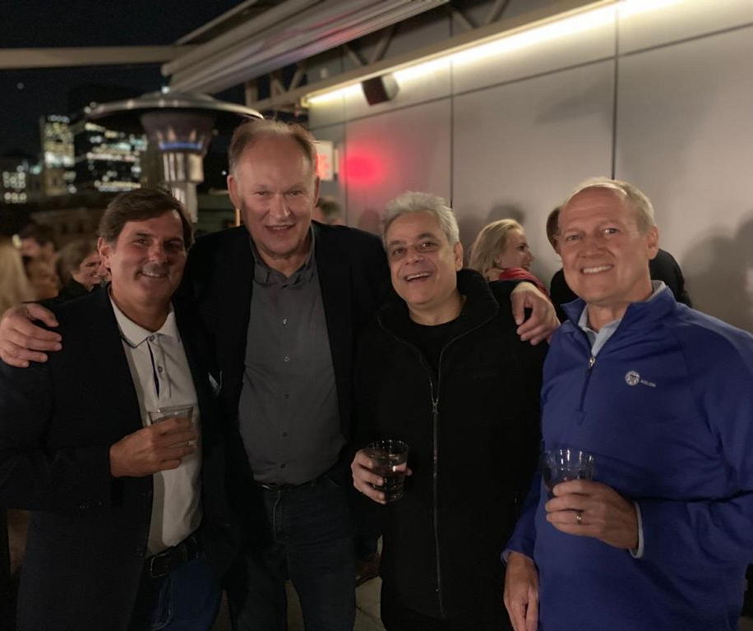
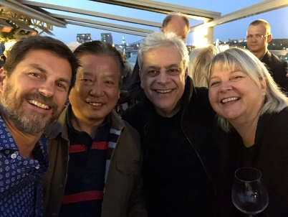
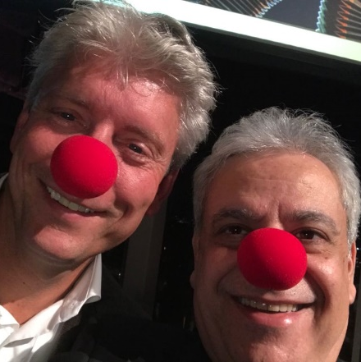
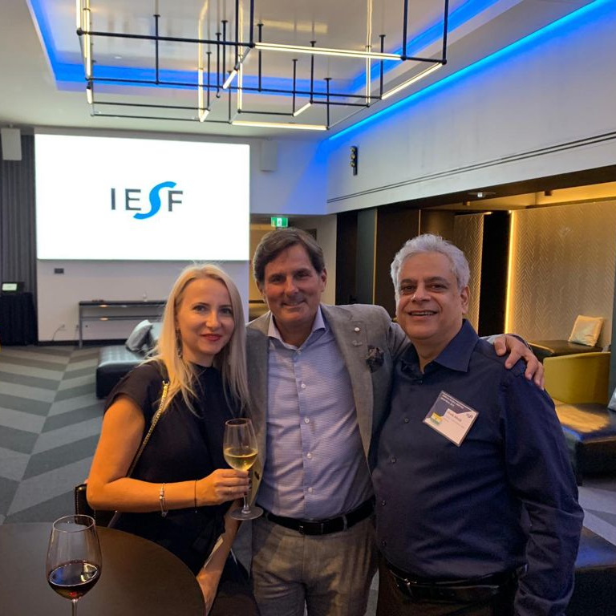
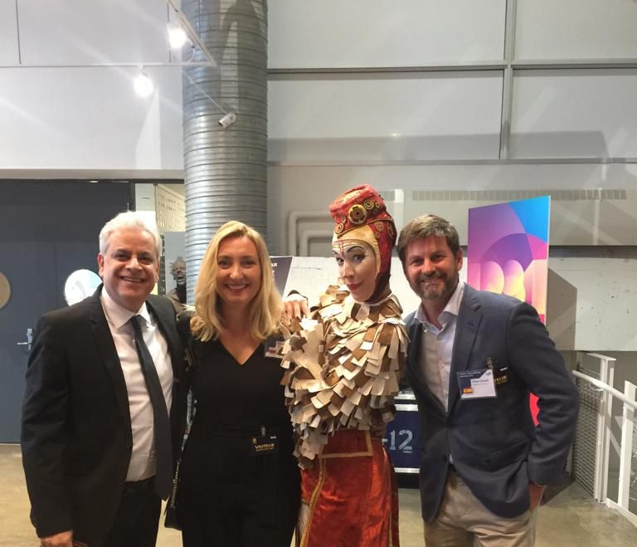
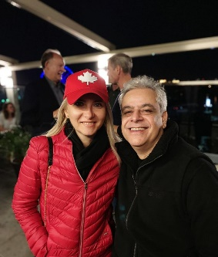
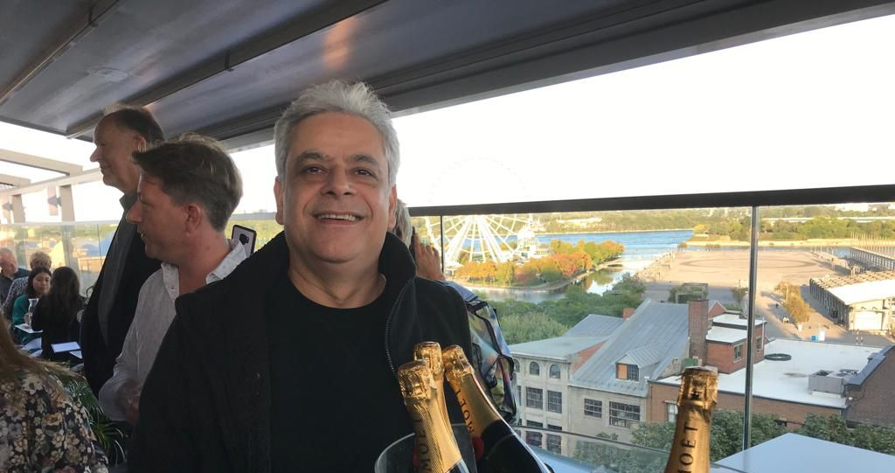
I AM MISSING ALL THE FUN AT THE IESF AGM.
DUE TO TRAVEL RESTRICTIONS IN INDIA, I AM UNABLE TO ATTEND IN-PERSON.

Slide 32
UPDATE FROM INDIA
Total Cases: 30 Million
Population : 1.39 Billion
Active:- 3,00,000
Fatalities:- Half Million People
People
Covid Situation
GDP : $ 3.2 Trillion
6.9% ↑ has risen from 3.8%
Growth expected at 7.5 % in 2021
Economy
Un-Employment Rate

Slide 33
IESF CROSS BORDER REPORT 2020/2021 CONFIAR GLOBAL INDIA
Our cross border association with IESF partners
Country
Partners
Clients
Positions
Mr. Dror Katabi
(Kishurim HR)
HR Manager
Israel
Chief Executive Officer
Mr. Dror Katabi
(Kishurim HR)
Israel
Ms. Adelina Rosco
(Rosman Group)
General Manager
South
Romania

Slide 34
CONFIAR - COVID UPDATE INDIA
All the major sectors of the economy were badly hit except agriculture.
Half a million people died, due to Covid in India.
80% of the adults have been vaccinated in India (Single Shot).
Confiar recruitment and search business did not see much fall in revenues in 2020. 2021 seems a like a small challenge and we may not see growth in revenues in 2021.
Healthcare, Pharmaceuticals, E-Commerce, Supply Chain and Infrastructure may be the largest sectors looking to hire in India.
Economy shows a steep rise in unemployment rates.

Slide 35
VIRTUAL MEETINGS AND INTERVIEWS ARE THE NEW NORMAL GLOBALLY
CONFIAR, INDIA OFFICES ARE NOW OPEN WITH FULL ATTENDANCE.

Slide 36
Hoping to See you Soon
Stay Safe Stay Healthy
Vivek Ahuja
Managing Director
Confiar Global/IESF INDIA
Mobile number +91-9810417578
vivek@confiar.in
www.confiar.in

Slide 37
Business Update IESF China
IESF China evolves from Covid

Slide 38
EVOLVES FROM COVID
6th October 2021
(Presentation to IESF Global Conference 2021)

Slide 39
Business & Organization Portfolios Before COVID
< February 2020
Primary: Executive Search, Secondary: HR Outsourcing, RPO, Business Start-up Consultancy
Office Presences: Shanghai, Guangzhou, Hong Kong, Wuhan, Beijing
Employees: 33

Slide 40
Business & Organization Portfolios At COVID
2020
Executive Search, HR Outsourcing, RPO, HR Advisory.
Office Presences: Shanghai, Guangzhou, Hong Kong
Employees: 25

Slide 41
Business & Organization Portfolios
YTD 2021
Executive Search, HR Outsourcing, RPO.
Office Presences: Shanghai, Guangzhou, Hong Kong, Wuhan, *Beijing, *Chengdu
Employees: 40

Slide 42
NEW PARTNER INTRODUCTION
Notes:
Daniel

Slide 43
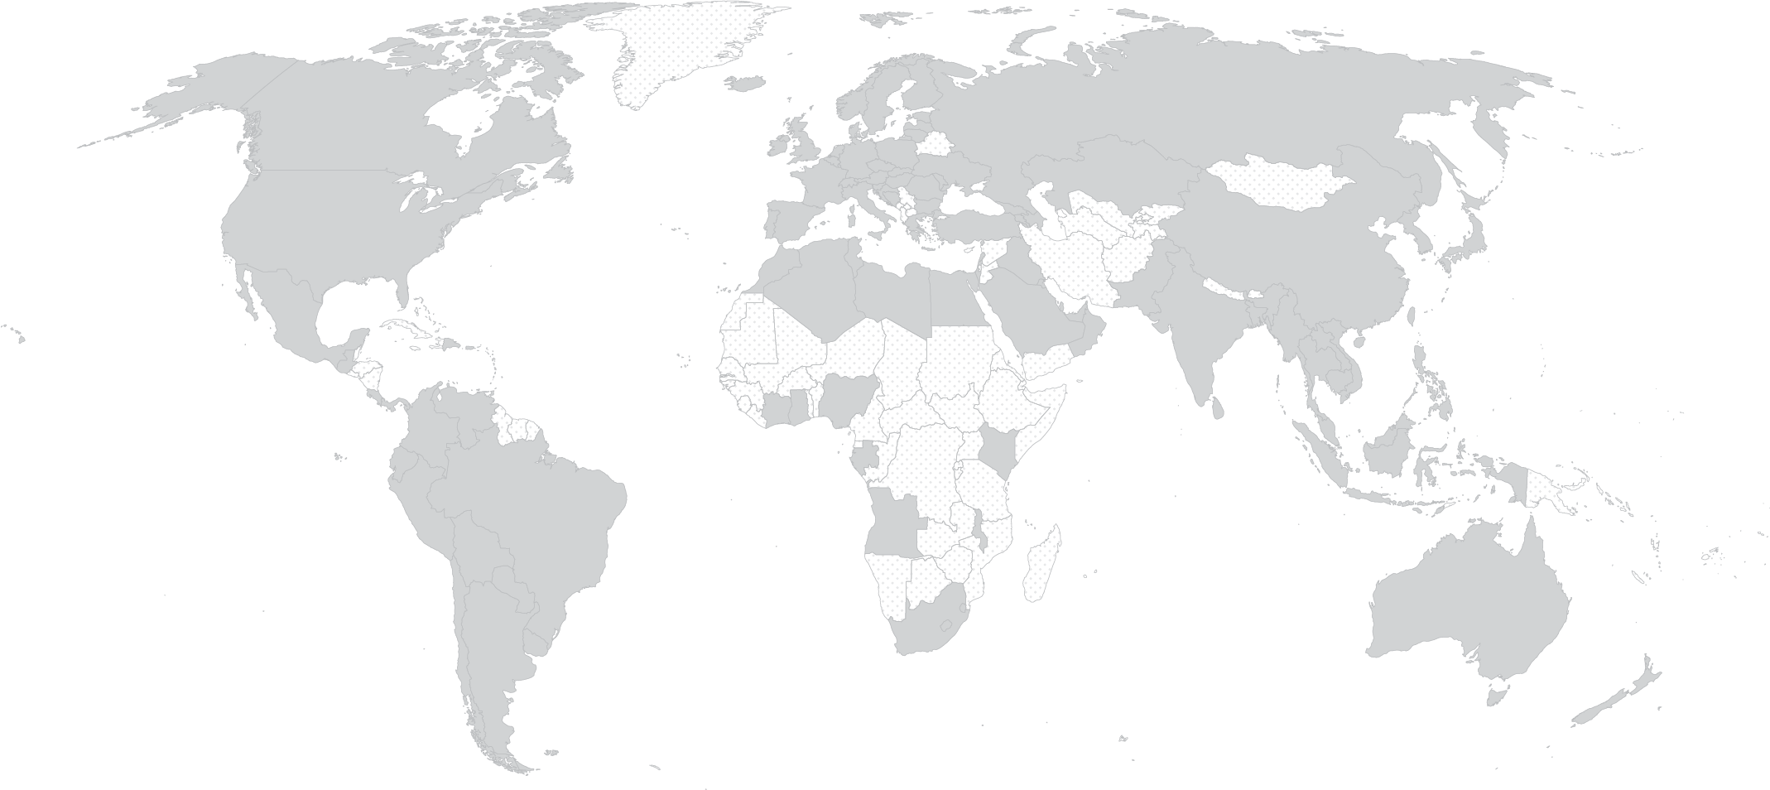
Introducing Cielo – global network
Global Capability, Local Insight
108 Countries
185 Clients
39 Languages
3k Employees
17 Offices
manchester
cologne
london
budapest
MILWAUKEE
paris
wuhan
shanghai
dubai
Guangzhou
Hong kong
MEXICO CITY
manila
BOGOTá
singapore
GLOBAL RECOGNITION OF EXCELLENCE
São Paulo
BUENOS AIRES

Slide 44
Notes:
Last week, HRO Today announced their annual RPO Baker’s Dozen Customer Satisfaction Ratings™
Sue Marks shared last week that for the second year in a row, Cielo has ranked #1 globally! AND, we ranked #1 in Healthcare for the eighth consecutive year. Equally as impressive, we were ranked #1 in Breadth of Service and #1 in Quality of Service.
Congratulations, everyone, and THANK YOU!
Thank you for putting our customers at the center every day during these most challenging times.

Slide 47
Cielo APAC
Global best practice, Respecting local nuances
ON THE GROUND PRESENCE
Full service offices in Singapore, Hong Kong, Manila, Guangzhou, Shanghai, and Wuhan
Onsite client support in 11 countries
EXTENSIVE LOCAL EXPERIENCE
Supporting clients across Life Sciences, Consumer Brands, IT & Engineering, Semiconductor and Professional Services
More than 7500 annual hires
PROVEN CAPABILITY
>65% roles are niche / high value, 98% direct delivery
Fluent in regional hiring nuances and 15 local languages
South KOREA
JAPAN
Wuhan
shanghai
INDIA
TAIWAN
Guangzhou
Hong Kong
THAILAND
Philippines
VIETNAM
Singapore
MALAYSIA
INDONESIA
AUSTRALIA
CLIENTS

Slide 48
2021 – the journey so far
China

Slide 49
Commitments to IESF:
Executive Search Services (The Greater China)
Regional/National/Local Executive Search
Talents Mapping & Market Intelligence Studies
Interim Management
Practice Groups
Life Science, Healthcare & Medical
Mobility, Industrial & Advanced Manufactures
Sourcing/Distribution/Luxury Retails
Infrastructure/Energy/Construction/Transport
Functional Group – HR, Finance, Legal, Mass Communication

Slide 50
Coffee Break
20 minutes

Slide 51
IESF Competitors
Kirsten

Slide 52
Competitor Analysis
Analysis based on:
Pricing
Marketing
Products & Services
Strategy
Target Market
Size: number of locations & global visibility
Competitive Analysis Comparison
Top 5 ranking – International Executive Search networks like IESF
Learnings for IESF looking at strengths and weaknesses worldwide
Distinctive character of IESF

Slide 53
Analysis – investigated ’competitors’
Analysis
Competitive Analysis Comparison
Top 5 ranking – International Executive Search networks
Learnings for IESF
Distinctive character of IESF

Slide 54
Analysis
Pricing - fixed membership fee or not & height
Marketing Strategy - message, brand, visibility & number of activities
Products & Services - focus only on Executive Search or also more Products or Services
Strategy - Process of the group, internal meetings, Industry Groups
Target Market - SMB, large or Fortune 500, but also the focus on that target audience
Number of locations & global visibility
Analysis
Competitive Analysis Comparison
Top 5 ranking – International Executive Search networks
Learnings for IESF
Distinctive character of IESF

Slide 55
Analysis - similarities
Pricing
Marketing Strategy
Products & Services
Strategy
Target Market
Number of locations & global visibility
Analysis
Competitive Analysis Comparison
Top 5 ranking – International Executive Search networks
Learnings for IESF
Distinctive character of IESF
Around the same size in nr. of locations & global visibility
Focus mainly on executive search – c-level positions
Work with same industry focus groups
Meet each other 1’s a year at least
Ask for a membership fee and offer exclusive partnership per country

Slide 56
Analysis – differences
Pricing
Marketing Strategy
Products & Services
Strategy
Target Market
Number of locations & global visibility
Analysis
Competitive Analysis Comparison
Top 5 ranking – International Executive Search networks
Learnings for IESF
Distinctive character of IESF
Affiliate / subsidiairy model
Strong branding – use brandname
Recruiting (not only c-level)
Extra services such as:
Board services
Leadership development
Assessment
Global talent pool (focussed on candidates)
Academy for partners

Slide 57
Competitive Analysis
Pricing
Marketing Strategy
Products & Services
Strategy
Target Market
Number of locations & global visibility
Analysis
Competitive Analysis Comparison
Top 5 ranking – International Executive Search networks
Learnings for IESF
Distinctive character of IESF
+
Existing network & strong brand name
-
+
-
Active in Marketing

Slide 58
Competitive Analysis
Pricing
Marketing Strategy
Products & Services
Strategy
Target Market
Number of locations & global visibility
Analysis
Competitive Analysis Comparison
Top 5 ranking – International Executive Search networks
Learnings for IESF
Distinctive character of IESF
+
Number of Industries they focus on
-
-
+
Number of services besides Executive Search

Slide 59
Competitive Analysis
Pricing
Marketing Strategy
Products & Services
Strategy
Target Market
Number of locations & global visibility
Analysis
Competitive Analysis Comparison
Top 5 ranking – International Executive Search networks
Learnings for IESF
Distinctive character of IESF
+
Strong focus on audience
-
-
SMB - Company size from small to large – Fortune 500
+

Slide 60
Competitive Analysis
Pricing
Marketing Strategy
Products & Services
Strategy
Target Market
Number of locations & global visibility
Analysis
Competitive Analysis Comparison
Top 5 ranking – International Executive Search networks
Learnings for IESF
Distinctive character of IESF
+
Global representation & visibility (online)
-
-
+
Number of partners / member countries

Slide 61
Pricing
Marketing Strategy
Products & Services
Strategy
Target Market
Number of locations & global visibility
Top 5 ranking – International Executive Search networks
1.
2.
3.
4.
5.
Characteristics considered:
Global visibility (size)
Strong Brand name
Very active in Marketing (online) – size of online network & google visibility
Personal network (more than just online)
Extra services besides Executive search branded
Extra advantages for the members
Analysis
Competitive Analysis Comparison
Top 5 ranking – International Executive Search networks
Learnings for IESF
Distinctive character of IESF

Slide 62
Learnings for IESF
Pricing – we’re asking a real fair (low) membership fee for a close network
Marketing Strategy – we can definitely increase visibility also with new tools such as video & podcasts
Products & Services – we can keep our focus on executive search, but also think about branding the other services, such as Leadership Development, Board services, etc.
Strategy – Industry focus is an important one in the market. Clients expect it and want prove of expertise
Target Market – focus specifically on SMB’s is exceptional and I think distinctive
Number of locations & global visibility – IESF is not the biggest player in the field. We need to focus on growing the network but keeping the intimacy partners expect.
Analysis
Competitive Analysis Comparison
Top 5 ranking – International Executive Search networks
Learnings for IESF
Distinctive character of IESF

Slide 63
Distinctive character of IESF
Transparent Association with fair membership fee and great advantages
Close partnerships and meet each other often
Sharing expertise & Thought Leadership on executive search worldwide
Focus on executive search – c-level & senior management positions
Only boutique firms can enter (all networks work retained)
15 sector practices with experiences partners worldwide
Focussed on the SMB’s
Slowly growing the exclusive partner network, without losing the personal touch
Mainly entrepreneurs/owners in the meetings who can share experience without hesitation
Analysis
Competitive Analysis Comparison
Top 5 ranking – International Executive Search networks
Learnings for IESF
Distinctive character of IESF

Slide 64
USP’s IESF:
IESF’s success is built on a strong foundation of trust across cultures, values and dedicated member firms.
We have forged strong relations with partners in all member nations through regular regional meetings and practice groups built around vertical and geographic markets.
We know our partners personally and understand their businesses and executive search strategies.
Any comments or suggestions?

Slide 65
Agilium Worldwide
Pricing
Similar as IESF
Marketing Strategy
Less active & small Linked In community
Partner video’s on YouTube
Products & Services
Global contact per sector
Strategy
12 sectors
Target Market
Executive Search but from all sizes – from Fortune 500 to smb
Number of locations & global visibility
27 members – 29 countries (exclusive per region as well)

Slide 66
AIMS
Pricing
Subsidiary model
Marketing Strategy
Active and big Linked In community
AIMS as a brandname for all partners
Products & Services
Much more than Executive Search, also talent development, hr support
Strategy
9 service pillars
Target Market
HR – talent – senior management – leadership consulting
Number of locations & global visibility
50 partners – with AIMS business partner look and feel

Slide 67
AMROP
Pricing
Subsidiary model
Marketing Strategy
Focus on sustainability
Active on Linked In & News
Amrop is the brandname
Products & Services
Executive search, board services & leadership services
Strategy
7 industry focus
Target Market
advises the world’s most dynamic, agile organizations
Number of locations & global visibility
54 countries

Slide 68
INTERSEARCH
Pricing
Yearly membership fee
Marketing Strategy
Very big on LinkedIn & active as well
Products & Services
Executive search
Strategy
Boutique firm members
Intersearch Academy
Target Market
No focus – all industries and sizes
Number of locations & global visibility
50 countries

Slide 69
IRC
Pricing
High yearly membership fee
Marketing Strategy
Very active
Strong IRC branding, lots of video
Products & Services
11 target groups (industries) with production practice leaders
Strategy
IRC Institute
Target Market
largest multinationals and SMEs
Number of locations & global visibility
90 cities on 6 continents

Slide 70
IMSA Search
Pricing
Yearly membership fee
Marketing Strategy
Not that active and also not recently on website
Linked posts are similar to IESF
Products & Services
Executive search
IMSA Barons.ai, a pioneer artificial intelligence search automation platform for candidates sharing
Strategy
8 sector practices
Target Market
SMB
Number of locations & global visibility
26 partner countries

Slide 71
Penrhyn
Pricing
Yearly membership fee
Marketing Strategy
Not that active
No active big followers on LinkedIn
Products & Services
Executive search
Talent Development & Board Services
Strategy
Boutique firm members
A bit more focused on 10 sectors
Target Market
SMB
Number of locations & global visibility
22 countries

Slide 72
Inac
Pricing
Affiliated offices / no high membership fee
Marketing Strategy
Very big on LinkedIn & active as well
Products & Services
Executive search
Leadership & Board Development
Assessments
Interim Search
Strategy
Non exclusive partnerships per country
Not only boutique firms, but also freelancers
Target Market
SMB
Number of locations & global visibility
50 affiliate partners, in 36 countries over 6 continents

Slide 73
Discussion:
Why do we belong to this group? (IESF)

Slide 74
- WHY AM I PART OF IESF -
Normand Lebeau
President & Chief Guardian of the Mandrake Experience
Barcelona, October 2021

Slide 75
After 14 years +, what’s in it for Mandrake?
What’s in it for me?

Slide 76
The answer is simple…
“IT BUILDS THE BRAND.”

Slide 77
I am a marketing graduate,
I AM A BELIEVER IN THE BRAND.

Slide 78
My clients/stakeholders hear about my trip
2 months prior
and
2 months after.

Slide 79
Here is how I see my investment (time)
in IESF:

Slide 80
Chance to discuss with people in my industry who are not competitors
Gain information: we are consultants, we sell knowledge
Address specific issues with my partners
Be exposed to new business development initiatives
Be able to service my clients with international footprint
Receive business from the network $$ (last in line)

Slide 81
THANKS FOR YOUR ATTENTION!
QUESTIONS?

Slide 82
Coffee Break
20 minutes

Slide 83
ONLINE INTERVIEWS STUDY
APRIL 2021

Slide 84
ONLINE INTERVIEWS STUDY
Online interviews - the new normal?
Headway Executive Search has conducted a study on the ways in which recruitment processes have changed as a result of the COVID-19 pandemic and the advent of working from home and digitalisation.
Hiring an employee without meeting them in person – unthinkable just over a year ago – has become common practice in many companies.
The aim of this survey was to analyse how this change has taken place; which aspects have changed as a result; which aspects are more difficult to address without face-to-face interviews; and what future trends may be.
Participating in the study were more than 500 directors from 8 different sectors: Industry and Infrastructures; Finance and Professional Services; FMCG and Retail; Pharmaceuticals and Chemistry; IT and Telecommunications; Tourism, Leisure and Media; Logistics and Transportation; and Automotion.
we make you grow

Slide 85
ONLINE INTERVIEWS STUDY
1. What sector does your company belong to?
More than 50% of the respondents were from the Industry (19.7%), FMCG (17.8%) and Finance (15.9%) sectors. These were followed by Pharmaceuticals and Chemistry; IT and Telecommunications; Tourism, Leisure and Media; Logistics and Transportation; and Automotion, in that order.
we make you grow

Slide 86
ONLINE INTERVIEWS STUDY
2. Comparison with face-to-face interviews:
What percentage of your interviews were held online before the pandemic?
What percentage of your interviews do you currently hold online?
What percentage of your interviews do you think you will hold online in the future?
Online interviews look set to triple compared to pre-pandemic levels.
BEFORE
NOW
FUTURE
17.60%
75.30%
58.60%
Before the COVID-19 pandemic, only 17.6% of interviews were held online. During the pandemic, 75.3% of interviews have been taking place online. Our respondents believe that 58.6% of interviews will continue to be held online in the future.
we make you grow

Slide 87
ONLINE INTERVIEWS STUDY
3. How do you prefer to conduct interviews?
9.60%
Online
In-person
44.60%
45.5%
Both
Less than 10% of the respondents prefer completely online processes.
Only 9.6% of the respondents prefer to carry out the recruitment process entirely online. This is much lower than the 44.5% who prefer to do it in person. 44.5%, meanwhile, prefer to combine both methods to interview their candidates.
we make you grow

Slide 88
ONLINE INTERVIEWS STUDY
4. Of the following aspects, choose the one that you miss most when conducting online interviews.
37.8%
25.2%
10.7%
6.7%
5.0%
Almost half of the respondents highlighted the difficulty of reading non-verbal language in online interviews.
4.8%
4.0%
3.4%
1.7%
0.2%
we make you grow

Slide 89
ONLINE INTERVIEWS STUDY
5. During the pandemic, have you hired any new employees without meeting them in person?
9.60%
Yes
No
44.60%
34.7%
35% of companies have hired a candidate without meeting them in person.
34.7% of the respondents hired a candidate without meeting them in person. 65.3%, meanwhile, did not hire any candidates who were only interviewed online.
we make you grow

Slide 90
ONLINE INTERVIEWS STUDY
6. Of the candidates that you hired without holding a face-to-face interview, do you think your opinion would have changed if you had met them in person?
9.60%
Yes
No
1 in 3 companies would have changed their mind had they met the candidate in person.
44.60%
34.7%
36.0%
64.0%
64% of the respondents did not change their mind after meeting the candidate in person. 36% would have changed their mind if they’d have met the candidate in person.
we make you grow

Slide 91
ONLINE INTERVIEWS STUDY
Findings of the “Online Interviews” survey
Of the survey results, four pieces of data stand out:
A first finding of the “Online Interviews” study is that online interviewing will continue to be a major trend in the future. It will remain the most commonly-used interview method for recruitment process once the pandemic is over.
Prior to the COVID-19 pandemic, only 17.6% of interviews were held online. Currently, in the midst of the pandemic, this number has increased to 75.3%. Interviewers feel that they will continue using this method in 58.6% of interviews in the future, more than three times the pre-pandemic number.
A second finding is that 34.7% of companies have hired employees without meeting them in person, as a result of running a 100% online recruitment process. The remaining 65.3% preferred to meet the candidate in person before taking a decision.
we make you grow

Slide 92
ONLINE INTERVIEWS STUDY
A third finding is that 36% of the companies that hired someone after a completely online recruitment process state that they would have changed their mind had they met the candidate in person.
In other words, 1 out of 3 companies feel that they did not hire the right person after running a 100% online recruitment process. The other 64%, meanwhile, feel that they hired the right candidate.
The survey also reveals that companies do not yet feel comfortable with 100% online recruitment processes. Only 10% of companies prefer completely online processes, compared to 45% who prefer conducting face-to-face recruitment processes. A further 45% prefer to use a hybrid model.
A fourth finding of the survey is that respondents were largely unanimous in what they considered to be weaknesses in online recruitment processes.
38% feel that the most important aspect, and the thing that they most miss in online interviews, is the ability to interpret non-verbal language*. 25%, 1 in every 4 respondents, state that they miss the ability to evaluate first impressions. In total, 63% of the respondents consider these two aspects to be the things that they most struggle to assess in online interviews, much more than the other options.
(*) Albert Mehrabian: only 7% of communication potential lies in words (verbal communication). The remaining 93% is split into body language (55%) and paraverbal language or the use of voice (38%). In other words, 93% of communication is non-verbal.
we make you grow

Slide 94
- BRAND BUILDING -
The Importance of your USP
(Unique Selling Proposition)
Normand Lebeau
President & Chief Guardian of the Mandrake Experience
Barcelona, October 2021

Slide 95
“In the service business you are either cheaper or different…
You cannot be neither and you cannot be both”

Slide 96
MANDRAKE CHOSES TO BE DIFFERENT!
How do we define ourselves?
How do we set ourselves a part?

Slide 97
START WITH THE FOLLOWING THOUGHT:
What is the emotion you want a stakeholder to feel when they see your logo/hear your name?

Slide 98
WE HAVE ESTABLISHED :
Results (Takes care of itself)
Added value
Knowledge
Where the real game is played

Slide 99
ADDED VALUE AND KNOWLEDGE MEANS:
Bring some level of new information every time

Slide 100
HOW WE STRIVE TO DO IT (1/2)
Conferences (CEO/CHRO)
Sports Analogy
“Huis Clos” (CHRO)
100 CHRO / 4 meetings per year
Speakers from different topics
Linkedin
All new postings
All closing

Slide 101
HOW WE STRIVE TO DO IT (2/2)
Article sharing (HBR) to CEO/CHRO
With comments
QAE (Québécois à l’étranger)
Introduced in Lyon
Now 7 executives places
Generates a great “buzz”

Slide 102
QAE
Shows clients that we are creative
(New talent pool)
Brings us additional international tonus
Governments are craving the effort
(Met with the Québec delegate here in Barcelona)

Slide 103
SUGGESTED TAKE HOME
Why should I spend time with Mandrake?
(What am I going to learn?)

Slide 104
REMEMBER:
“In the service business you are either cheaper or different…
You cannot be neither and you cannot be both”
CHOSE TO BE DIFFERENT!
(STAND APART)

Slide 105
EXAMPLES OF LINKEDIN POSTING
Opening

Slide 106
EXAMPLES OF LINKEDIN POSTING + MAILCHIMP
Closing

Slide 107
THANKS FOR YOUR ATTENTION!
QUESTIONS?

Slide 108
Lunch
Let’s meet in the lobby at 02.55 PM
For the bus to McLaren Museum

Slide 109
If you have any questions, do not hesitate to
contact your Executive Assistant ☺
kirsten@vandegroep.nl +31 6 13 167 370

