Slide 1
AGM Barcelona 2021
International
Executive Search Federation
Thursday October 7th

Slide 2
Agenda AGM October 7th
09.00 AM IESF Finance update Gertjan
09.20 AM IESF Farewell speech President Victor
09.40 AM IESF Presidency Rotation & New goals Gertjan
10.00 AM Round table: Everything changes Adelina & Dror
11.00 AM Coffee Break
11.20 AM IESF panel: Ask us anything Dror, Achim, Normand & Victor
12.20 AM Acceptance of new partners Victor
12.35 AM Next Year’s AGM & ending speech Victor & Gertjan
12.50 PM Lunch
02.20 PM Free time, departure to airport

Slide 3
Financials
Report 2020 / 2021
AGM Barcelona – October 7th 2021

Slide 4
Financial process since changes in Lyon 2018
IESF changed from LTD to Association in NL
IESF changed Hongkong bank account to NL bank account
4 eyes-principle + 2 eyes Executive Assistant (EA)
Payments processed by Executive Assistant (EA) after approval President & Treasurer
Investments always agreed upon in Leadership Council meetings with all LC members, including President & Treasurer
Small payments within approved budget are done without LC approval

Slide 5
Current Assets & Preliminary result
Bank balance NL € 76.780,40 = ＄ 90.593,58
Membership fees 2021 € 40.989,00 ＄ 48.399,69
Cross borders 20/21 € 8.364,53 ＄ 9.879,14
Costs
Meetings (AGM) € 20.000,00 ＄ 23.539,50
Bank Costs € 200,00 ＄ 236,21
Office support € 21.780,00 (5.445 per Q) ＄ 25.722,72
Marketing € 9.454,50 ＄ 11.166,00
Website € 337,45 ＄ 398,54
Result -€ 2.418,85 -＄ 2.846,35

Slide 6
Income 2022
Annual membership fees
22 members
€ 2.544 – based on＄3.000
Cross border commission
5% rule
＄30K in 2017/2018 - € 25.431
＄35K in 2018/2019 - € 29.669,50
＄18K+ in 2019/2021 – € 16.000

Slide 7
Expenses 2022
President Allowance & Regional Meetings
€ 5.500,- ＄6.494,98
AGM Costs
€ 20 K ＄23.619,30
Marketing
€ 15 K ＄17.714,48
Both Brand awareness as well as Partnership Development
Secretarial & Administration Allowance
25K (previously 22K) ＄29.524,12

Slide 8
Budget 2022
22 x Membership fees € 55.968 ＄ 66.086,85
Cross border commission € 20.000 ＄ 23.619,30
Total income € 75.968 ＄ 89.702,79
Partner development travel costs € 5.000 ＄ 5.903,67
President Allowance & Expenses Regionals € 5.500 ＄ 6.494,04
AGM Costs € 20.000 ＄ 23.619,30
Marketing € 15.000 ＄ 17.711,02
Brand Awareness & Partnership development
Website € 2.000 ＄ 2.361,10
Secretarial & administrative € 25.000 ＄ 29.513,75
Bank & accounting € 1.000 ＄ 1.180,55
Legal *optional € 2.000 ＄ 2.361,10
Total expenses € 75.500 ＄ 89.131,52
Result € 468 ＄ 552,56

Slide 9
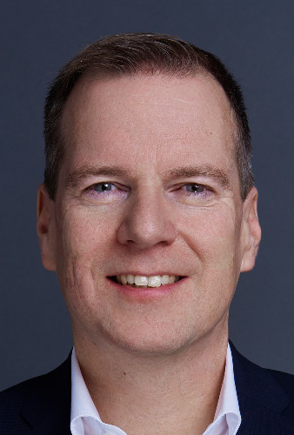
New Treasurer
Suggested by Leadership Council: Stephan Löw
Approval at the AGM

Slide 10
Questions or comments?

Slide 12
INTERNATIONAL
EXECUTIVE SEARCH FEDERATION
PRESIDENCY
2018 - 2021

Slide 13
SEPTEMBER 2018
NEW PRESIDENT GOALS
1. SIMPLIFY OUR ENTITY AND BANKING SYSTEM
Change Bank
Change Entity location (considering a 360º change)
Treasurer not only supervising the account, but managing completely
2. PROVIDE TOOLS TO THE PARTNERS
Completely change the system and focus on the Intranet that provides a service instead of only record invoicing
2. INCREASE SUPPORT TO PARTNERS
An executive assistant actively focused on:
Partner Development
Client Data collection
Marketing & Communication (Social Media, Website, Intranet)

Slide 14
NEW PRESIDENT
ACCOMPLISHMENTS
1. SIMPLIFY OUR ENTITY AND
BANKING SYSTEM
Change Bank
Change Entity location (considering a 360º change)
Treasurer not only supervising the account, but managing completely
New Entity Registered in the Netherlands
New bank account in the Netherlands (Rabobank)
Treasurer is fully managing the IESF bank account. Nothing is paid without two approvals (President and Treasurer)

Slide 15
NEW PRESIDENT
ACCOMPLISHMENTS
2. PROVIDE TOOLS TO
THE PARTNERS
Completely change the system and focus on the Intranet that provides a service instead of only record invoicing
New IESF Website
New IESF Intranet
Access to the Client Database Yearly updated by each partner.

Slide 16
NEW PRESIDENT
ACCOMPLISHMENTS
Executive assistant providing the administrative support:
Partnership Development
Meetings & Events
Cross Border control
Marketing & Social Media
Intranet & Website
Multinational client collection in updated in a yearly basis
Increased Brand Awareness (LinkedIn followers increase 56%, Newsletter, Articles written by IESF Partners).
3. INCREASE SUPPORT TO PARTNERS
An executive assistant actively focused on:
Partner Development
Client Data collection
Marketing & Communication (Social Media, Website, Intranet)

Slide 17
PRESIDENT´S GOALS
2019/2020
1. GENERATE MORE CROSS BORDERS
Establish IESF Industry groups
Constant communication among group members (every 2 months) and leaders (every Q)
Sharing best practises & client approaches
2. EVALUATION SYSTEM
Add additional features in Intranet such as evaluating the cross border assignments
Insights of those assignments that were cancelled
3. DEVELOP THE PARTNERSHIP
Continue developing the partnership in countries such as UAE, South Africa, Indonesia etc.

Slide 18
ACCOMPLISHMENTS
1. GENERATE MORE CROSS BOARDERS
Establish Industry Groups
Constant communication among group members (every 2 months) and leaders (every Q)
Sharing best practises & client approaches
New Industry Groups:
Manufacturing
Mobility
FMCG & Retail
Technology
New Brainstorming Group: Looking tor an IESF USP
LC meetings (6 per year)

Slide 19
ACCOMPLISHMENTS
New system in the Intranet that asks for feedback each time a cross border collaboration has ended. Objective: detect and if necessary scale to LC in order to help any partner that’s having trouble / difficulties.
Learn from errors and increase teamwork collaboration.
2. EVALUATION SYSTEM
Add additional features in Intranet such as evaluating the cross border assignments
Insights of those assignments that were cancelled

Slide 20
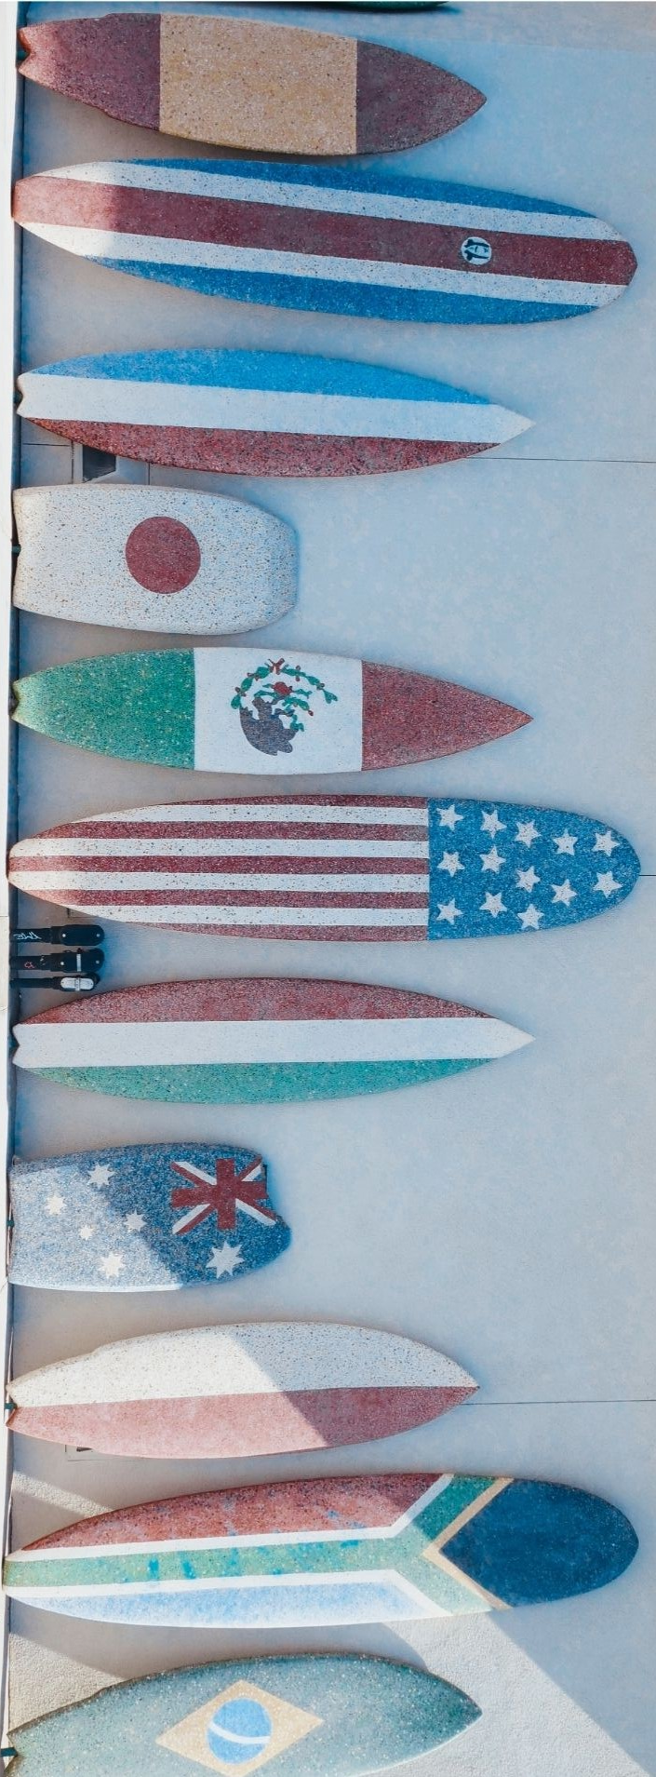
ACCOMPLISHMENTS
3. DEVELOP THE PARTNERSHIP
Continue developing the partnership in countries such as UAE, South Africa, Indonesia etc.
DENMARK
ITALY
PANAMA
PERÚ
SINGAPORE
SWITZERLAND
TURKEY

Slide 21
PRESIDENT´S GOALS 2020/2021
1. SURVIVAL MODE
Establish an extraordinary low Membership fee.
Increase Communication among partners
2. NEW MARKETING STRATEGY
Add a LinkedIn IESF Corporate Web Page.
New entries in our website
3. DEVELOP THE PARTNERSHIP
Continue developing the partnership in countries such as UK, U.S.A., Brazil, UAE, etc.

Slide 22
ACCOMPLISHMENTS
SURVIVAL MODE
Establish a new and extraordinary low Membership Fee for 2021 of €1,960 to help partners.
Constant communication among group through WhatsApp Group, and via emails to maintain closeness.
New temporary Fee approved
1st Online AGM in the history. … And Hopefully the last one!
New ZOOM IESF account and new Industry Groups:
Life Sciences
Renewal Energies

Slide 23
ACCOMPLISHMENTS
2. NEW MARKETING STRATEGY
Add a LinkedIn IESF Corporate Web Page. We are wealthy and we have a nice budget to try new things!
New entries in our website
New IESF Corporate page in LinkedIn that give us more followers, awareness, viewers, and traffic.
New “button” in the IESF website for “JOIN IESF”

Slide 24
ACCOMPLISHMENTS
3. DEVELOP THE PARTNERSHIP
Continue developing the partnership in countries such as UK, U.S.A, Brazil, UAE etc.
NORWAY
U.S.A.
…and probably Brazil in 2022

Slide 25
PRESIDENT´S ACHIEVEMENTS IN NUMERS 2018 – 2021
TURN AROUND P/L ACCOUNT RESULTS: From $-27,677.27 *to €44,071 first year (2019)**.
INCREASE GLOBAL PRESENCE: From 15 countries to 22
LINKEDIN PRESENCE: From 370 followers to 2,512
* AGM 2017/2018 // **2020: €54,337 but NO AGM, so real about €35,000 (COVID, reservation €5,000 paid in Shanghai already…)

Slide 26
Thank you!

Slide 27
New President Objectives
2021-2024
Gertjan van de Groep

Slide 28
New President themes
Retain & Expand our Partner network
Focus on Thought Leadership - Engagement & Added Value
Professional & Simple

Slide 29
New President Objectives
Retain and Expand our Partner Network
Partner satisfaction research
Implement improvements
Focus on Partnership Development
Thought Leadership - Engagement & Added Value
Frequent Marketing according to theme calendar
Increase visibility through Marketing activities
Increase sharing & learning (newsletter/webinars/podcasts)
IESF Quality
Local benefits of being part of the global network
Focus on Professionalism & Transparency
More communication from the Leadership Council
Role of the Advisory Board
Maintain set-up Treasurer and Executive Assistant
Any ideas and suggestions?

Slide 30
Any comments?
Thank you!

Slide 31
Round table “Everything changes:
Employer branding & Candidate commitment”
Adelina & Dror

Slide 32
Coffee Break
20 minutes

Slide 33
IESF Panel: Ask us anything
Dror, Achim, Normand, Victor

Slide 34
Acceptance of new partners

Slide 35
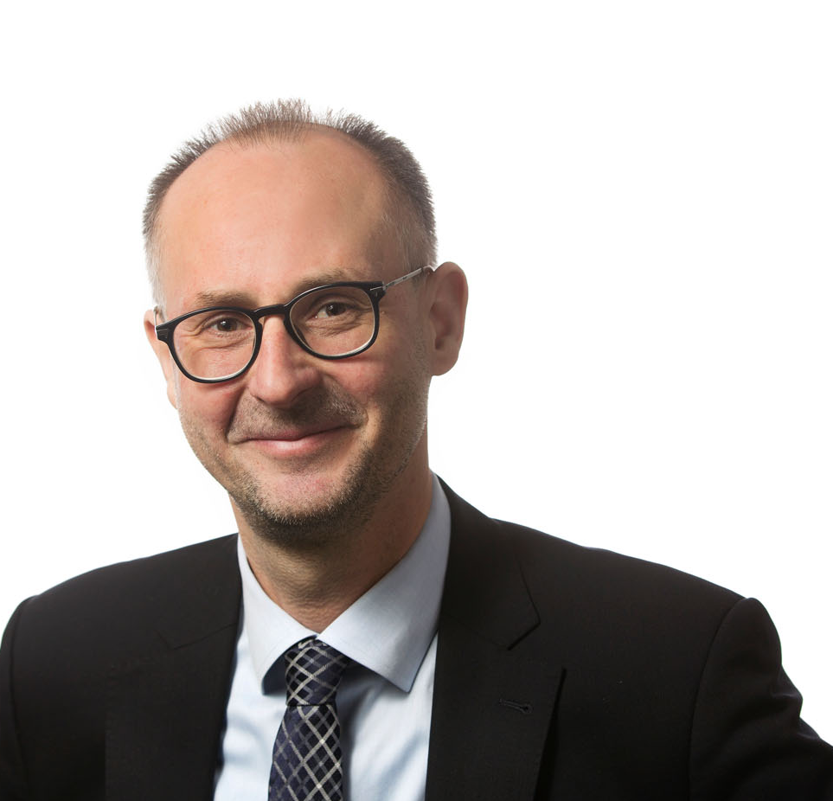
Norway – Tor-Egil Ruud

Slide 36
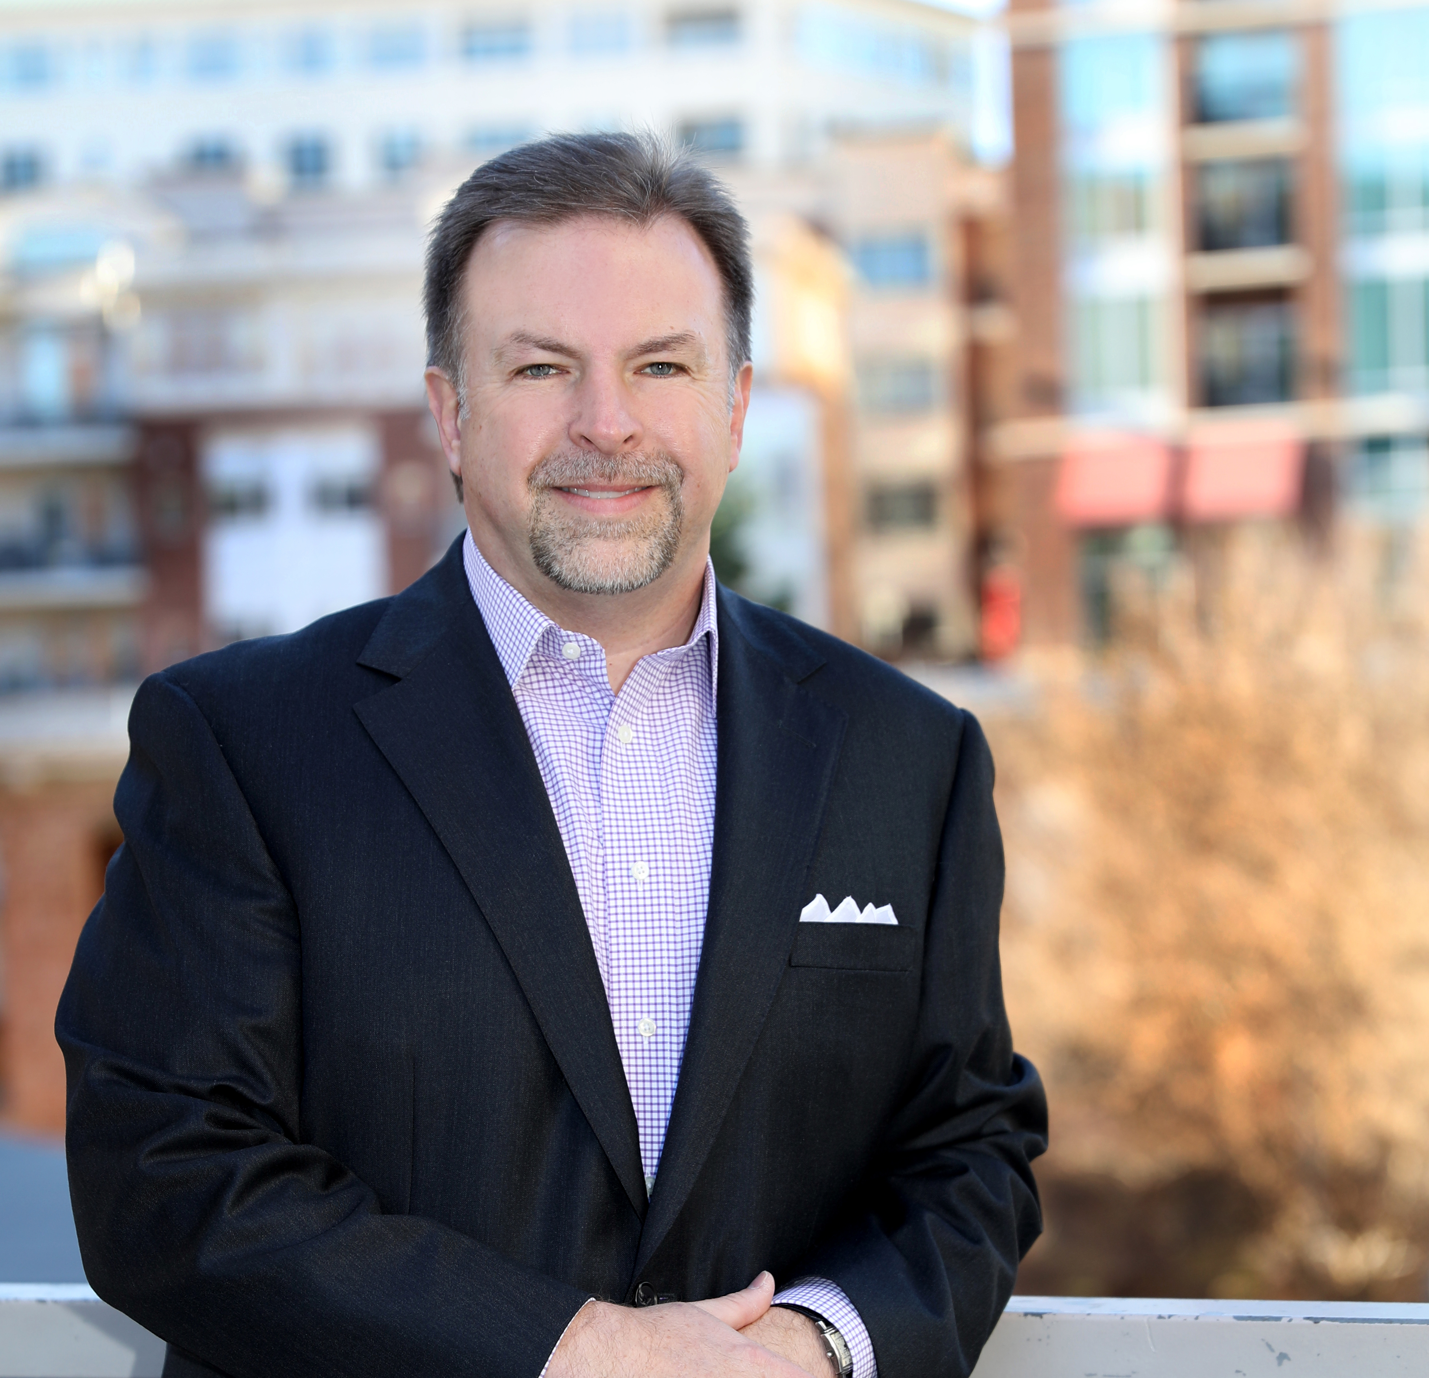
USA – Steve Hall

Slide 37
Video Message from our
Advisory Board member
Tim Smith

Slide 38
Next Year’s AGM & ending speech
Victor & Gertjan

Slide 39
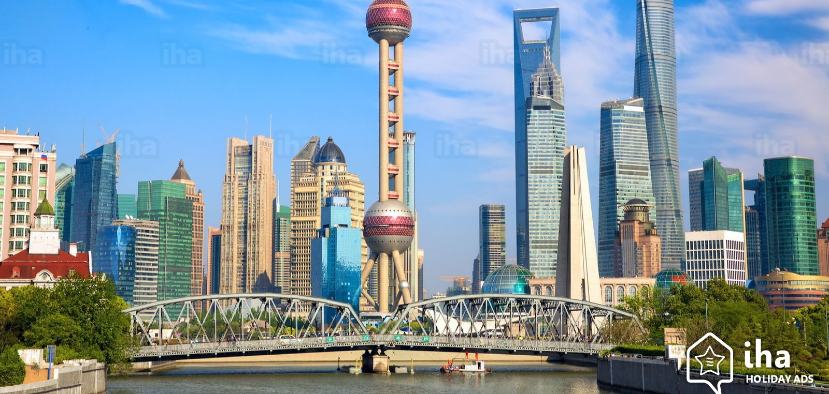
Shanghai 2022
Deze foto van Onbekende auteur is gelicentieerd onder CC BY-SA-NC
Deze foto van Onbekende auteur is gelicentieerd onder CC BY-SA

Slide 40
Lunch & free time
Departure to airport

Slide 41
If you have any questions, do not hesitate to
contact your Executive Assistant ☺
kirsten@vandegroep.nl +31 6 13 167 370

