Slide 1
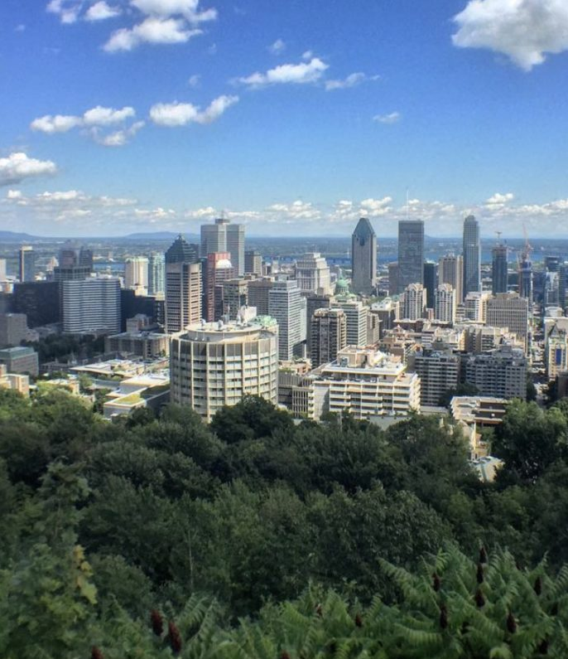
ANNUAL GLOBAL MEETING MONTREAL 2019
INTERNATIONAL EXECUTIVE SEARCH FEDERATION
16th - 19th of September
This Photo by Unknown Author is licensed under CC BY-SA

Slide 2
AGENDA
Montreal bridges

Slide 3
MONDAY 16th of September
WELCOME COCKTAIL
TIME: 7:00 PM
Hotel W at “La Galerie” 901 Square Victoria Montreal, Quebec H2Z 1R1 514-395-3100
AGENDA

Slide 4
TUESDAY 17th of September
CONFERENCE ROOM: STUDIO 3
9:00 - 9:15 AM Welcome and opening remarks (15 min) - Victor & Normand
9:15 - 10:15 AM New partner presentation (1h) - Denmark, Italy, Turkey, South Korea, Peru and Singapore - 10 min. each
10:15 - 10:35 AM Prospecting New Partners (20 min) – Margarita & Victor
10:35 - 10:45 AM Cross Border Award 2019 (10 min) – Victor & Margarita
10:45 - 11:00 AM Coffee Break (15 min)
11:00 - 12:30 PM Partner/client presentation (1h 30 min) – (5 minutes each)
12:30 - 1:45 PM Lunch (1h15 min)
1:45 - 3:45 PM IESF Industry Groups (2 h) Victor & 6 Leaders of the groups
3:45 - 4:00 PM Coffee Break (15 min)
4:00 - 4:30 PM Cross Border Fee flexibility (30min) – Discussion
5:15 PM Pick up at Hotel W – Travel to International Cirque du Soleil Headquarters
6:30 PM Presentation from Cirque du Soleil’s Chief Human Resources Officer / Client Event « Cirque in transformation: The challenges of protecting an iconic brand and a legendary culture. »
AGENDA

Slide 5
WEDNESDAY 18th of September
CONFERENCE ROOM: STUDIO 3
8:30 – 9:00 AM IESF Brand Awareness / Intranet / Website Margarita (30 min)
9:00 - 10:00 AM IESF Financials and Budget (1h) - Gertjan
10:00 - 11:30 AM Speaker: Ross Bernstein, International Business Speaker & Best Selling Sports Author (1h30)
11:30 - 12:00 AM IESF Presidency goals and Leadership Council rotation (30 min)
12:00 - 1:00 PM Lunch (1h)
1:00 - 1:30 PM BClose Monitoring Onboarding (30 min)– Victor & Margarita
1:30 - 2:15 PM IESF Tools/ Economies of Scale (45 min)- Discussion
2:15 - 2:45 PM Coffee break (30 min)
2:45 - 3:30 PM Our Business Strategy (45 min) – Ole
3:30 - 4:30 PM Open discussion on topics suggested by partners such as Al, New research techniques etc.
6:00 PM Cocktail dinner at: Terrasse William Gray | Section Saint Vincent 421 Saint Vincent Street |8th Floor H2Y 3A6
AGENDA
William Gray Terrasse View

Slide 6
19th September
CONFERENCE ROOM: STUDIO 3
9:00 - 10:00 AM Patrick Meirlaen – “ The Future of Work ” (1h)
10:00 - 11:00 AM John Vincent – “As an executive coach, what I have learned from my discussions with entrepreneurs.” (1h)
11:00 - 11:30 AM Coffee break (30 min)
11:30 - 11:45 AM Acceptance of new partners (15 min)
11:45 - 12:00 PM Next Year’s AGM and ending speech (15 min) - Victor & Normand
12:30 - 1:00 PM Lunch (30 min)
AGENDA

Slide 7
ACCOMODATION
Marché Bonsecours

Slide 8
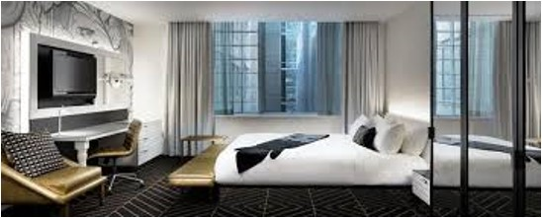
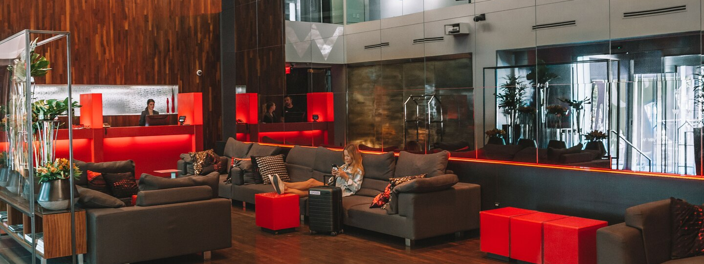
ACCOMODATION
HOTEL W - MONTREAL
901 Square-Victoria
H2Z1R1
Montreal
+1 514-395-3100
ABOUT THE W - LINK
RESERVE YOUR ROOM NOW To extend your stay, please contact Sophie
Deadline to book is August 22, 2019

Slide 9
TRANSPORTATION
What to do in the Old Port

Slide 10
TRANSPORTATION
Visit YUL airport website: https://www.admtl.com/en/flights
Estimated taxi fare: 41 CAD (one way)
Hotel direction: 7.5 miles
Bus service, fee: 10 CAD (one way)
Driving directions
From Montréal-Pierre Elliott Trudeau International Airport. Get on Autoroute 20 from Boulevard Roméo-Vachon N/Roméo-Vachon Blvd N and boul. Roméo-Vachon N. Continue on Autoroute 20 to Ville-Marie, Montréal. Take exit 4 from Autoroute 720 E. Take Rue Saint-Antoine O to Rue du Square-Victoria. W Montréal will be on the right.
Olympic Stadium
Google Map Link

Slide 11
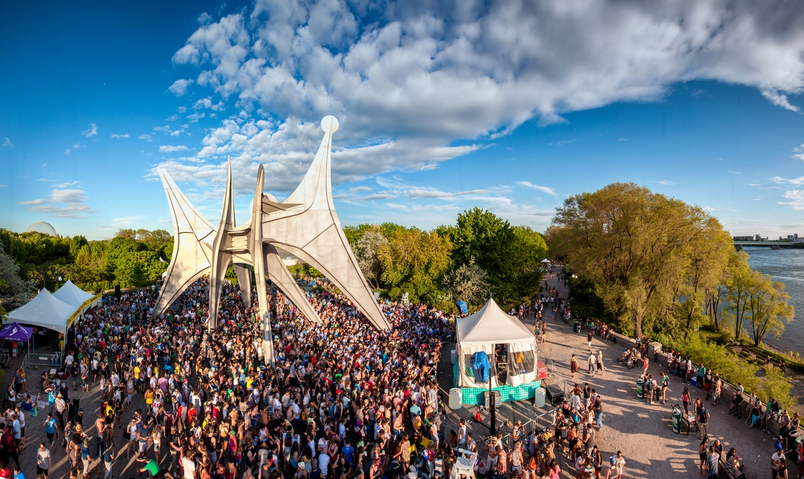
BIOGRAPHIES
Parc Jean-Drapeau

Slide 12
Lyne Lamothe
BIOGRAPHY
Chief Talent Officer at Cirque du Soleil Entertainment Group
About Lyne
Human Resources and communication executive with over 25 years of experience in large organizations such as Cirque du Soleil Entertainment Group, Saputo Inc., La Presse, Liz Claiborne and Nestlé. Advanced expertise in change management - particularly during critical times of organizational transformations - and in mergers and acquisitions. Her role at Cirque is to help leaders invoke the imagination, provoke the senses, and evoke the emotions of all Cirque talent around the world.

Slide 13
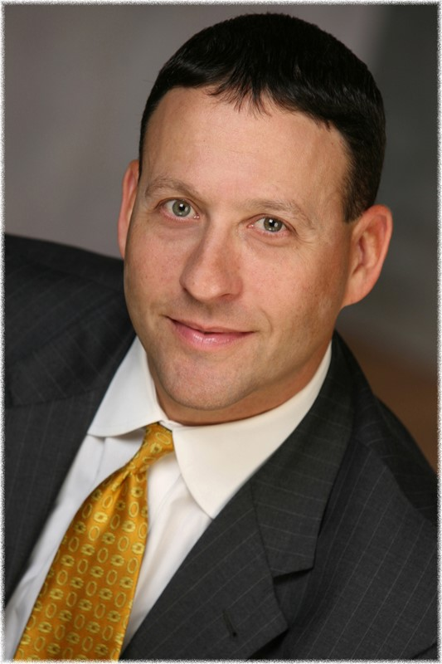
Ross Bernstein
BIOGRAPHY
Inspirational Business Speaker & Best-Selling Sports Author
About Ross
The best-selling author of nearly 50 sports books, Ross Bernstein is an award-winning peak performance hall of fame business speaker who's keynoted conferences for Fortune 500 companies on all seven continents and has been featured on CNN, SPN, Fox News, and “CBS This Morning,” as well as in the Wall Street Journal, New York Times and USA Today.
Ross weaves sports stories, about the DNA of champions, along with stories of companies who he has worked with around the world — and shares best practice ideas on ways to overcome disruption, while ultimately building stronger relationships. At the core of his message is the simple fact that we like to do business with people who we trust, who we like, and who just “get it” — CHAMPIONS.

Slide 14
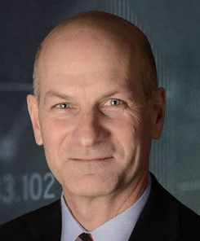
John Vincent
BIOGRAPHY
Chair – CEO Private Advisory Groups TEC Canada
About John
TEC Chair John Vincent has enjoyed a colourful career revolving around a variety of enterprises from very early stage to larger and more mature. He has worked as a CEO and from the outside as a financial and private equity investor and as an advisor, mentor or coach.
He continues to vary his career as the founder of CEO911 Inc., providing
business advisory services and coaching to CEOs, using strong listening skills to help CEOs connect the dots into clearer, more coherent pictures. His current activities include executive coaching for CEOs and senior executives, serving on corporate boards of directors, and facilitating workshops on strategy and corporate values. He also provides teambuilding workshops through Montreal’s most successful escape game company, Echappe-Toi, coaches or mentors start-up teams at accelerators Founder Fuel, Impulsion, & Espace inc. and coaches' students in the McGILL-HEC Executive MBA program.

Slide 15
ANY QUESTIONS?
Margarita Solovjova
margarita.solovjova@headway.es
+34 693 058 051
Sophie Turcotte
sturcotte@mandrake.ca
+1 514-878-4224, ext. 233

