Slide 1
Marketing
Results 2021 / Plans 2022
AGM Barcelona – October 6th 2021

Slide 2
AMERICAS – EMEA – ASIAPAC
Partnership Development
“Since 2002, successfully delivering
local executive talent through a global network of IESF partners”

Slide 3
Example
Australia
UK
UAE
Approach – targeted search and additional focused Linked In campaign If you know potential partners, please share with Kirsten

Slide 4
Our search
Australia
UK
UAE
Prospects
11
Prospects
16
Prospects
11
Interviews
0
Interviews
3
Interviews
Shortlisted
Shortlisted
1
Shortlisted
Success
Success
Success

Slide 5
Join IESF – website & Linked In
www.iesf.com/join-iesf

Slide 6
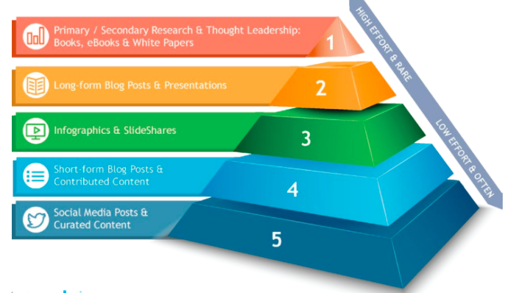
IESF Marketing
Content Marketing Strategy
Brand Awareness
Brand Loyalty
Customer Education
Customer Engagement
Partnership development

Slide 7
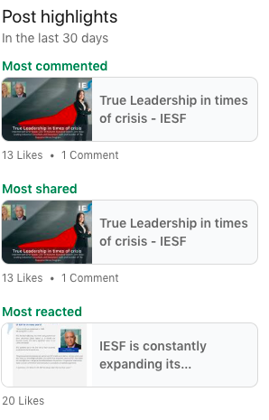
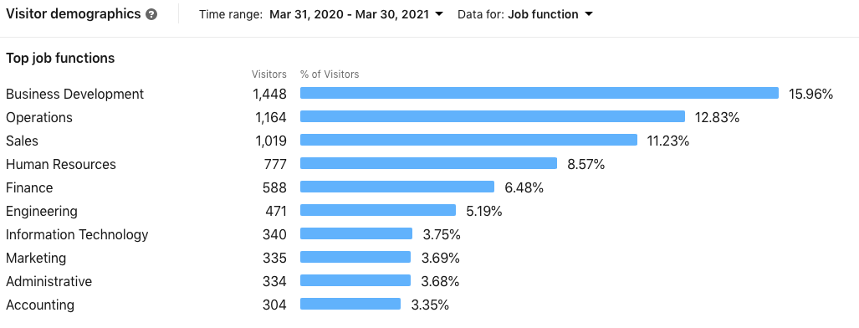
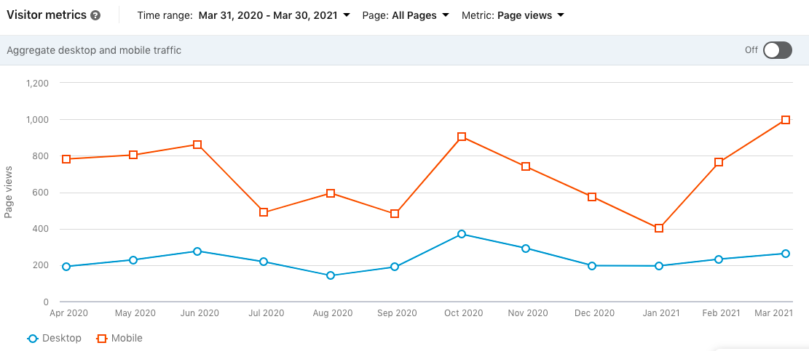
IESF Marketing facts & figures
Number of publications 2020: 11
Number of publications 2021 so far: 6
Number of followers on IESF LinkedIn company page: 2200

Slide 8
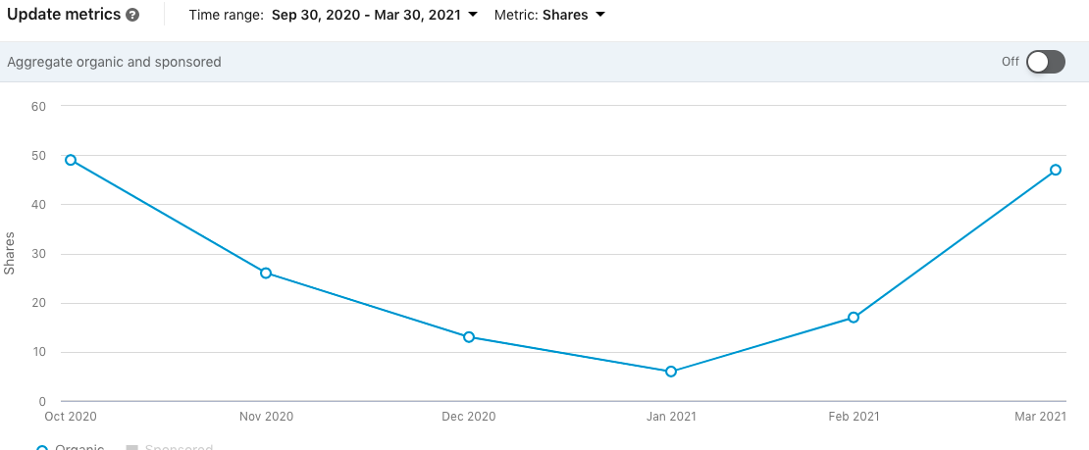
Marketing facts & figures

Slide 9
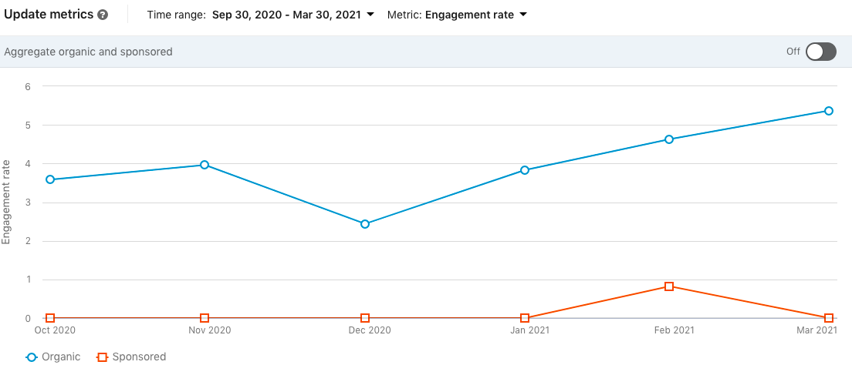
Marketing facts & figures

Slide 10
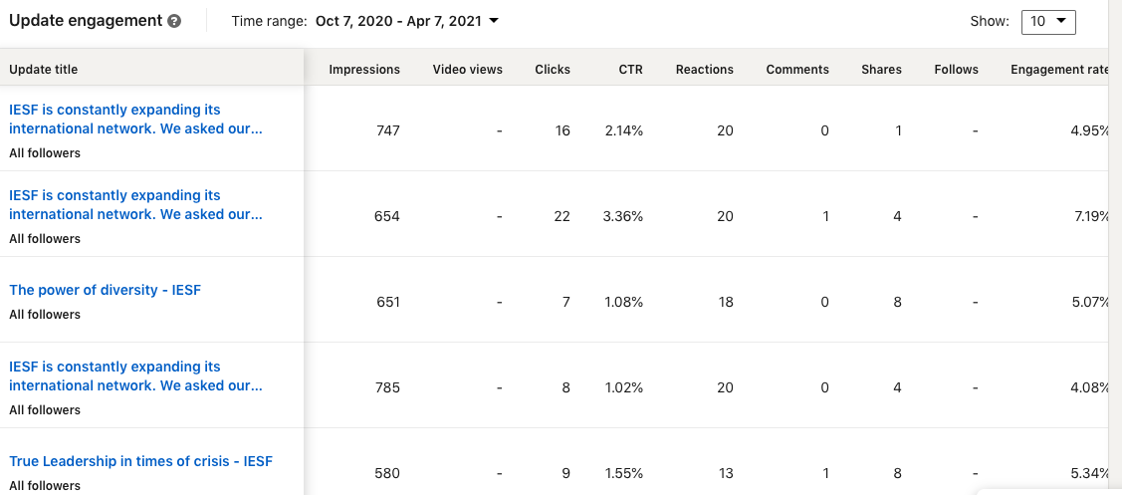
Marketing facts & figures

Slide 11
IESF Marketing goals 2021
Duplicate the number of publications according to the Marketing Planning for 2021 to: 30 publications minimum from various sorts
Increase number of followers LinkedIn page with 1000 members in 2021
Maintaining the level of clicks and shares around 40 a month (both organic and sponsored)
Maintaining the high engagement rates for our content around 5 – 7%
Also share and generate IESF publications with business media worldwide
A detailed plan and budget will be presented to you at the AGM

Slide 12
IESF Marketing 2021
Share your ideas
Share your existing content
Share your local business media titles
Share & Like IESF updates with your network
The global calendar will be shared with you via e-mail & Kirsten will contact each partner upfront if your content is coming up

Slide 13
IESF Content Planning Marketing 2021 preview

Slide 14
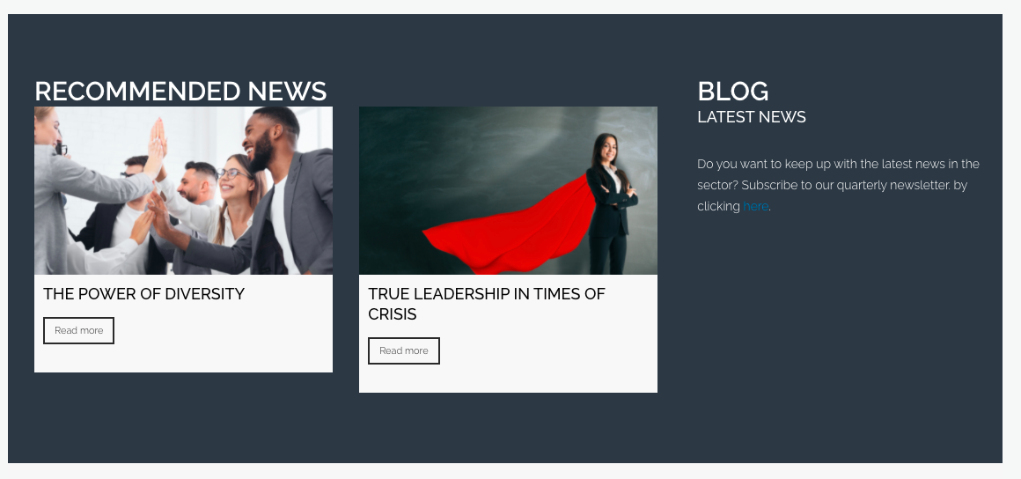
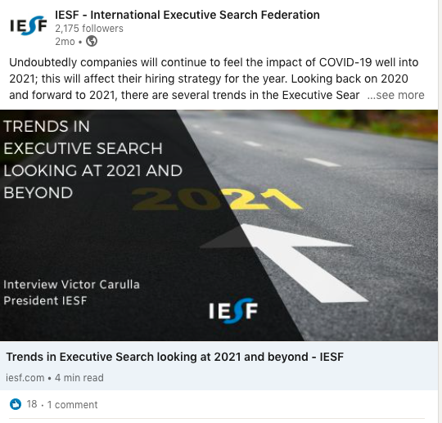
IESF Marketing 2021 – examples

Slide 15
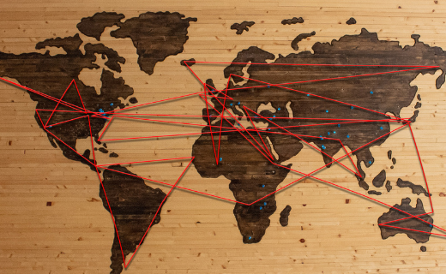
Consultants exchange

Slide 16
Any comments?

Slide 17
If you have any questions, do not hesitate to
contact your Executive Assistant ☺
kirsten@vandegroep.nl

