Slide 1
Searching For Deep (New) Meaning

Slide 2
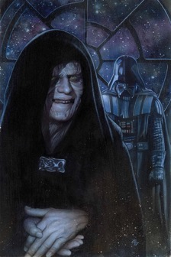
Sith Vs. Jedi Companies
Vs.
Commonly used to describe a group of warriors attached to the dark side of the Force.
Jedi are the guardians of peace. Although their origins are very old, they have become the guardians and warriors of the Galactic Republic after thousands of generations.

Slide 3
How We Got Here

Slide 4
Mega Urbanization
We are being urbanized rapidly in the last 10 years. We will urbanize rapidly in the next 10 years as well.
70% living in megacities
While the number of mouths to feed is increasing, the land allocated for agriculture is decreasing: Urbanization has significant adverse effects on agriculture. The issue of sustainability is very serious. Innovation in production not only services is crucial.

Slide 5
Mega Urbanization Has Aged the World
World is aging, Europe is already aged
COUNTRY | The year when 7% was reached | The year when 14% was or will be reached | Time needed (Years)
France | 1865 | 1980 | 115
Germany | 1930 | 1975 | 45
Sweden | 1890 | 1975 | 85
UK | 1930 | 1975 | 45
USA | 1945 | 2020 | 75
Turkey | 2012 | 2039 | 27
While the population is aging steadily, the percentage of singles in the population is increasing as well. The average age when people get married is increasingly higher.

Slide 6
Today Mega Cities Are Sustainability Wrecks
Megacities are turning into garbage and emission generating hubs, and if unmanaged they will become an economic disaster.
It costs $250 billions to manage megacity waste worldwide today.
It will cost more than $425 billions by 2030.
This is an unmanagable cost for middle-income developing countries.

Slide 7
Soon We Will Face Water and Energy Problems
World drinking water is not sustainable.
Plastic using brands will have to work on the water sustainability of the country in the near future.
The energy demand in the world will explode in the next years.
It will increase dramatically by 40%.

Slide 8
Neoliberalism = Idle Cash Economy
There are close to 100 trillion dollars sitting idle as opportunities run dry.
There is so much cash looking for opportunity right now and the world is in a dire straits because of this lack of opportunities.

Slide 9
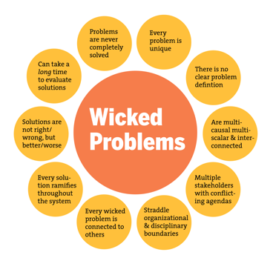
The Age of Wicked Problems and Uncertainty
Climate crisis, inequality of income distribution, epidemics… We are faced with problems that we cannot solve alone…
Uncertainty is now the norm of life. So much so that even the intensity of uncertainty is variable. We have to get used to living with it.

Slide 10
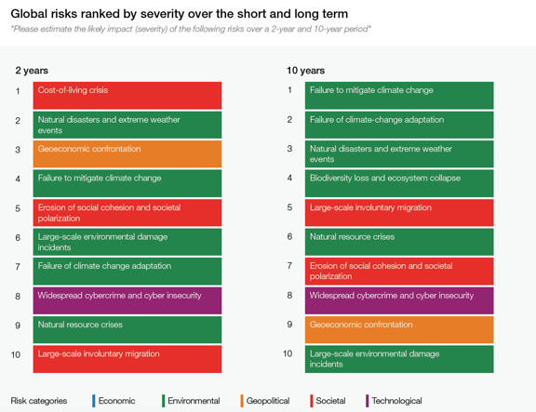
Diversity of Risks to Increase in the Next 10 Years

Slide 11
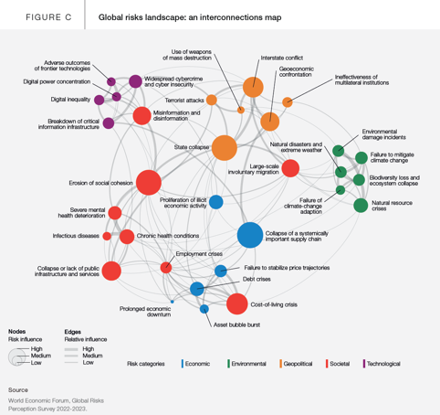
Everything Connects to Everything
Evil problems and risks are intertwined.
While correcting one side, the risk of spoiling the other side is ver high.
That's why a holistic perspective and different ideas are very valuable.

Slide 12
What Companies Want

Slide 13
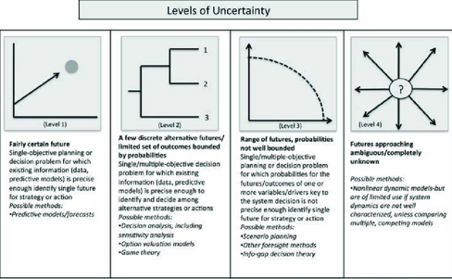
Prepare for the Future
Unfortunately, there is no single, linear future in this era. We have to produce different scenarios with different approaches for the future, to predict them proactively and to pivot according to developments

Slide 14
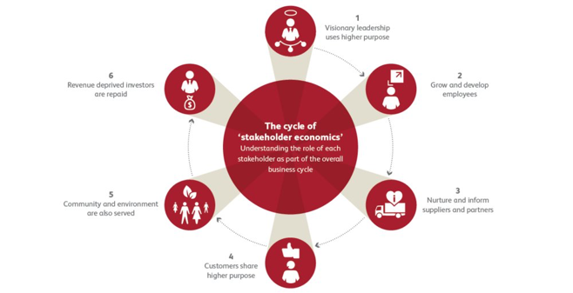
Trying To Understand The Stakeholder Cycle Better

Slide 15
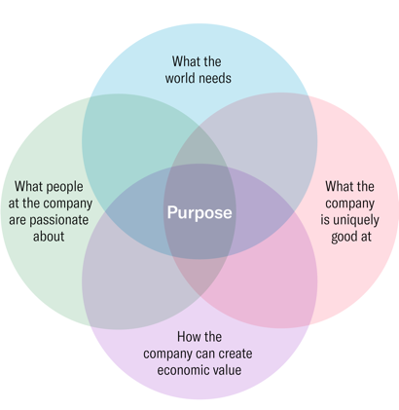
Looking to Become Purpose Companies
Jedi lies at the intersection of these four circles.

Slide 16
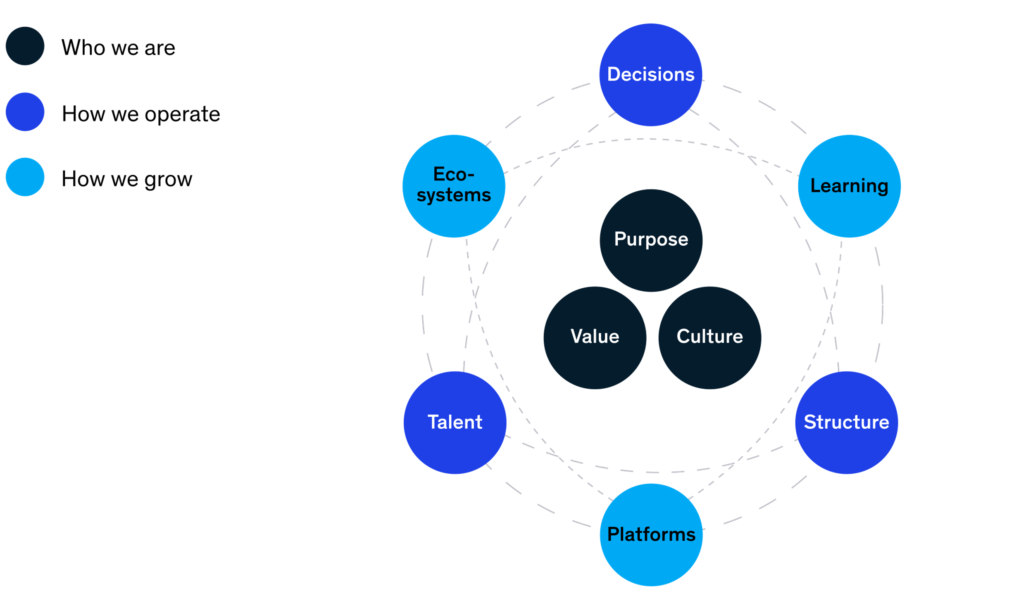
Which Sets Off by Asking 3 Main Questions

Slide 17
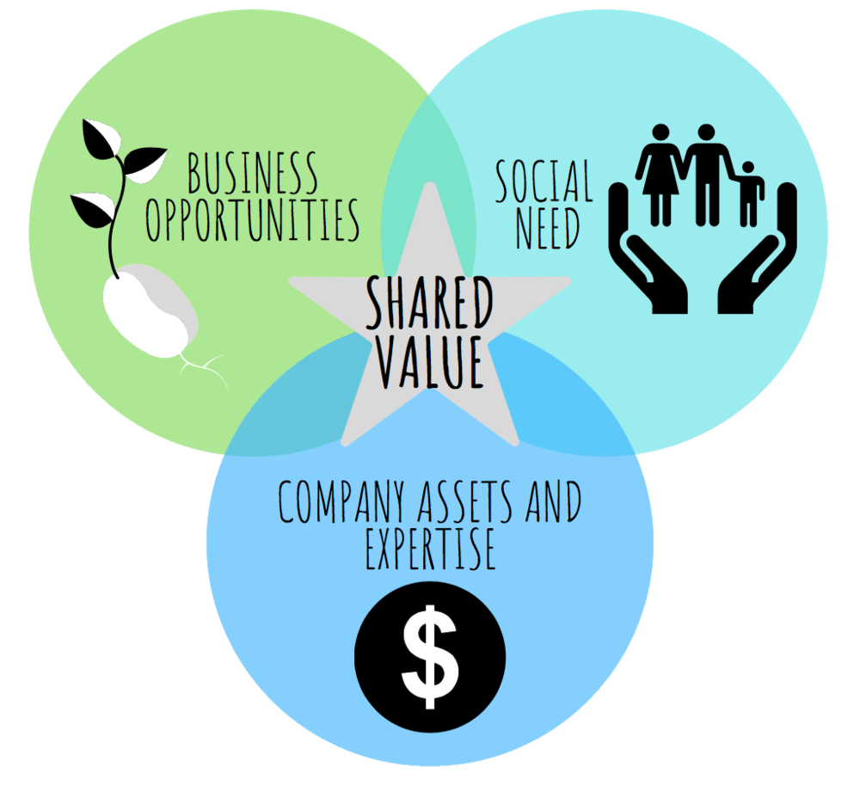
What They Really Want to Achieve

Slide 18
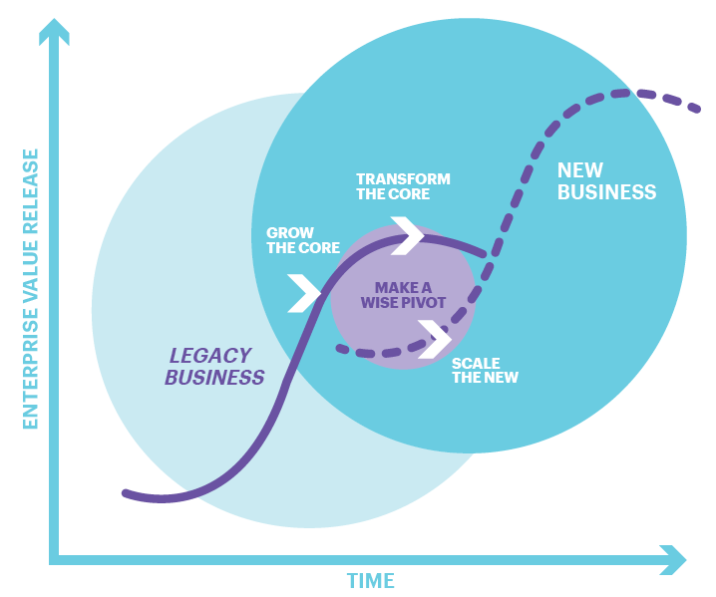
Need to Make Smart Pivots

Slide 19
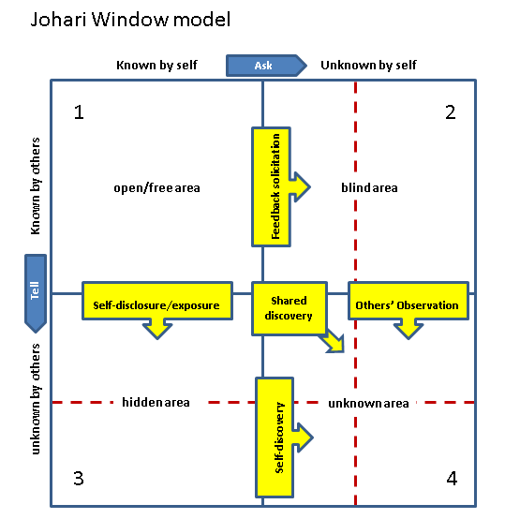
But Companies Don’t Know Themselves as Well as They Think They Do
In this era of wicked problems, companies do not know themselves well and as such, they are not ready to deal with these problems.

Slide 20
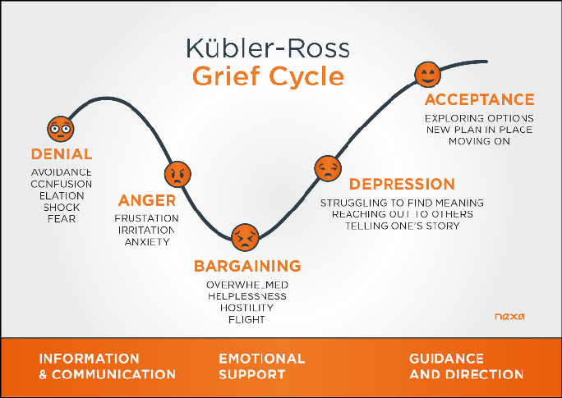
This Inner Unpreparedness to the New Age Triggers Internal Grief

Slide 21
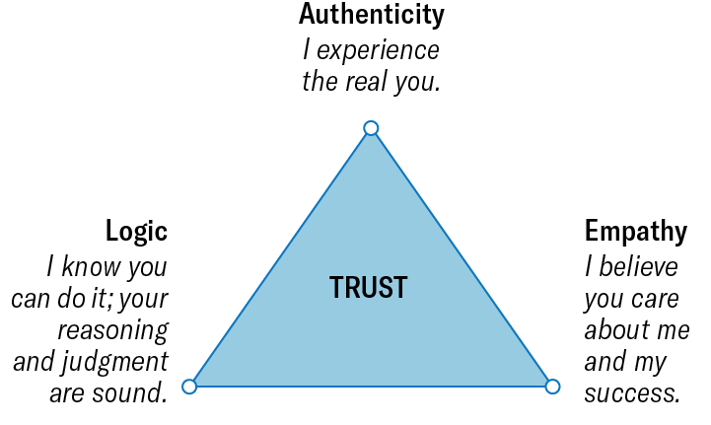
What People Want From Their Companies is Trust

Slide 22
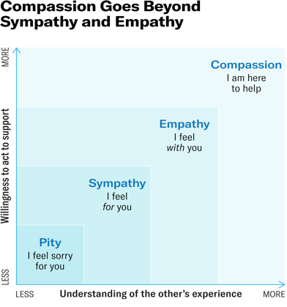
What People Want From Their Companies is Compassion

Slide 23
What Happens In Employee Subconsciousness

Slide 24
Implicit Memory

Slide 25
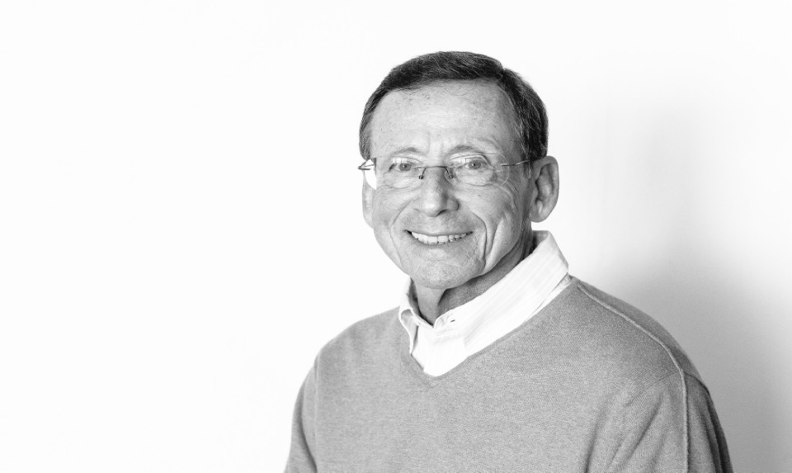
The Native Language of Implicit Memory is Images
Gerald Zaltman
Harvard Business School

Slide 26
The Native Language of Implicit Memory is Images

Slide 27
Metaphors are Doors Into Subconsciousness
CONNECTION
TRANSFORMATION
BALANCE
CONTAINER
JOURNEY
RESOURCE
CONTROL

Slide 28
Employee Subconsciousness
CONTAINER
FORCE
RESOURCE (REVERSE)

Slide 29
Employee Subconsciousness
= THE AGE OF ANXIETY
CONTAINER
FORCE

Slide 30
Employee Subconsciousness
+
CONTAINER
POWER
REVERSE RESOURCE
The most critical resources that we have lost:
Our Emotional Self and Moods

Slide 31
In the Age of Anxiety
There Is No Absolute Human Measure Of Worth. The Value Is Set In A Reference Where The Culture Lives In.

Slide 32
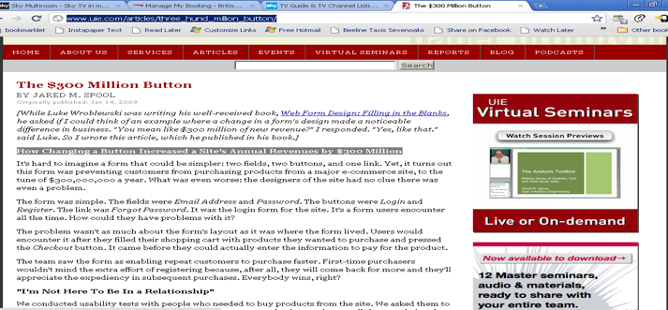
In the Age of Anxiety
Brain Hates Starting But Desperately Needs Completing

Slide 33
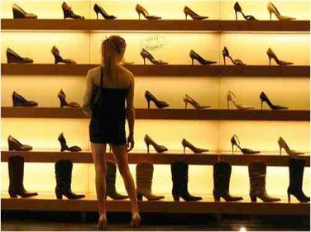
In the Age of Anxiety
What ever you do, human are fed up of huge number of choices and employee initiatives.
Choice architecture: make it simple and easy
Simplify it for them by..
Group
Choose defaults
Involve technology
Gamify
LIBERTANISM ➔ PATERNALISM

Slide 34
In the Age of Anxiety
You can change employee behaviors without changing any of the attitudes.
In the new reality, behaviors do not reflect established beliefs and attitudes anymore. So spending all the effort to change belief, may work in a change in attitude but not in behavior as well. You need to invest in both changing the attitude and behavior as well. If you do not have the necessary funds, than concentrate on behaviors first.

Slide 35
Final Words

Slide 36
“Genius of any kind is the ability and willingness to leave the known world behind and explore new territory.”
- Karla McLaren, The Art of Empathy: A Complete Guide to Life’s Most Essential Skill

Slide 37
HELP THEM TRANSFORM FROM SITH TO JEDI COMPANIES
From the vertical and hierarchical to the horizontal and sympathetic structures.
People think that in Jedi structures, they can reveal their personal lives as well as their creativity in business life. For this reason, structures that give space to the individual are seen as structures that break the vertical, hierarchical structures of the past and bring exciting applications to life for people.
Don't overestimate resilience.
Human is fragile, show you understand this. This will hep them feel safe.

Slide 38
HELP THEM WITH THEIR CULTURAL DISEASE: THE DEPTH DEFICIT
A depth deficit is characterized by:
The absence of deep thinking about inner questions/problems
A failure to go beyond the surface thinking
A failure to use insights from different disciplines to structure human culture.
The absence of bold, imaginative thinking about what turns on or engages employee’ minds.

Slide 39
HELP THEM FIND MEANING
Finding the balance between employee benefit and social benefit,
To be able to establish a business life without missing life and ignoring human own needs,
The new human wants to feel that s/he can put something out individually, to be a part of a job where s/he can be satisfied and find meaning in a productive and creative environment.
WE will need to communicate not a brand that has meaning but a company that has a meaning as well.

Slide 40
NEVER WITHOUT SINCERE EFFORT

Slide 41
Thank You!

