Slide 1
Academy Masterclass
Successfully recruit among countries
and cultures Tuesday March 21 2023

Slide 2
Some background
When hiring the best talent in a highly competitive global market, it’s essential for recruiters to navigate cross-cultural differences among candidates effectively. Your recruitment process should accommodate candidates who come from diverse backgrounds and behave and think differently.
To ensure effective recruitment and a positive onboarding experience, teams need to be familiar with cultural customs and the variations in perspectives toward workplace culture within their hiring pool.
Our languages, gestures, body language, prime focuses, and responses can differ. These differences can lead to a disconnect when not fully understood, and if not approached properly they can cause your organization to miss out on top talent.
In this Masterclass we share experiences, best practices and the values and steps in the recruitment process that according to our client’s perspective, are most important.
2 IESF clients from different Industries explain!

Slide 3
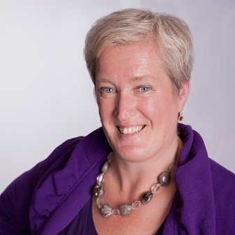
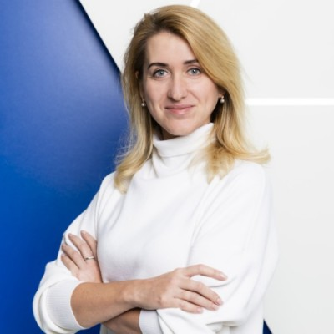
Your hosts for today
Vicky Chittenden Global Human Resources Manager
at Cargo Control Company
Katheryna Purkhalo
Group Senior HR Business Partner/Director at FM Logistic

Slide 4
They will tell us more about
Short introduction on person, role & sector
The countries they operate
What kind of values are important in recruiting for their HQ?
What differences do you experience per country?
What is important in the process? What can we learn/ improve?
Why work with IESF, what are important aspects to highlight more?
If you have any questions for the Q&A afterwards please leave them in a personal chat to Kirsten, she will moderate, select and ask.

Slide 5
Who is Vicky?
25+ years of experience in HR
Building from scratch or taking HR to next level within international companies/context.
First HR manager role: massive experience in multicultural HR & recruitment (Amsterdam-based multi-lingual call centre ; more than 20 nationalities)
Culture DNA: Denglish. Born in UK, raised in NL by British parents
Current role: Global HR Manager Cargo Control Company

Slide 7
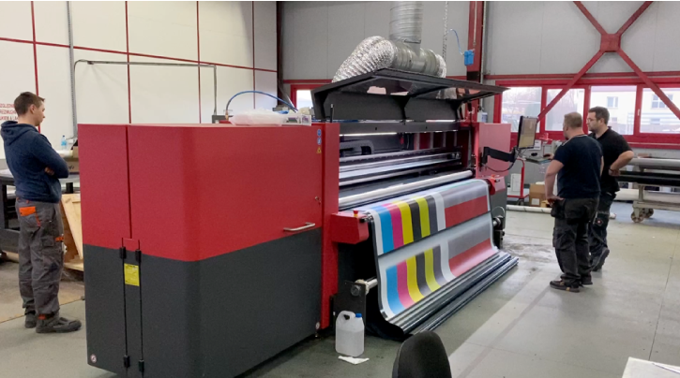
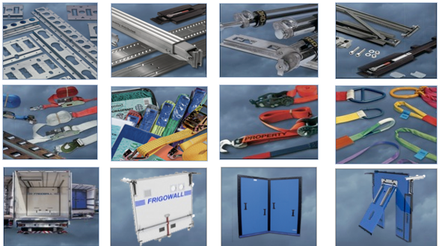

Slide 8
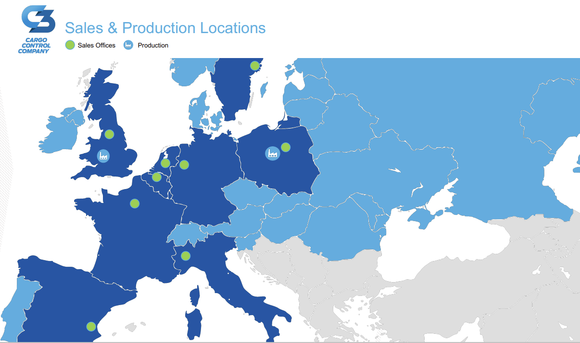
Approx. 600 FTE
150 white collar
450 blue collar
Privately owned company
Sales teams in 9 countries
Production locations: Konin/ Kuny (Poland), Hirwaun (UK)
Holding company in NL

Slide 10
Top talent@C3
Fitting with our Values:
Entrepreneurial
Professionalism
Collaboration
Well-being
(Cultural) diversity: yes!
Self-awareness and self-reflection: yes!
Flexible approach: yes!
Open, interested and learning mindset: yes!
Job requirements (knowledge, experience, expertise)

Slide 11
My recipe when recruiting across cultures
Me, myself and I…
Compare countries - Hofstede Insights (hofstede-insights.com)
Concept of “interesting”
Find the story…
Ask for key learnings in the relationship and communication area. What was the biggest misunderstanding / misconception you ever had about someone? How did you find out? What did you learn?
Use of tools such as DISC, Big5 etc to further reduce bias

Slide 12
What is yours? How do you navigate your clients through cultural differences?
Kick off with anecdote (uncomfortable experience with a German recruiter)

Slide 13
Kateryna Purkhalo
18 years of experience in HR
Experienced in consulting, construction, entertainment, retail, logistics sectors
Started from mass recruitment of blue collars currently working with executive positions
Ukrainian, who was brave enough to move to France knowing only one word in french - “bonjour” :)
Currently Group Senior HRBP/ Director FM Logistic => Central, Eastern Europe and Asia

Slide 14
FM Logistic in short
2022
A family company privately owned
55
YEARS
LOCATIONS
171
MILLION SQM
4.1
31/03/2022
14
28,600
1.51
COUNTRIES
FTE EMPLOYEES
BILLION€
IN REVENUE

Slide 15
Personnel Embodiment of FM values and FM WAY
TRUST EACH OTHER
to engage
Employee Value Proposition
We power our company and the supply chain by empowering our people
Make responsible consumption possible for all
ACT WITH OPENNESS
to transform
Customer Value Proposition
We design and run responsible supply chain models fostering changes in consumption habits and in our society
FOCUS ON PERFORMANCE
to succeed

Slide 16
Differences and similarities of the markets
Market specificity & maturity
Culture uniqueness & code
Communication differences & behavior specificites
Different languages & education systems
Legal aspects
C&B specificities
Shortage of, especially skilled, resources
Overheated market = candidate’s market
Work & life balance
Career opportunities
Sustainable development
Diversity & inclusion
Business itself
Notes:
Maturity (market expertise, know how, skills available)

Slide 17
What is important in the process
Wide understanding of the market
Focus on skills and potential
Keep flexibility and ability to adjust
Openness and focus on potential solution

Slide 18
Q & A Share your questions in a personal chat to Kirsten
She will moderate, select and ask.
Or raise your hand virtually in Zoom.

