Slide 1
Digital Transformation in SEA Growth…, it’s very Bullish!
2023
Guillaume Panot
Synpulse Pte Ltd
40 min + Q&A

Slide 2
Hi! My name is Giom
Head of Product (South Asia) at Synpulse.
15 Years in Asia
10 Years in Software SaaS
10 Years in Sales for APAC
IE Business Business School: Executive MBA.
CNAM Engineer
He brings innovation with AI and manages a complex roadmap for Banking SaaS products with 4 squads to address industry-focus challenges in the finance industry.

Slide 3
Synpulse Digital Transformation Goal
Building a $1Billion company (Valuation) in 2027 (4 years)
Consulting
Finance/ Insurance
Product
(B2B SaaS)
Service
(Cloud)
= $1B
Multiplier
x1.5
x3-5
x5-10
Revenues
$200M
$75M
$40M
Valuation
$333M
$333M
$333M

Slide 4
Importance of SaaS for Digital Transformation
When you got it right
VS
Build a New Digital Bank
Use a SaaS Digital Banking
Cycle Time:
+3 years to go-live
Cycle Time:
6-10 months GTM (MVP)
Total Cost: $150-200m
Approx. Cost: +$10m
50+ SaaS
Integrations
Only necessary integrations with VB8
Managed
Within the bank
Synpulse
Managed Platform
Synpulse ARR ~$1,5M to 15M
LTV ~ $15M - $75M
Notes:
SGD or USD?

Slide 5
Agenda
Introduction
Hypergrowth
What’s currently happening ?
5 Key Trends Shaping SEA and Singapore's IT Industry in 2023
Headwinds
Q&A

Slide 6
1 - Introduction
Southeast Asia is one of the fastest-growing digital economies in the world. With a young and tech-savvy population, the region is rapidly adopting digital technologies to transform businesses and industries.
The expected compound annual growth rate (CAGR) for digital transformation in Southeast Asia is 23.60% from 2023 to 2030.
Notes:
This means that the digital transformation market in Southeast Asia is expected to grow from US$752.38 billion in 2023 to US$4339.82 billion by 2030.

Slide 7
Global Digital Transformation
ASIA
Notes:
Southeast Asia Digital Economy to Reach $363 Billion by 2025
E-commerce drives growth, Google, Temasek, Bain say in report
Region’s online spending could balloon to $1 trillion by 2030

Slide 8
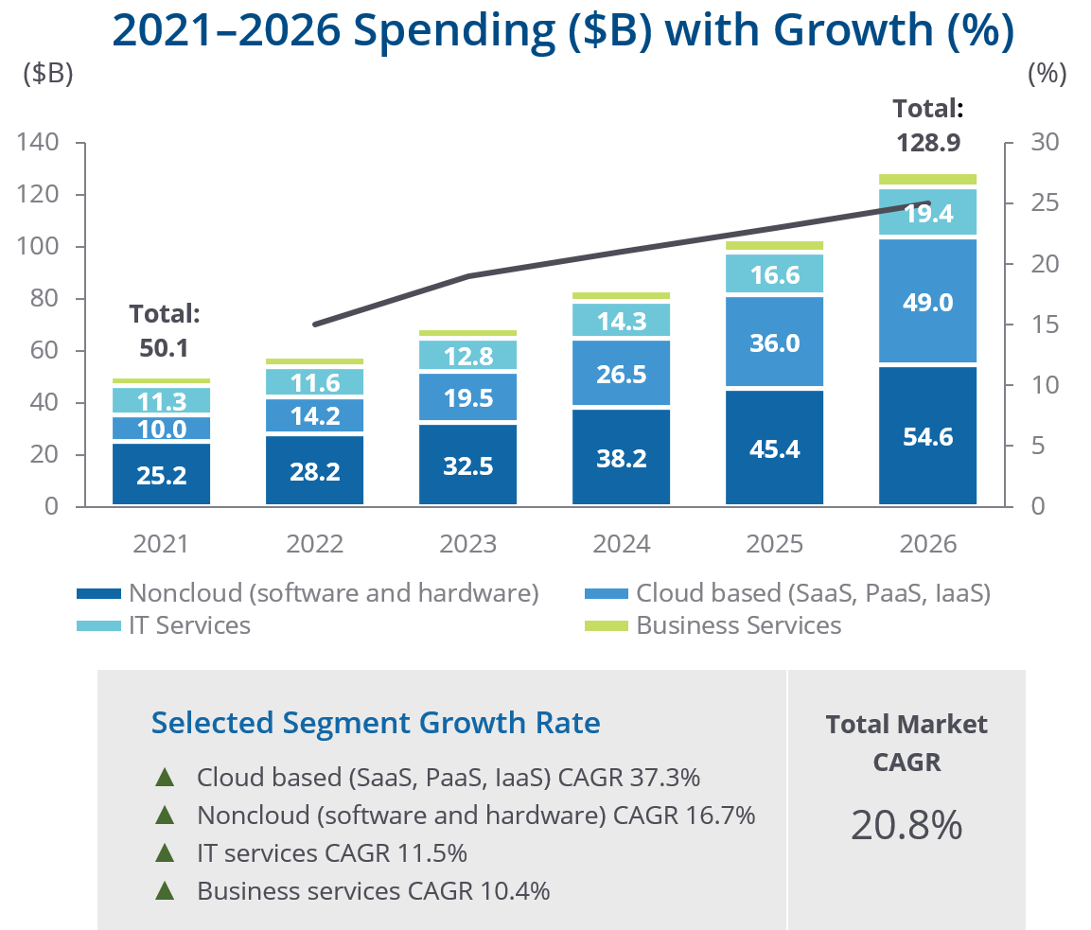
SEA Digital Spending Forecast
Notes:
Southeast Asia Digital Economy to Reach $363 Billion by 2025
E-commerce drives growth, Google, Temasek, Bain say in report
Region’s online spending could balloon to $1 trillion by 2030

Slide 9
2 - Digital Hypergrowth till 2025
In Southeast Asia, where the digital economy is projected to be worth nearly US$200 billion by the end of 2022 and is expected to reach US$330 billion by 2025.
This growth is driving increased demand for data centres, IT human capital, IT experts, cybersecurity, IoT, …

Slide 10
Key Highlights
The digital economy in Southeast Asia is expected to grow from US$129 billion in 2022 to US$280 billion in 2027.
The number of digital consumers in Southeast Asia is expected to grow from 370 million in 2022 to 402 million by 2027.
Investment in digital transformation in Southeast Asia is expected to reach US$110 billion by 2025.
Notes:
Article 2: Low Digital Literacy in Southeast Asia
Another major barrier to digital transformation in Southeast Asia is low digital literacy. According to a study by the ASEAN Foundation, only 32% of Southeast Asians have the skills and knowledge to use digital technologies effectively.
The lack of digital skills is a major challenge for businesses in Southeast Asia. It is difficult to find qualified workers and to implement new digital technologies. This is putting Southeast Asian businesses at a competitive disadvantage.
Article 3: Cybersecurity Concerns in Southeast Asia
Southeast Asia is increasingly vulnerable to cyberattacks. In 2020, the region experienced a 30% increase in cyberattacks. This is due to a number of factors, including the increasing use of digital technologies and the lack of cybersecurity awareness.
Cyberattacks can have a devastating impact on businesses and economies. They can lead to data breaches, financial losses, and reputational damage. This is a major concern for businesses in Southeast Asia, where cybersecurity expertise is limited.
Article 4: Regulatory Challenges in Southeast Asia
Governments in Southeast Asia are still developing regulations for emerging digital technologies, such as artificial intelligence and blockchain. This can create uncertainty and hinder innovation.
Businesses in Southeast Asia need to be aware of the regulatory landscape and to ensure that they are complying with all applicable laws and regulations. This can be a challenge, as the regulatory landscape is constantly evolving.
Article 5: Cultural Barriers to Digital Transformation in Southeast Asia
Traditional cultural values and norms can sometimes clash with the requirements of digital transformation. For example, in some Southeast Asian cultures, it is considered rude to say no. This can make it difficult to implement new digital technologies that require users to change their behavior.
Businesses in Southeast Asia need to be sensitive to cultural barriers and to develop strategies to overcome them. This may involve working with local communities and leaders to build support for digital transformation.

Slide 11
Some Key Drivers
The growing adoption of smartphones and mobile internet.
The rise of e-commerce and digital payments.
The increasing demand for digital services from businesses and consumers.
Government support for digital transformation initiatives.
Notes:
Article 2: Low Digital Literacy in Southeast Asia
Another major barrier to digital transformation in Southeast Asia is low digital literacy. According to a study by the ASEAN Foundation, only 32% of Southeast Asians have the skills and knowledge to use digital technologies effectively.
The lack of digital skills is a major challenge for businesses in Southeast Asia. It is difficult to find qualified workers and to implement new digital technologies. This is putting Southeast Asian businesses at a competitive disadvantage.
Article 3: Cybersecurity Concerns in Southeast Asia
Southeast Asia is increasingly vulnerable to cyberattacks. In 2020, the region experienced a 30% increase in cyberattacks. This is due to a number of factors, including the increasing use of digital technologies and the lack of cybersecurity awareness.
Cyberattacks can have a devastating impact on businesses and economies. They can lead to data breaches, financial losses, and reputational damage. This is a major concern for businesses in Southeast Asia, where cybersecurity expertise is limited.
Article 4: Regulatory Challenges in Southeast Asia
Governments in Southeast Asia are still developing regulations for emerging digital technologies, such as artificial intelligence and blockchain. This can create uncertainty and hinder innovation.
Businesses in Southeast Asia need to be aware of the regulatory landscape and to ensure that they are complying with all applicable laws and regulations. This can be a challenge, as the regulatory landscape is constantly evolving.
Article 5: Cultural Barriers to Digital Transformation in Southeast Asia
Traditional cultural values and norms can sometimes clash with the requirements of digital transformation. For example, in some Southeast Asian cultures, it is considered rude to say no. This can make it difficult to implement new digital technologies that require users to change their behavior.
Businesses in Southeast Asia need to be sensitive to cultural barriers and to develop strategies to overcome them. This may involve working with local communities and leaders to build support for digital transformation.

Slide 12
Some Key Impacts
Increased economic growth
Job creation in IT
Improved productivity
Enhanced innovation
Improved quality of life for citizens
B2B growth and diversifications
E-commerce expansion (17% CAGR from 2022 to 2025)
Deployment of AI
Increase in Digital Payment
New cloud solutions
Investments in Big Data
Notes:
Article 2: Low Digital Literacy in Southeast Asia
Another major barrier to digital transformation in Southeast Asia is low digital literacy. According to a study by the ASEAN Foundation, only 32% of Southeast Asians have the skills and knowledge to use digital technologies effectively.
The lack of digital skills is a major challenge for businesses in Southeast Asia. It is difficult to find qualified workers and to implement new digital technologies. This is putting Southeast Asian businesses at a competitive disadvantage.
Article 3: Cybersecurity Concerns in Southeast Asia
Southeast Asia is increasingly vulnerable to cyberattacks. In 2020, the region experienced a 30% increase in cyberattacks. This is due to a number of factors, including the increasing use of digital technologies and the lack of cybersecurity awareness.
Cyberattacks can have a devastating impact on businesses and economies. They can lead to data breaches, financial losses, and reputational damage. This is a major concern for businesses in Southeast Asia, where cybersecurity expertise is limited.
Article 4: Regulatory Challenges in Southeast Asia
Governments in Southeast Asia are still developing regulations for emerging digital technologies, such as artificial intelligence and blockchain. This can create uncertainty and hinder innovation.
Businesses in Southeast Asia need to be aware of the regulatory landscape and to ensure that they are complying with all applicable laws and regulations. This can be a challenge, as the regulatory landscape is constantly evolving.
Article 5: Cultural Barriers to Digital Transformation in Southeast Asia
Traditional cultural values and norms can sometimes clash with the requirements of digital transformation. For example, in some Southeast Asian cultures, it is considered rude to say no. This can make it difficult to implement new digital technologies that require users to change their behavior.
Businesses in Southeast Asia need to be sensitive to cultural barriers and to develop strategies to overcome them. This may involve working with local communities and leaders to build support for digital transformation.

Slide 13
3 - What’s currently happening ?
Companies are trying to embrace the digital transformation as fast as they can.
B2B and SaaS applications are supporting and accelerate the growth.
Still some challenges at the local levels, especially when it comes to IT expertise.
Banks are continue to target full digital transformations with new solutions
Government are supporting the transformations

Slide 14
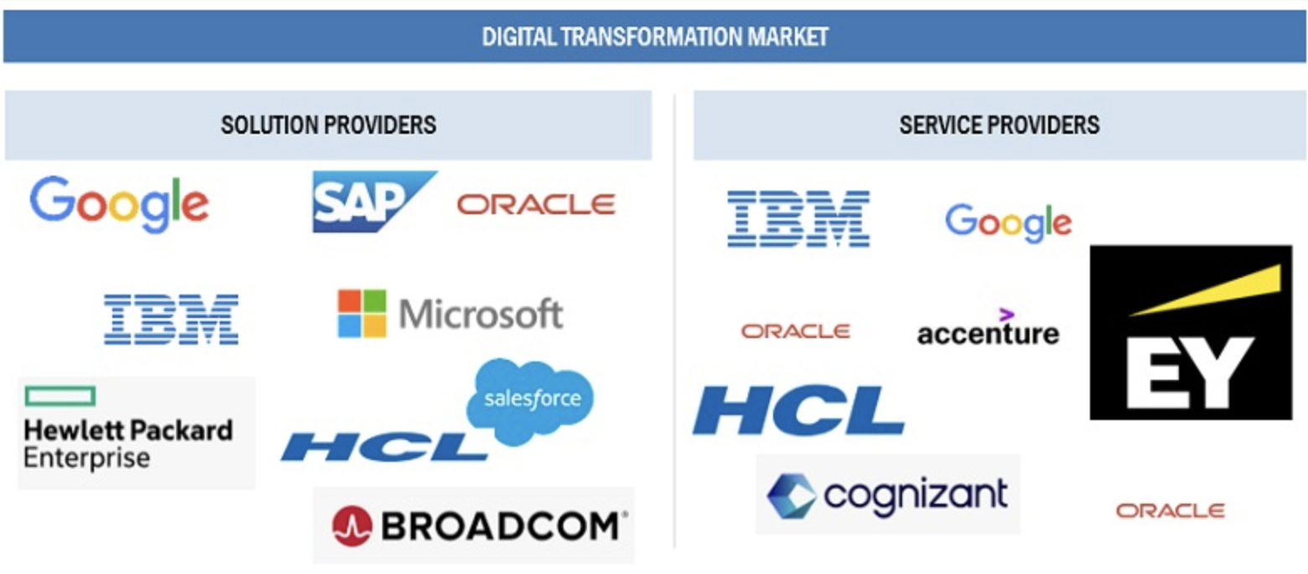
Where is the demand?
Data management and analytics
Legacy systems upgrade
Cybersecurity
Cloud managements
Web3/Blockchain
IoT (5G productivity)
ESG
Demand for expertise / project management

Slide 15
4 – 5 Key Trends Shaping SEA and Singapore's IT Industry in 2023
Cybersecurity Concerns
Regulatory Challenges
Cultural Barriers to Digital Transformation
Interest rate > Economy slow down
China slow down
Notes:
Super low unemployment

Slide 16
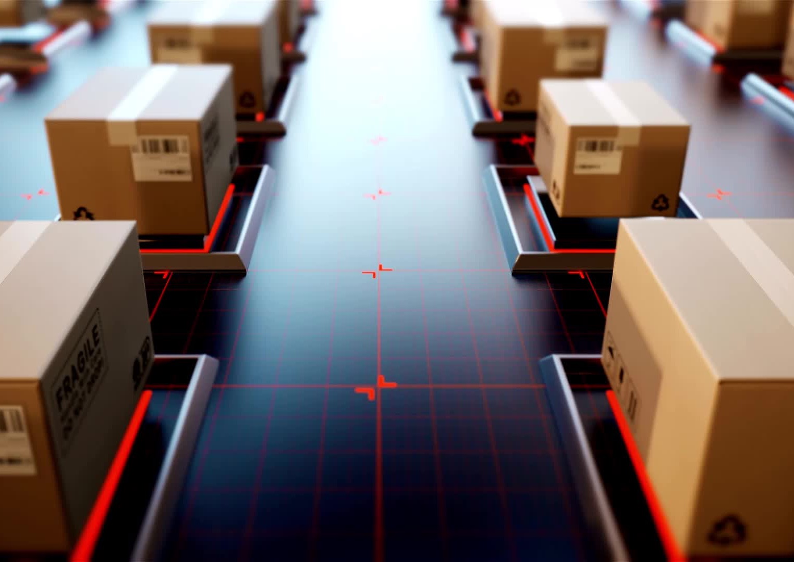
1-Digitalization Driving IT Forward
Digital transformation is leading companies to enhance team collaboration and engagement.
Emphasis will be on digitization, process improvement, and system automation.
Workforce Singapore's Jobs Transformation Maps (JTMs) underline the importance of IoT and analytics to position Singapore as a leading tech-driven city-state.
Singapore’s Smart Nation initiative indicates a move towards changing how businesses and people operate, suggesting growth in specific IT roles.
Notes:
Smart Nation focuses :
Urban living
ESG
Transport
Education healthcare
Finance

Slide 17
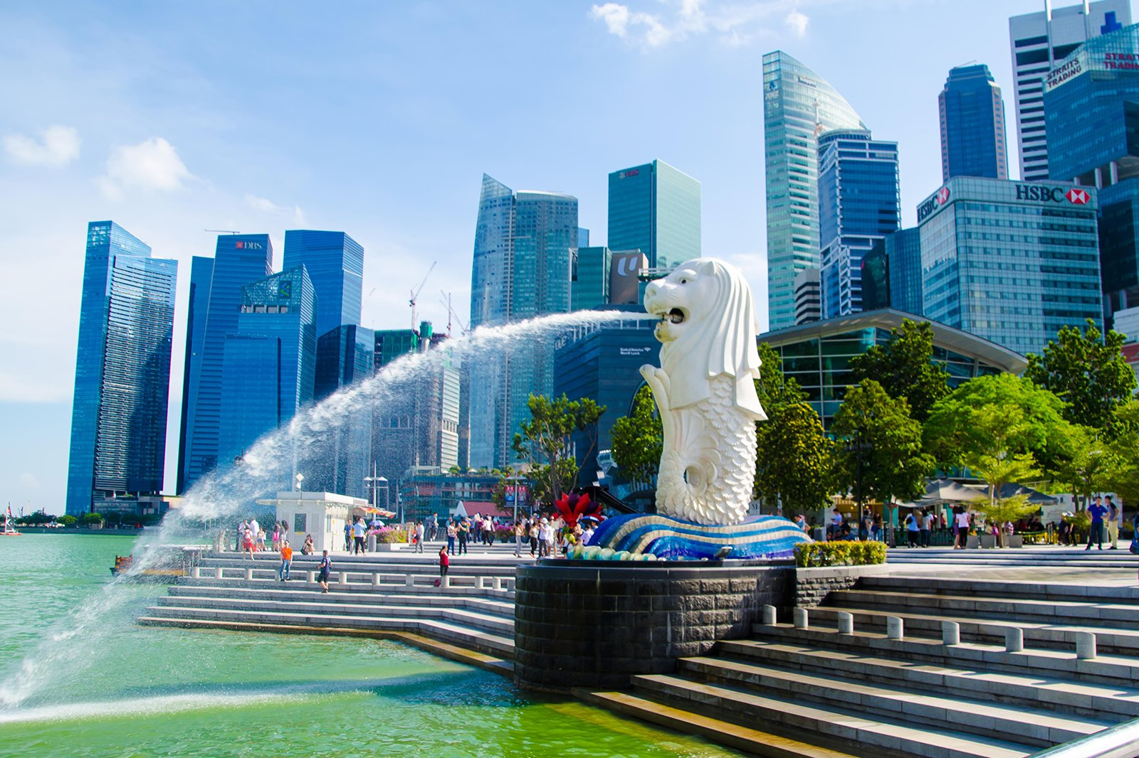
“Financial sector blueprint aims to create up to 4,000 new jobs a year until 2025; MAS pledges S$400m to develop local talent”

Slide 18
2 - Rising Importance of AI and Data Analytics Roles
Increased focus on roles like AI engineering, SAP, data science, full-stack development, and development operations.
The push for digitalization is influenced by the challenges presented by the global economy and the need for companies to adapt swiftly in volatile conditions.
JTMs emphasize a rising demand for skills in software engineering, cloud and mobility, as well as AI and analytics.

Slide 19
3.Expansion of IT Roles in the Financial Services Industry
A report by Singapore’s NTUC LearningHub indicates that 84% of employers believe there is a growing requirement for employees to possess foundational coding skills.
In general, Singapore's IT consulting companies highlights the continued necessity for proficiency in JavaScript, C, and Python to support company automation and digital transition.

Slide 20
4 - Essential Nature of Coding Skills
The Industry Transformation Map (ITM) 2025 aims for Singapore to become a prominent financial center in Asia, expecting an average annual growth of 4-5% for the financial sector.
IT roles in the financial sector will focus on:
Digitalizing financial infrastructure and enhancing digital platform development.
Supporting the net-zero transition in Asia.
Enhancing the realm of sustainable finance , ESG.
Improving cross-border payment linkage and digital currency connectivity.
The MAS reported over 3,000 new IT roles in the financial services in 2022, indicating the sector's growing demand for IT talent.

Slide 21
5 - Cybersecurity Taking Center Stage in Financial Services IT
The growth of the financial services sector in Singapore brings challenges, especially around cybersecurity.
Vincent Loy of MAS highlights the increasing cyber risks associated with third-party service adoption by financial institutions.
The success of ITM's objectives requires a sturdy and secure digital infrastructure.
Professionals specializing in cloud security, application development security, and network security will find greater opportunities given the heightened demand for cybersecurity skills.

Slide 22
5 - Challenges and headwinds
Cybersecurity Concerns
Regulatory Challenges
Cultural Barriers to Digital Transformation
Interest rate > Economy slow down, S&P Market correction
China slow down

Slide 23
6 - Questions and Answers
Thank you!

