Slide 1
Regional Meeting - Thursday April 11
SUCCESSFULLY
DELIVERING LOCAL
EXECUTIVE TALENT
THROUGH A
GLOBAL NETWORK
Notes:
1

Slide 2
PLANNING DAY 1
09.00 - 09.15
09.15 - 09.45
09.45 - 10.30
10.30 - 10.45
10.45 - 11.15
11.15 - 12.00
12.00 - 13.00
13.00 - 13.30
13.30 - 14.00
14.00 - 14.30
14.30 - 14.45
14.45 - 15.45
15.45 - 16.15
16.15 - 16.30
16.45 - 17.00
17.15 - 19.30
19.30 - 21.00
European Market situation & How do we anticipate (Gertjan)
Break-Out sessions (all)
Presentations outcomes & Selecting best practices (all)
Coffee break
Insights from the UK - Matt Hogg
AI in executive search - presentation AI group (Bibi)
Lunch
Diversity and Inclusion (Adelina & Vincenzo)
Cross Border development Taskforce (Eva, Adelina & Dror)
Cross Border success stories
Coffee Break
Key-note speaker IESF Switzerland - Frode Hvaring (MD Novelia Assessment)
Evaluation after cross border (Gertjan)
Partner support Questions & Sharings (all)
Departure for train station, train to Lutry at 5 pm
Panoramic tour of the Lavaux (world heritage site), aboard the
Lutry Petit Train + Wine tasting at a local domain
Dinner at Villa Malfi restaurant, Lutry
IESF I LAUSANNE 2024
IESF I 03
Notes:
4

Slide 3
EUROPEAN MARKET SITUATION
& HOW DO WE ANTICIPATE
GERTJAN

Slide 4
EUROPEAN MARKET SITUATION
& HOW DO WE ANTICIPATE
COVID-19 pandemic influenced executive search demands.
Record-breaking revenues in 2022 and first half of 2023 highlighting industry's success.
Industry's swift adaptation to circumstances like due to economic shifts.
Softening business conditions in technology, financial services, consulting, retail, manufacturing, and crypto sectors.
High-profile layoffs and workforce reductions across sectors.
In our European market, it's not a crisis—it's a strategic pause to regroup.
IESF I LAUSANNE 2024
IESF I 03
Notes:
6

Slide 5
GLOBAL ECONOMIC OUTLOOK
Global GDP Growth Projections: Projected at 2.9% for 2023, slowing to 2.7% in 2024, and improving slightly to 3.0% in 2025.
Regional Growth Trends: Asia expected to drive the bulk of global growth from 2023 to 2025.
Inflation Expectations: Consumer price inflation projected to decline from 7.0% in 2023 to 5.2% in 2024, and further to 3.8% in 2025.
U.S. Economic Outlook: GDP growth projected at 2.4% in 2023, slowing to 1.5% in 2024, and picking up to 1.7% in 2025.
Euro area’s growth at 0.6% in 2023, rising to 0.9% in 2024 and 1.5% in 2025.
China’s growth expected at 5.2% in 2023, then dropping to 4.7% in 2024 and 4.2% in 2025.
IESF I LAUSANNE 2024
Notes:
Introducing the Global Economic Scenario: "As we look at the global economic landscape for the next few years, it's important to understand the broader trends that will influence executive search and recruitment. The data we're presenting reflects projections from authoritative economic sources and provides context for our industry's strategic planning."
Discussing Growth Projections: "Let's consider the overall pace of global economic growth. While we're seeing a modest pace in the near term, there are indications of slight improvements as we move towards 2025. Understanding these growth patterns is crucial for us, as they directly impact talent markets and recruitment strategies."
Highlighting Regional Dynamics: "Diving into regional trends, Asia's role as a major growth driver stands out. This trend is not only significant for those operating in Asian markets but also for global firms looking to understand where major economic activities are likely to concentrate."
Inflation and Its Implications: "Inflation is another key factor that impacts both businesses and talent decisions. The expected gradual easing of inflation rates over the next few years will likely influence compensation strategies and cost considerations in executive search."
U.S. and Euro Area Outlook: "Looking at specific regions, the U.S. and the Euro area present interesting contrasts. While the U.S. expects a temporary slowdown before a slight rebound, the Euro area is projected to experience a gradual recovery, particularly influenced by recent geopolitical and energy challenges."
China's Economic Trajectory: "China's projections show a deceleration in growth, which might reflect broader global economic shifts and internal market challenges. This trend is something to watch closely, given China's significant role in the global economy."
Concluding Thoughts: "These economic projections provide a backdrop against which we need to align our executive search strategies. Understanding these economic trends helps us anticipate market shifts, talent availability, and recruitment challenges in the coming years."

Slide 6
ECONOMIC OUTLOOK EUROPE
Modest growth in most European Markets, will be held back by fiscal tightening and tough conditions|
Tighter financial conditions, higher interest rates (ECB is expecting a decrease if interest 0,75%)
Labour Market Tightness to hold back investments
Geopolitical tensions and external demand slowing will weigh down trade
EU parliamentary elections to derail green policies
Russia-Ukraine / Israel - Palestina war influencing international trade and economic choices
*source: BMI
IESF I LAUSANNE 2024
Notes:
Introducing the Global Economic Scenario: "As we look at the global economic landscape for the next few years, it's important to understand the broader trends that will influence executive search and recruitment. The data we're presenting reflects projections from authoritative economic sources and provides context for our industry's strategic planning."
Discussing Growth Projections: "Let's consider the overall pace of global economic growth. While we're seeing a modest pace in the near term, there are indications of slight improvements as we move towards 2025. Understanding these growth patterns is crucial for us, as they directly impact talent markets and recruitment strategies."
Highlighting Regional Dynamics: "Diving into regional trends, Asia's role as a major growth driver stands out. This trend is not only significant for those operating in Asian markets but also for global firms looking to understand where major economic activities are likely to concentrate."
Inflation and Its Implications: "Inflation is another key factor that impacts both businesses and talent decisions. The expected gradual easing of inflation rates over the next few years will likely influence compensation strategies and cost considerations in executive search."
U.S. and Euro Area Outlook: "Looking at specific regions, the U.S. and the Euro area present interesting contrasts. While the U.S. expects a temporary slowdown before a slight rebound, the Euro area is projected to experience a gradual recovery, particularly influenced by recent geopolitical and energy challenges."
China's Economic Trajectory: "China's projections show a deceleration in growth, which might reflect broader global economic shifts and internal market challenges. This trend is something to watch closely, given China's significant role in the global economy."
Concluding Thoughts: "These economic projections provide a backdrop against which we need to align our executive search strategies. Understanding these economic trends helps us anticipate market shifts, talent availability, and recruitment challenges in the coming years."

Slide 7
ECONOMIC OUTLOOK EUROPE
IESF I LAUSANNE 2024
Notes:
Introducing the Global Economic Scenario: "As we look at the global economic landscape for the next few years, it's important to understand the broader trends that will influence executive search and recruitment. The data we're presenting reflects projections from authoritative economic sources and provides context for our industry's strategic planning."
Discussing Growth Projections: "Let's consider the overall pace of global economic growth. While we're seeing a modest pace in the near term, there are indications of slight improvements as we move towards 2025. Understanding these growth patterns is crucial for us, as they directly impact talent markets and recruitment strategies."
Highlighting Regional Dynamics: "Diving into regional trends, Asia's role as a major growth driver stands out. This trend is not only significant for those operating in Asian markets but also for global firms looking to understand where major economic activities are likely to concentrate."
Inflation and Its Implications: "Inflation is another key factor that impacts both businesses and talent decisions. The expected gradual easing of inflation rates over the next few years will likely influence compensation strategies and cost considerations in executive search."
U.S. and Euro Area Outlook: "Looking at specific regions, the U.S. and the Euro area present interesting contrasts. While the U.S. expects a temporary slowdown before a slight rebound, the Euro area is projected to experience a gradual recovery, particularly influenced by recent geopolitical and energy challenges."
China's Economic Trajectory: "China's projections show a deceleration in growth, which might reflect broader global economic shifts and internal market challenges. This trend is something to watch closely, given China's significant role in the global economy."
Concluding Thoughts: "These economic projections provide a backdrop against which we need to align our executive search strategies. Understanding these economic trends helps us anticipate market shifts, talent availability, and recruitment challenges in the coming years."

Slide 8
EUROPEAN MARKET OVERVIEW
& RECRUITMENT EVOLUTION
"The European recruitment landscape is currently undergoing a slight transformative change.
Driven by innovation and shifting workforce dynamics, HR practices are evolving to meet the new demands of the digital era.
With a focus on agile methodologies and strategic talent acquisition, firms are navigating a market that is both competitive and ripe with opportunity.”
IESF I LAUSANNE 2024
IESF I 03
Notes:
6

Slide 9
3 ESSENTIAL STRATEGIES FOR EXECUTIVE SEARCH
1
2
3
Adaptability
Managing expecatations
Proactive leadership in ES
The necessity of adaptability and innovative solutions in 2024 and beyond.
Emphasis on managing client and candidate expectations and finding talent within constraints.
Anticipating future trends and preparing for dynamic market shifts to maintain industry leadership.
IESF I LAUSANNE 2024
Notes:
"In this part of our discussion, we'll explore three essential strategies for executive search firms to stay ahead in 2023 and beyond. These strategies are vital for us to maintain our edge in a rapidly changing market.
First, let's talk about the importance of being adaptable and innovative. The world is changing faster than ever, and so are the needs of businesses. To stay relevant, we need to be flexible and come up with new, creative ways to meet these evolving demands. This means thinking outside the box and being ready to adjust our approaches quickly.
Next, we focus on the significance of managing client expectations while finding the right leaders within certain limits. In today's market, clients might have high expectations, but they also face their own constraints, like budgets or specific skill requirements. Our role is to guide them realistically, helping them understand what's possible and finding the best talent that fits within their parameters.
Lastly, we need to be forward-thinking, anticipating future trends and getting ready for shifts in the market. This is about understanding where the business world is heading and preparing ourselves to meet the needs of tomorrow, not just today. By staying informed about potential changes and planning ahead, we can ensure that our firms remain leaders in the executive search industry.
Together, these strategies represent a roadmap for our continued success and leadership in the executive search field, even as we navigate through uncertain times."

Slide 10
BREAK-OUT SESSIONS
Share adaptive sales & marketing strategies
What do you do differently?
Review market approach adjustments
Discuss process efficiency and cost-saving measures
What do you do differently in your executive search projects?
Process evaluation & improvement
How do you as an entrepreneur act in this situation?
What type of leadership are you showing?
Assess employee engagement strategies
Highlight tech usage for competitive advantage
Discuss digital transformation impacts
Share AI applications and innovative tech initiatives
2
Process
3
organization
4
TECHNOLOGY &
INNOVATION
1
COMMERCE
IESF I LAUSANNE 2024
Notes:
6

Slide 11
BREAK-OUT SESSIONS
4
TECHNOLOGY &
INNOVATION
Adelina (Romania),
Dror (Israel),
Valérie (France) ,
Stephan (Germany),
Tim (Belgium),
Didier (France)
Alyssa (Panama),
Bibi (Denmark),
Eva (Hungary),
Gertjan (The Netherlands),
Tilmann (Germany),
Vincenzo (Switzerland)
Michael (UK)
Ewa (Poland),
Yenni (Austria),
Bart (Belgium),
Florian (Germany),
Normand (Canada),
Victor (Spain)
Tina (Germany)
Christina (Romania),
Elli (Germany),
Leonie (South-Africa),
Matt (United Kingdom),
Maxime (Canada),
Eti (Israel)
1
COMMERCE
2
Process
3
organization
IESF I LAUSANNE 2024
Notes:
6

Slide 12
Presentations Outcomes Break-Out Groups & selected best practices
1
COMMERCE
2
PROCESS
3
ORGANIZATION
4
TECHNOLOGY &
INNOVATION
Be more present in de market: events, social media, promotions
Investigating new industries: Defense, New Energy
Use specialist consultants within IESF network
Add a cancelation fee instead of fee with start
Recommedantion from your network
Cold calling
Evaluation with different organisations and networks
Meeting more f2f at the client
Work together with consulting companies
More focus on your commercial activities
Outsourcing of non-core activities
Focus on core activities (ES)
Focus on sales & business development: fixed days
Developing Playbook / standard process for acquisition activities
Focus on practice and expertise
Increased focus on KPI’s, to anticipate and make accurate decisions
Marketing Planning & Investments
Survey (client and candidate)
Brainstorming session in our process
Purpose/company culture
Retaining your talent – engagement
Decentralised the office /management
Learn to manage by trust
Create an environment where it’s ok to make mistakes and employees feel empowered
To find a clear strategy for your company, so people know what’s expected of them
More individual an decentralised communications
Be closer to your people when they are there: How do they feel?
Internal bot that automates their research and several aspects: operations, assessing
Shared video online via Linked In, technology wil disrupt (Matt)
HR AI automation tool. Draft a candidate profile with database information.
Integrate AI in your ATS
IESF I LAUSANNE 2024

Slide 13
COFFEE BREAK
15 MINUTES

Slide 14
INSIGHTS FROM THE UK
MATT

Slide 15
Matt Hogg
Wallace Hind Selection, United Kingdom
Business Insights from the UK
Size of UK Business Market
Current Landscape
Trends in the UK Labour Market
Recruitment Challenges and Solutions
Employer Branding
Growth is on the Horizon
Future Outlook trends
Questions
IESF I LAUSANNE 2024
Notes:
3

Slide 16
Number of Employment Turnover Businesses (Thousands) (Millions)
All UK (pvt) businesses 5,555,130 27,524 4,479,552
Sole Traders 4,110,145 (74%) 4,485 330,789
All employers 1,444,985 23,039 4,148,763
2 to 9 employees 1,177,335 4,288 (19%) 592,131
10 to 49 employees 222,785 4,346 (19%) 669,553
50 to 249 employees 36,905 3,596 (15%) 762,947
250 or more employees 7,960 10,809 (47%) 2,124,131
Of the 23 Million workers in the UK almost 50% are employed by the c.8000 businesses which are considered ‘Large’, an average of 1,350 employees each.
With internal recruiters on the rise, realistically there are 267,650 target businesses, an audience that makes up less than 5% of all UK businesses.
Size of the UK Business Market
(Private sector)
Italy 6 Million
Germany 5.2 Million
France 4 Million
Spain 3.4 Million
Poland 2.6 Million
Netherlands 2.3 Million
Hungary 2 Million
IESF I LAUSANNE 2024
IESF I 03

Slide 17
Current
Landscape
A challenging financial climate and geopolitical issues have had a notable effect in the UK. Although 2023 started brightly there are now 30% less vacancies compared with 2021 (equating to less than 1 million).
Technology sector saw a 56% reduction, with only Industrials and Engineering seeing a slight increase. Amazon ranked in the top 5 hiring businesses in the previous 5 years but did not make the top 20 in 2023.
Unemployment is still at an all-time low (3.8%).
Despite this…
2023 saw a 2% rise in the market being worth £41.7 billion (35.2 temporary / 6.5 permanent).
The demand for ‘green’ roles in recycling and sustainability sectors continues to increase, 1 in 5 businesses are increasing these positions.
59% of businesses are confident that they will recruit in 2024. The most likely industries to increase hiring: Transportation & Distribution (36%), Construction (36%), Medical & Health Services (35%), Finance & Accounting (32%), IT & Telecoms (31%).
IESF I LAUSANNE 2024
Notes:
3

Slide 18
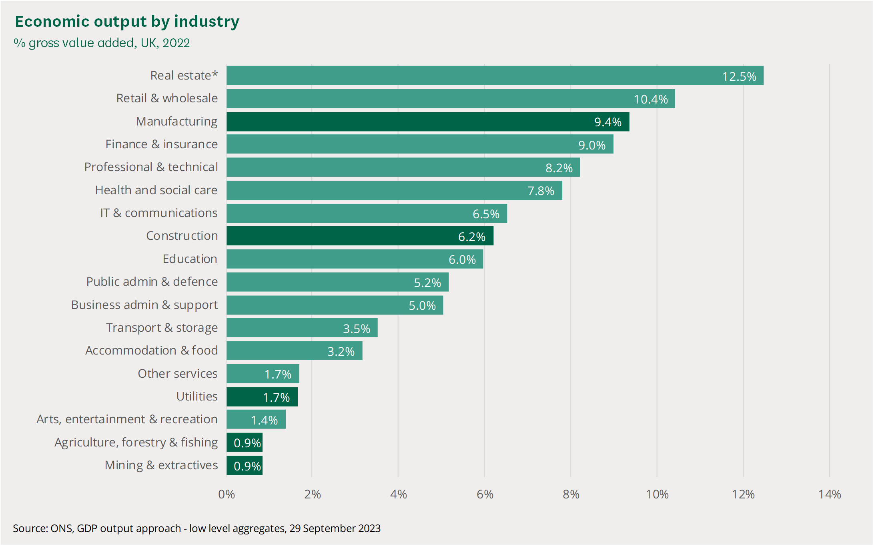
Current
Landscape
GVA is a measure of economic output that is like gross domestic product, or GDP. GVA measures the value of products and services produced minus the costs incurred in production, though not including labour costs.
IESF I LAUSANNE 2024
Notes:
3

Slide 19
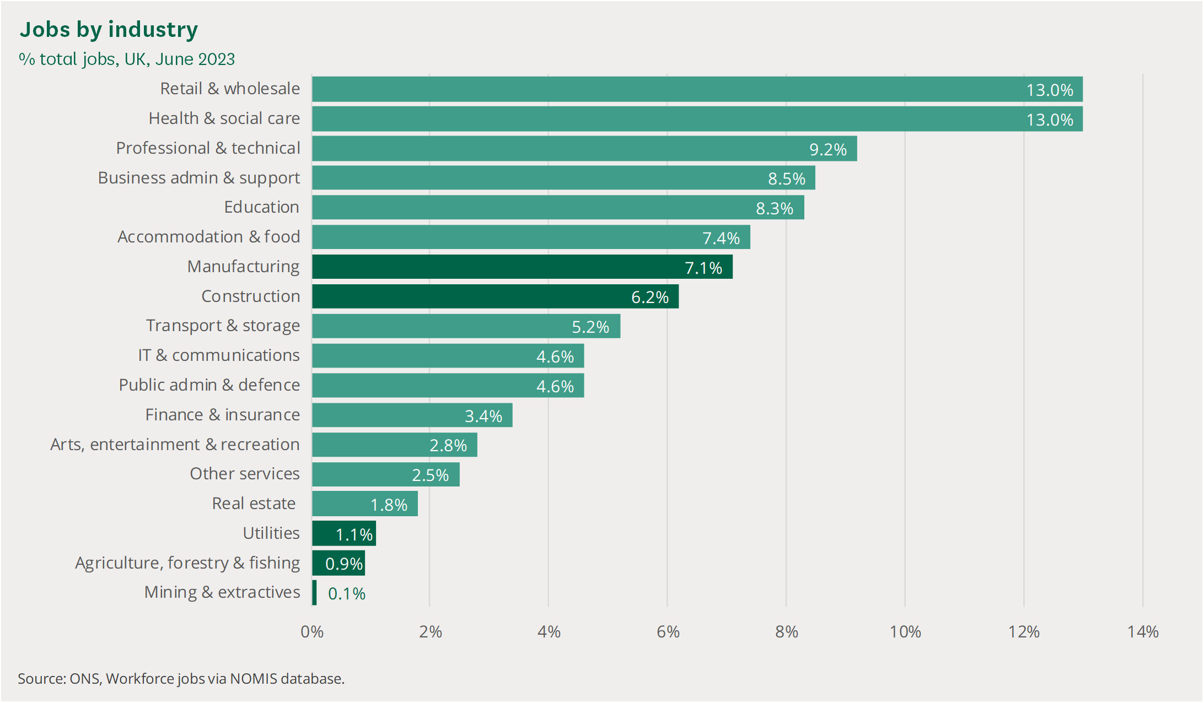
Current
Landscape
Having a diverse client base is essential to reduce risk
IESF I LAUSANNE 2024
Notes:
3

Slide 20
Trends in the UK Labour Market
The ongoing rebalancing of labour demand and supply will continue, with the historically tight labour market likely to loosen only gradually.
Candidates are likely to retain a degree of leverage over pay and conditions, with flexibility set to remain a powerful tool for job attraction and retention.
High wage growth has peaked, but its persistence remains key to the outlook for interest rates.
Foreign interest in UK jobs has doubled in the past two years amid record net migration.
GenAI will disrupt the job market and has already ignited rapid job growth in its creation and use.
Average wages including bonuses increased in real terms in the three months to January 2024, with an annual change of 1.6%. The real annual change in wages excluding bonuses was 2.0%. Nominal wages continued to rise, at a rate of 6%.
IESF I LAUSANNE 2024
IESF I 03

Slide 21
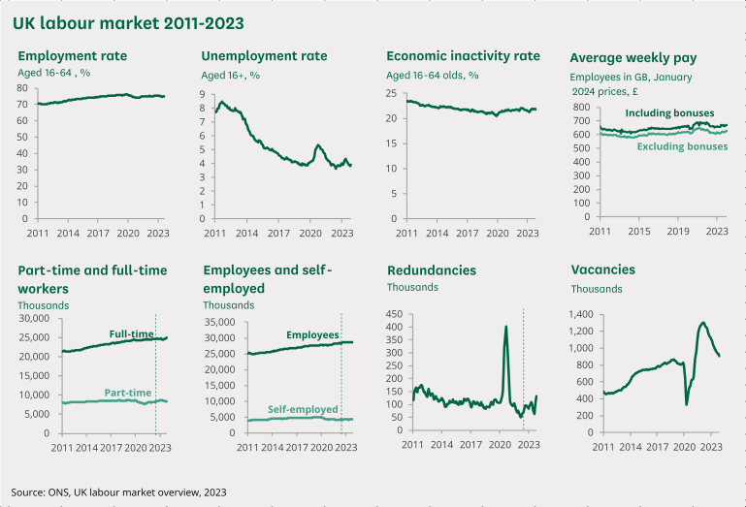
In the year to November 2023 to January 2024, employment, unemployment and economic inactivity levels have all increased, although there has been a fall in the employment rate. There was a slight fall in nominal pay growth, but an increase in real pay in the three months to January 2024.
Trends in the UK Labour Market
IESF I LAUSANNE 2024
IESF I 03

Slide 22
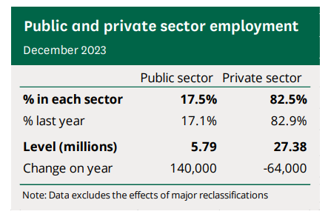
Trends in the UK Labour Market
(Private vs Public sector)
In 2023, there was an increase in the number of people working in the public sector, but a decrease in the private sector.
Before the start of the pandemic, the percentage of all workers who worked in the private sector had been steadily increasing since 2010. The pandemic reversed this pattern. Since 2020, there has been an increase in the number of workers in the public sector, while private sector employment has fallen.
IESF I LAUSANNE 2024
IESF I 03

Slide 23
Competition: 30,000 registered recruitment agencies, employing 200,000 people.
80% of UK recruiters employ less than 10 staff and have a turnover of less than £1 Million (24,000), c. 30% of these are based in London.
The number of people retiring outweighs the volume of new people entering the workforce.
Client and candidate expectations are at an all-time high and quite often ‘miles apart’.
Employee engagement rate is only 21% globally.
Attitudes to work are changing, in a recent UK survey conducted by Kings College London, 30% of Gen Z stated ‘it was pointless working hard’.
Generationally the UK’s attitude to work, in 2022, 52% of Millennials said it would be a good thing if less importance were placed on work – up from 31% back in 2005.
28% of Gen X shared that career progression is neither important nor unimportant. Maybe a pay rise or a new title would be nice, but they aren’t going to extreme lengths to get it.
The UK ranked 12th out of 18 ‘Westernised Nations’ that in the long run, hard work paid off.
Recruitment Challenges and Solutions
The number of recruitment agencies Worldwide is estimated to be 160,000.
Japan 33,000
Germany 20,000
Netherlands 14,000
US 12,000
Italy 3,500
France 1,700
IESF I LAUSANNE 2024
IESF I 03

Slide 24
Employer Branding
Employer brand is how businesses differentiate themselves in the labour market and reflects the actual experience of employees. 75% of job hunters consider an employer's brand before applying for a job, therefore it is important for a company to have a strong employer brand.
The key advantages are:
Competitive advantage
Number and experience of applicants
Improve retention and satisfaction rates
Increase employer brand awareness
Define your value proposition
Positive culture
IESF I LAUSANNE 2024
Notes:
3

Slide 25
Bystronic working in partnership with
Wallace Hind Selection
To recruit a Service Operations Manager
Created by: Matthew Hogg, Wallace Hind Selection, 1 main Road, Northampton, NN5 6JB
01604 758857 07920 025422 mh@wallacehind.com www.wallacehind.com

Slide 26
About Us – www.bystronic.com
The name Bystronic first appeared in 1964, when Bystronic Maschinen AG was founded in Bützberg. The company specialized in glass processing. The company’s name is a combination of the names of its three founders Byland, Schneider, and Trösch.
Bystronic is a globally leading technology company in sheet metal processing. Our high-quality solutions enable transformation into a productive and sustainable future. The focus is on the automation of the complete material and data flow of the cutting and bending process chain. The intelligent connectivity of our laser cutting systems and press brakes with innovative automation, software, and service solutions is the key to comprehensive digitalization in the sheet metal industry.
Our company headquarters are in Niederönz, Switzerland. Additional development and production sites are in Sulgen (Switzerland), Gotha (Germany), Cazzago San Martino and San Giuliano Milanese (Italy), Tianjin, Shanghai, Shenzhen (China), and Hoffman Estates (USA). We are actively represented by our own sales and service subsidiaries in more than 30 countries and by agents in numerous other countries.
We stand for customer proximity, high-performance innovations, service excellence, and local expertise. As a trusted partner, we aim for long-term collaboration to solidify lasting customer relationships.
Bystronic has over 3,600 employees worldwide at more than 40 locations and generated a net revenue of CHF 1'015.9 million in 2022. As of 2021, Bystronic AG is listed on the SIX Swiss Exchange (SIX: BYS).
https://bystronic-mediacenter.picturepark.com/v/LC2e4hho/
www.bystronic.com/gbr/en/company/history

Slide 27
Products
Fast, flexible, and precise - Smart machines for laser cutting
Bystronic's laser cutting machine systems will boost your output and ensure high quality and increased productivity.
Our laser cutting machine systems are also designed for automation. The right solution enables both unmanned production and faster switching to manual processing.
Smart, intuitively operable, and strong - Press brakes for any need
Our machines are simple to operate. The intuitive software makes all process steps easier and ensures convenient bending, even without prior experience. In combination with our automation solutions, automatic production is possible at any time.
Flexible, powerful, and fast
Our high-end tube laser makes higher accuracy and quality possible in your production. The 2D and 3D laser cutting technology takes care of it. Process a variety of materials and sizes with precision, in doing so, saves energy and maintenance costs.

Slide 28
Sectors

Slide 29
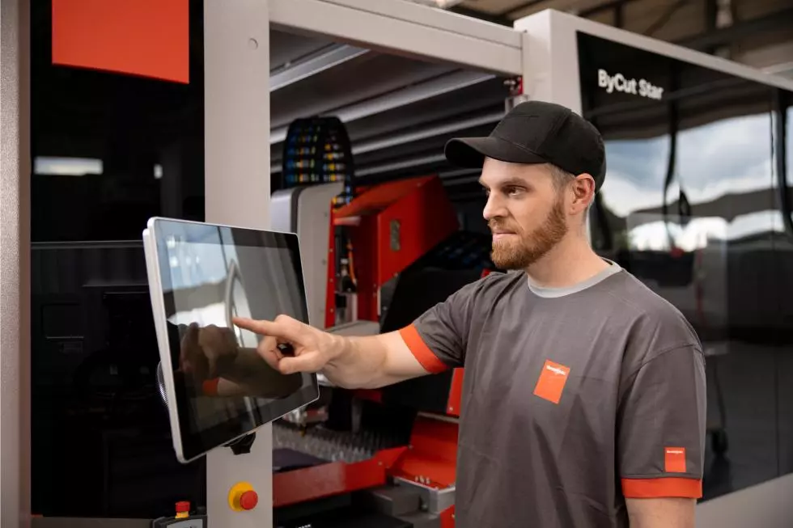
Services
360° Customer Advisor - Onsite proactive advice from the expert
It takes over the inspection of various critical components of your machines and auxiliary systems to increase productivity. It analyses whether the machine is properly maintained by the customer and operated by qualified personnel. The service includes Bystronic equipment, operators and certain accessories to determine if there is potential downtime. Bystronic Service brings clarity to the planning of your downtimes.
Parts & Consumables
Original spare parts kits from Bystronic guarantee the value retention of your Bystronic systems and extend their service life. All consumables are carefully selected and tested by our experts. They are optimally matched to your system and contribute to excellent results in production. Thanks to our decentralized logistics, you benefit from high availability and fast delivery times. Our web shop also offers you the opportunity to order spare parts around the clock.
Bystronic Customer Training - We train your employees
Fast to the desired quality: Certified training courses ensure the safe and efficient use of your machines.
Theory and practice: We offer you a wide range of training courses based on a combination of theoretical and practical exercise units.
Flexible and modern: The training courses take place at your site with the latest equipment.

Slide 30
Organisation Chart
Vacancy
Regional Manager North
Regional Manager South
Regional Manager Ireland
Regional Manager Midlands
Technical Manager
Hotliner
Customer
Service
Hotliner
Hotliner
Service
Supervisor x2
Technicians x10
Hotliner
Customer
Service
Service
Supervisor x2
Customer
Service
Service
Supervisor x2
Customer
Service
Service
Supervisor x2
Technicians x10
Technicians
x10
Technicians
x10
Andy Maxwell
Service Manager

Slide 31
Job Specification
Reporting to Andy Maxwell, Service Manager
Leads and promotes the Bystronic culture and values (People, Proactive, Openness). Creates a positive and inclusive working environment for all team members.
Promotes the objectives and targets of the Service Business Unit and Bystronic UK
Builds up and maintains strong relationships with the Service Manager and other Service Department Managers
Establishes clear development plans for Service Team Managers. Works with Service team managers to establish development plans for Service Technicians
Reviews current and forthcoming activities to establish capability requirements and performs GAP analysis of current skills and experience to determine training and development needs.
Plans and provides training for Service Team Managers and Service Technicians. Aligned to the needs of the business and the individual development plans and capabilities of the team members.
Develop the capabilities of Service Team Managers to enable them to act effectively as engineers and as managers. Assists the Service Team Managers in developing the capabilities of the Service Technicians.
Communicates clearly with Service Team Managers holding regular formal meetings and ensuring frequent informal contact.
Acts as a trusted source for disseminating information from the Bystronic management team to the field operations team
Acts as a trusted representative of the field operations team sharing their needs, requirements, ideas, and concerns with the BYUK management team.
High level of direct and indirect customer contact, including regular time on-site with members of the service team, prioritizing the Service Team Managers.
Provides customer reassurance for significant or ongoing issues and follows up on all NPS detractors
High focus on developing professionalism within the field service team. Communication skills, positive behaviours, proactivity, punctuality, dress, H&S, working methodology, housekeeping, tools, and equipment.
Works closely with the Spares Manager to ensure management of consignment car stock and special tools.

Slide 32
Job Specification, continued….
Works closely with the Project Manager (and installation Partner) who will be responsible for planning and scheduling forthcoming installations.
Works closely with Aftersales Manager, who will be responsible for planning and scheduling Preventative Maintenance Services, to ensure all planned preventative maintenance services are correctly and professionally delivered with all actions completed and documented.
Has responsibility for all contractors undertaking Service Operations activities, for and on behalf of BYUK.
Ensures all Service technicians have the right Tools and Equipment to enable them to complete their activities safely and as efficiently as practicable.
Responsibility for all service technician recruitment and onboarding
Succession planning for all Service Team Managers and Service Technicians (leavers, retirees, promotions)
Responsibility for ensuring customer satisfaction through the continual focus on NPS, FTFR. Direct responsibility for Engineer satisfaction (ES).
Ensuring all directives set out in the BYUK Handbook and Incident Management Proto-col are followed.
Promotes After-Sales activities and initiatives within the field operations team to ensure consistent achievement of targets aligned with the strategic goals of the business.
Assigns development tasks to the local service team, reviews work evaluates the performance against pre-determined and aligned goals and provides feedback.
Ensures a positive working environment and collaborative approach
Develops team by providing performance feedback, coaching, and motivation; responsible for the planning and supports of the completion of team training; assesses employees’ strengths and development needs and establishes personal development plans; holds constructive career development discussions.

Slide 33
Person Measurables
Recognised as a role model by peers, direct reports, and management. Delivers business results across a variety of measures, including, but not limited to:
Customer Satisfaction: NPS
Engineer Satisfaction: ES
Primary Leading Indicators: FTFR
Billable Hours
Employee Engagement
Service Efficiency Metrics
Displays strong leadership skills and behaviour, in areas such as:
Customer orientation and focus in line with World Class Service Vision
Motivation of and clear direction for Service Team Managers
Regular, timely, and constructive feedback sought and provided
Completion and quality of direct reports’ performance reviews and career development discussions
Open, honest, and sincere communication
Coaching of employees (direct reports and others)
Advocate for change and continuous improvement
Identifies and implements operational improvements
Demonstrates comprehensive talent development skills, such as:
Identifies the individual strengths and development needs of direct reports; creates and implements development plans (based on corporate framework) and demonstrates success
Attains retention and promotion rates above benchmarks
Ensures the quality of recruited talent and capability development

Slide 34
Personal Skills and Experience
Personal Skills
Understand customer satisfaction drivers
Ability to work closely with other Service Department Managers to deliver the Financial and Performance targets of the Service Business Unit and Bystronic UK
Resilient, determined to succeed, passionate in supporting others to succeed.
Ability to plan effectivity but also to react efficiently and decisively to changing circumstances
Customer Focus: Is dedicated to meeting the expectations and requirements of internal and external customers; gets first-hand customer information and uses it for improvements in service delivery; acts with customers in mind
Willingness to travel up to 50% throughout the UK, occasionally outside
Work Experience
Significant experience in a field service environment.
A proven track record of managing and directing multiple field service professionals.
Applicable product and industry knowledge and affinity with industrial customer solutions, technology, and services.
Education
Higher level of education, university degree in business-related/technical subject preferred OR equivalent time served experience in a similar role.

Slide 35
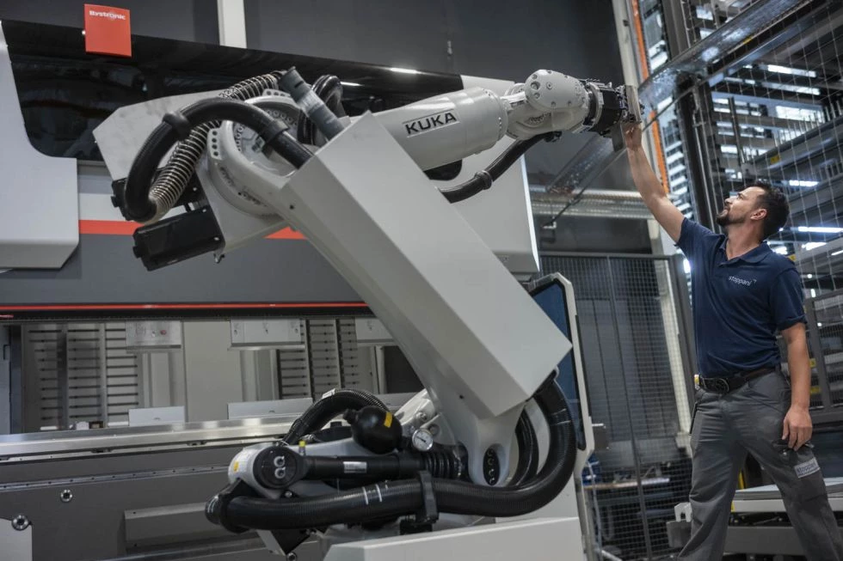
Package
£55,000 - £60,000
£8,000 Annual Bonus
Company Car
Contributory Pension
25 Days Holiday
Private Healthcare
Life Insurance
Benefits Hub
Process
Completed RFI returned to Wallace Hind
Selected Candidates presented to Andy Maxwell
Selected Candidates interview to preliminary interview with Matthew Hogg
Successful Candidates will be invited to interview with Andy Maxwell.
Final Interview with Andy Maxwell and Chris Burnett, Director Aftersales EMEA

Slide 36
Growth is on the horizon
Vistage, the world's leading business performance and leadership advancement organisation for small and medium-sized businesses key predictions for 2024:
Business confidence has increased, with 77% feeling economically optimistic
63% of business leaders anticipate an increase in revenue in 2024
53% expect to observe an increase in profitability within the next 12 months
56% are budgeting to increase number of staff
IESF I LAUSANNE 2024
IESF I 03

Slide 37
Future Outlook – 5 sectors to be excited by
1. Transport and Storage: According to the Office of National Statistics, transport and storage is currently the fastest-growing industry in the UK. The sector has seen strong growth in recent years, primarily thanks to a surge in online shopping post-pandemic. The number of new businesses in the industry increased by 21% from 2019-2021 alone.
2. Food and Drink Manufacturing: UK food and drink is a sector on the rise, being worth £112 billion as of 2021 and growing 4.2% in a year.
3. Education Technology: The UK market is valued at approximately £3.5 billion. The rise in EdTech companies has primarily been fuelled by the COVID-19 pandemic, as schools and universities have gravitated towards online learning.
4. E-commerce: COVID-19, fundamentally changed the way we shop. In particular, on-demand marketplaces specialising in same- or next-day deliveries of food, fashion, and beauty have been particularly popular. In 2020, it made up 32.5% of the country’s retail sales – a figure that is predicted to increase to 38.6% by 2025.
5. Healthcare: As an aging population the UK has had to make advancements in medical technology, and there’s a growing demand for medical services. In 2019, healthcare made up 10% of gross domestic product (GDP). This is forecast to increase year-on-year.
IESF I LAUSANNE 2024
IESF I 03

Slide 38
Thank you
IESF I LAUSANNE 2024
Notes:
3

Slide 39
AI IN EXECUTIVE SEARCH - PRESENTATION AI TASKFORCE
BIBI & KIRSTEN

Slide 40
IESF AI TASKFORCE
Highlight & present proven tools at AGM 2024
Test researched tool within several IESF partners to share advice to whole group
Demonstrate AI best practices for inspiration
Initiate online demos via Zoom for each interesting tool
IESF I LAUSANNE 2024
Notes:
6

Slide 41
AI IN EXECUTIVE SEARCH
Enhance the executive search industry by streamlining processes, improving candidate sourcing and offering deeper insights into candidates' fit for leadership roles.
How extensively is AI being used at work today and for what tasks?
What AI tools are emerging to support Executive Search?
How can you harness the potential of AI to create competitive advantage?
What are the ethical and legal implications of increasing use of AI among job candidates, and how will it change our processes?
IESF I LAUSANNE 2024
Notes:
6

Slide 42
AI FACT AND FIGURES
IESF I LAUSANNE 2024
Notes:
6

Slide 43
CANDIDATES AND AI
Job candidates are also using AI tools to create cover letters, résumés, and other content in support of their job searches
For example, candidates can use ChatGPT, Gemini (Google), Co-pilot (Microsoft) by providing it with a job description and a résumé and prompting it to suggest modifications.
Currently, there is no definitive way to determine whether a candidate has created content using AI.
Executive search teams operate with high uncertainty about whether and when AI is being used
*Conference Board 2023
IESF I LAUSANNE 2024
Notes:
6

Slide 44
AI: EXPANDING AND REFINING RECRUITMENT
AI expands our search, attracting a larger pool of candidates.
Example: AI analyses online profiles to identify potential candidates who match job criteria.
AI digs deeper into candidate backgrounds for a complete view.
Example: AI tools evaluate a candidate's work history and skills beyond their resume.
AI crafts compelling job ads to attract the best talent.
Example: AI recommends effective phrases and skills that are trending in the industry.
AI improves candidate engagement with quick, informative interactions.
Example: A chatbot provides immediate answers and collects candidate info outside business hours.
AI assists in assessing candidate suitability more accurately.
Example: AI analyses verbal and non-verbal cues during video interviews for compatibility.
Example: AI can be used for pre-screening via interviews via What’s app or email.
AI aids in researching and connecting with clients and prospects effectively.
Example: AI predicts client needs and identifies opportunities for new partnerships and supports in business development
*Conference Board 2023
IESF I LAUSANNE 2024
Notes:
Introducing the Global Economic Scenario: "As we look at the global economic landscape for the next few years, it's important to understand the broader trends that will influence executive search and recruitment. The data we're presenting reflects projections from authoritative economic sources and provides context for our industry's strategic planning."
Discussing Growth Projections: "Let's consider the overall pace of global economic growth. While we're seeing a modest pace in the near term, there are indications of slight improvements as we move towards 2025. Understanding these growth patterns is crucial for us, as they directly impact talent markets and recruitment strategies."
Highlighting Regional Dynamics: "Diving into regional trends, Asia's role as a major growth driver stands out. This trend is not only significant for those operating in Asian markets but also for global firms looking to understand where major economic activities are likely to concentrate."
Inflation and Its Implications: "Inflation is another key factor that impacts both businesses and talent decisions. The expected gradual easing of inflation rates over the next few years will likely influence compensation strategies and cost considerations in executive search."
U.S. and Euro Area Outlook: "Looking at specific regions, the U.S. and the Euro area present interesting contrasts. While the U.S. expects a temporary slowdown before a slight rebound, the Euro area is projected to experience a gradual recovery, particularly influenced by recent geopolitical and energy challenges."
China's Economic Trajectory: "China's projections show a deceleration in growth, which might reflect broader global economic shifts and internal market challenges. This trend is something to watch closely, given China's significant role in the global economy."
Concluding Thoughts: "These economic projections provide a backdrop against which we need to align our executive search strategies. Understanding these economic trends helps us anticipate market shifts, talent availability, and recruitment challenges in the coming years."

Slide 45
ACTIONS SO FAR
Online demonstration use of ChatGPT
Online Masterclass on AI in Executive Search with speaker Bas van den Haterd
Online 2 part Masterclass on AI and Social skills in recruitment by Trech
Investigated and tested a lot AI tools within our team
Selected the best tools for you to use in your executive search process
Today a preview and short demo of selected tools.
At the AGM in Amsterdam we will present our final results.
IESF I LAUSANNE 2024
Notes:
6

Slide 46
QUESTIONS TO THINK ABOUT
How will using AI for this specific task help make our process more efficient?
Will using AI in this way help achieve better recruiting outcomes?
How will using AI in this way influence our employer brand?
Will using AI in this way help expand our pools of qualified candidates?
How could using AI for this specific task harm potential candidates?
What should we do to mitigate the risks to recruiters and the organization yet still reap the benefits of using AI?
What guidelines do we need to put in place to ensure responsible use of AI by recruiters?
How will we measure impact, define success, and learn from failure?
IESF I LAUSANNE 2024
Notes:
6

Slide 47
IESF I LAUSANNE 2024
Notes:
Introducing the Global Economic Scenario: "As we look at the global economic landscape for the next few years, it's important to understand the broader trends that will influence executive search and recruitment. The data we're presenting reflects projections from authoritative economic sources and provides context for our industry's strategic planning."
Discussing Growth Projections: "Let's consider the overall pace of global economic growth. While we're seeing a modest pace in the near term, there are indications of slight improvements as we move towards 2025. Understanding these growth patterns is crucial for us, as they directly impact talent markets and recruitment strategies."
Highlighting Regional Dynamics: "Diving into regional trends, Asia's role as a major growth driver stands out. This trend is not only significant for those operating in Asian markets but also for global firms looking to understand where major economic activities are likely to concentrate."
Inflation and Its Implications: "Inflation is another key factor that impacts both businesses and talent decisions. The expected gradual easing of inflation rates over the next few years will likely influence compensation strategies and cost considerations in executive search."
U.S. and Euro Area Outlook: "Looking at specific regions, the U.S. and the Euro area present interesting contrasts. While the U.S. expects a temporary slowdown before a slight rebound, the Euro area is projected to experience a gradual recovery, particularly influenced by recent geopolitical and energy challenges."
China's Economic Trajectory: "China's projections show a deceleration in growth, which might reflect broader global economic shifts and internal market challenges. This trend is something to watch closely, given China's significant role in the global economy."
Concluding Thoughts: "These economic projections provide a backdrop against which we need to align our executive search strategies. Understanding these economic trends helps us anticipate market shifts, talent availability, and recruitment challenges in the coming years."

Slide 48
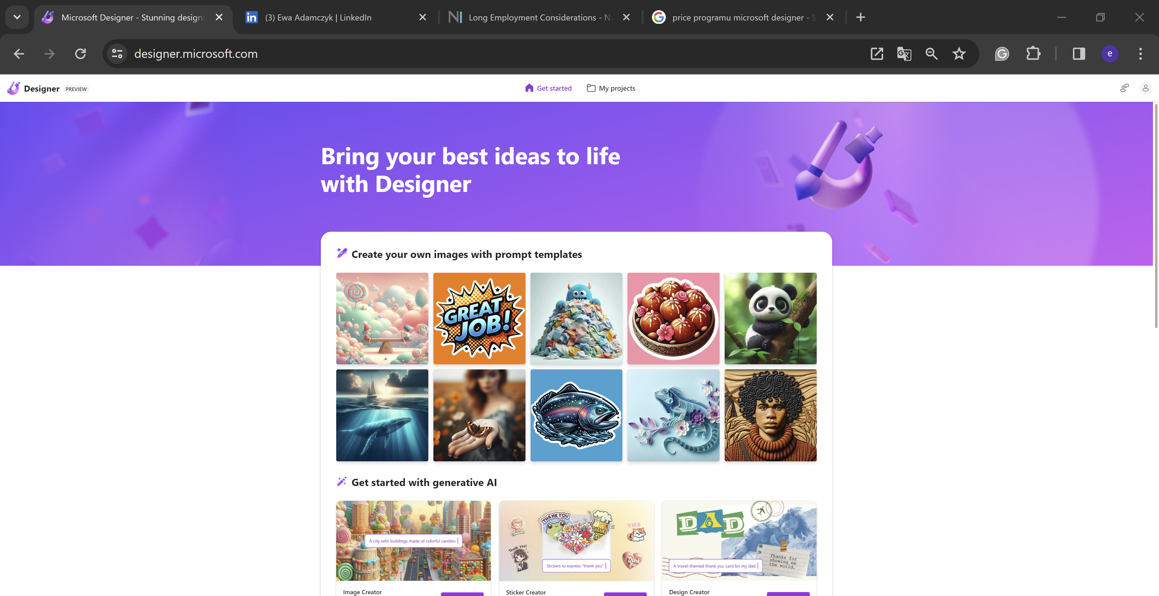
IESF | 2024
IESF I 03

Slide 49
AI Taskforce – Microsoft Designer
Generate pictures based on the prompt, single words, sentences
Very easy to use because of free templates
Free Version
IESF | 2024
IESF I 03

Slide 50
What for?
www
Facebook.
Instagram
LinkedIn
Presentations

Slide 51
Gamma Advantages
Time Saving & Cost Saving
Create picture in minutes
Better Company image
Company images looks more modern and professional
Colours and Fonts
You can change everything on the picture
Format & Size
Layout can be adapted to the needed format and size
Headline
It proposes to you a headline based on the prompt. Useful for the pictures you use in articles.

Slide 52
Online Presentation - How to use Microsoft DesignerGAMMA
https://www.youtube.com/watch?v=0W5jX3dJb4c

Slide 53
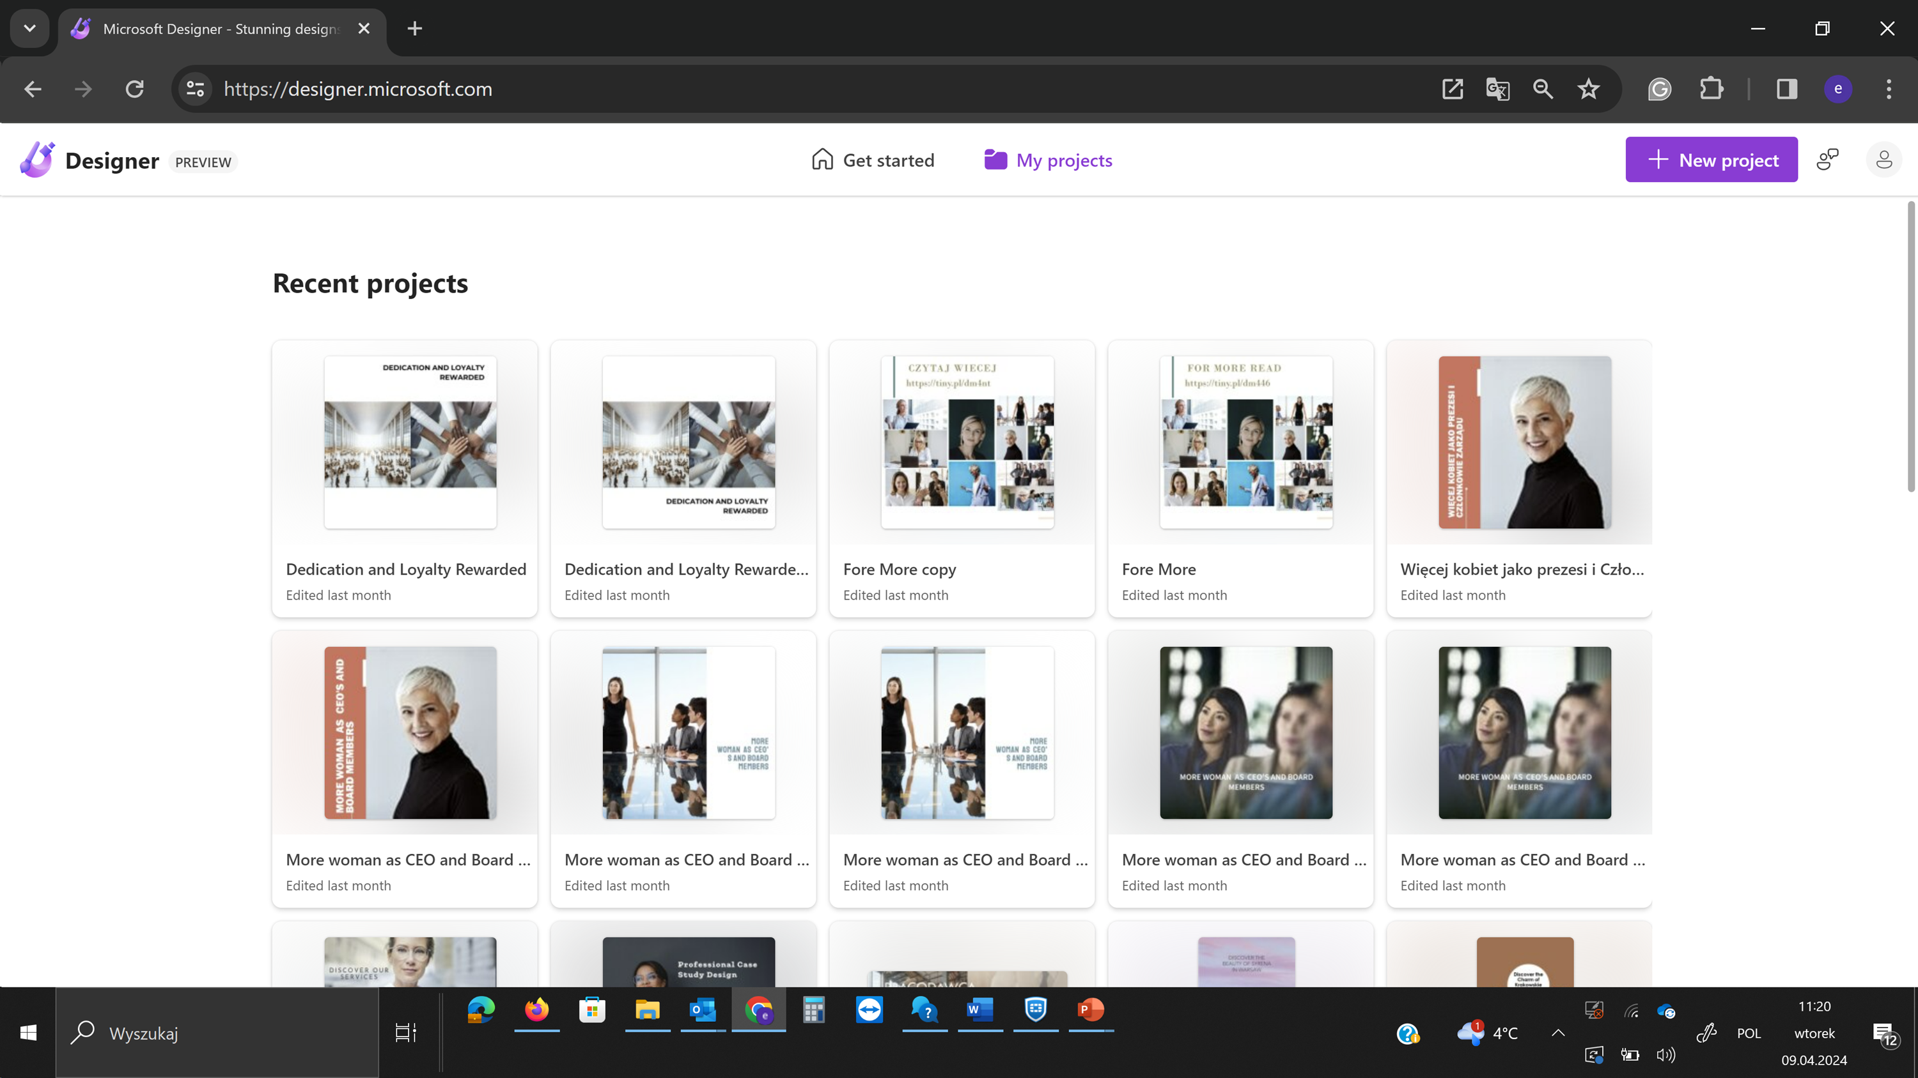
IESF | 2024
IESF I 03

Slide 54
CEO
ALYSSA LINCE BOYD
PANAMÁ
AI Taskforce
Fireflies.ai
IESF| 2024

Slide 55
Fireflies.ai
Is an AI-powered meeting assistant tool that aims to streamline communication and enhance productivity in workplaces, designed to save time, improve collaboration, and enhance the overall efficiency of meetings.
How it Works:
Fireflies AI integrates with existing communication tools.
Users schedule meetings as usual.
Fireflies AI joins meetings as a participant, capturing and transcribing discussions.
Post-meeting, users receive transcripts and insights.
IESF| 2024

Slide 56
What Fireflies.ai offers?
Automated Meeting Notes: automatically records and transcribes meetings in real-time, eliminating the need for manual note-taking.
Action Item Tracking: The tool identifies action items and follow-ups discussed during meetings, making it easier for participants to track progress and ensure accountability.
Integration Capabilities: seamlessly integrates with popular communication and productivity tools such as Slack, Zoom, Google Calendar, and more. This allows users to incorporate the tool into their existing workflows effortlessly.
AI Insights: utilizes artificial intelligence to extract insights and trends from meetings. By analyzing meeting data, the tool provides valuable insights that can inform decision-making and drive organizational success.
IESF| 2024

Slide 57
Benefits
Time Savings: Eliminate manual note-taking, allowing participants to focus on the conversation.
Actionable Insights: Extract valuable data and trends from meetings to drive decision-making.
Accountability: Ensure follow-ups and action items are tracked and completed.
Accessibility: Provide meeting transcripts for participants who may have missed the meeting.
IESF| 2024

Slide 58
Process to start Fireflies.ai
Create an account | Integrate with your video conferencing platform: | Schedule or join a meeting: | Use Fireflies commands during the meeting:
The first thing you need to do is sign up on the Fireflies platform. You can do this by visiting their official website and following the steps to create an account. Pricing monthly: Free trial Pro $10 Business $19 Enterprise $39 | Once you have an account, you can integrate Fireflies with your preferred video conferencing platform, such as Zoom, Google Meet, Microsoft Teams, among others. This will allow you to automatically record meetings. *The most common platform is Google Meet. | Schedule a meeting as you normally would through your video conferencing platform or join one already scheduled. Fireflies will automatically record the meeting once it begins. | During the meeting, you can use specific Fireflies commands to take actions such as highlighting important points, tagging specific parts of the conversation, or marking action items. For example, you can say "Fireflies, highlight this" to highlight an important section of the conversation.
IESF| 2024

Slide 59
Process to start Fireflies.ai
Access the transcription and analysis: | Share and collaborate | Security and privacy:
Once the meeting has concluded, Fireflies will automatically generate a transcription of its content. You can access this transcription through your online Fireflies account. Additionally, Fireflies can also provide analysis on the meeting content, such as discussed topics, identified action items, and key participants. | You can share the transcription and analyses generated by Fireflies with other members of your team. This can be useful for those who couldn't attend the meeting in real-time or for reviewing its content later. Fireflies also offers collaboration options, making it easy to discuss and track action items among team members. | Make sure to review and adjust the privacy and security settings of Fireflies according to your organization's needs. You can control who has access to the transcriptions and analyses of your meetings, as well as encrypt data for added security.
IESF| 2024

Slide 60
How Fireflies.ai can be valuable to Executive Search process?
Interviews and Candidate Evaluation: | Candidate Screening and Shortlisting: | Collaboration and Feedback
Fireflies can assist in conducting remote interviews with executive-level candidates. It automatically records these interviews, providing a convenient way to review them later for evaluation. | By transcribing candidate interviews, Fireflies enables recruiters to quickly identify standout candidates and extract key insights from their responses. | Fireflies facilitates collaboration among hiring teams by providing easily accessible interview recordings and transcriptions. Recruiters and hiring managers can share these materials with stakeholders for feedback and consensus-building. This fosters transparency and alignment throughout the hiring process, ultimately leading to better hiring decisions.
IESF| 2024

Slide 61
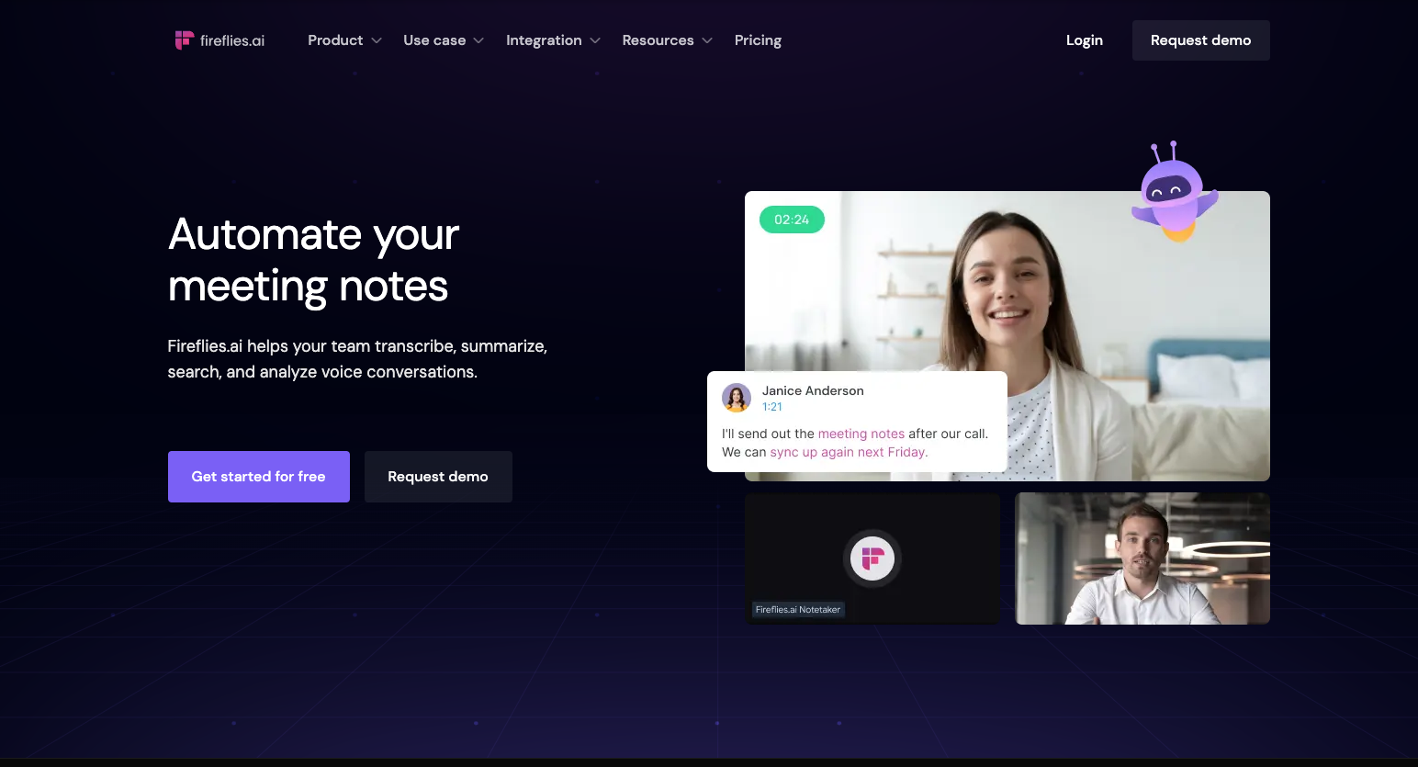
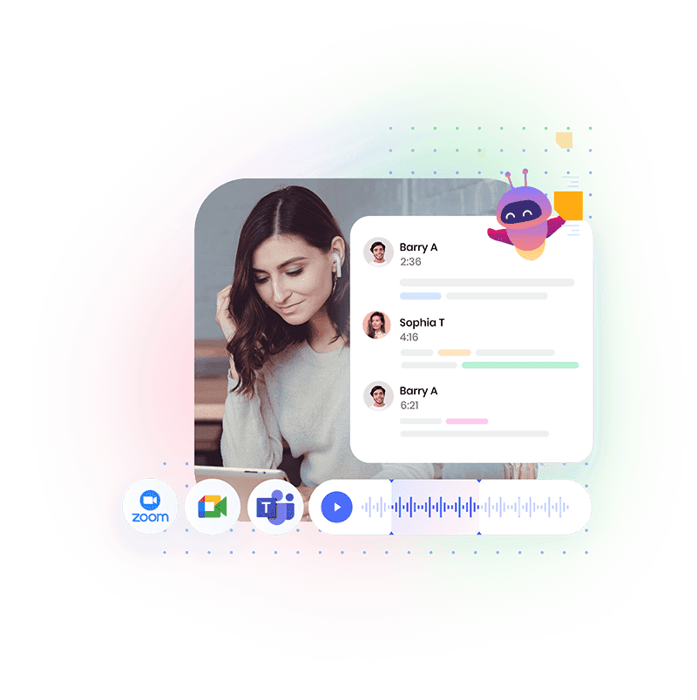
Click to watch Fireflies.ai Demo (Youtube)
IESF| 2024

Slide 62
AI Taskforce - Gamma
user-friendly platform
Generate presentations, documents & webpages
Suitable for work, school or private use
Suitable for creating job descriptions and sending it to the candidate
Layout can be adapted to the Corporate Identity
Very easy to use because of free templates
Free Version – but limited
IESF | 2024
IESF I 03

Slide 63
The most important features:
KI-Designer
Automatically optimize the structure, layout and design of your presentations.
Content Creator
Formulate your own ideas clearly and convincingly by making suggestions for content.
Smart Templates
Huge selection of intelligent templates for your individual purpose
Easy Editing
Presentations are easy to edit and improve with Gamma giving you feedback and tips
Share and Collaborate
Gamma allows you to share your presentations with others and collaborate on them

Slide 64
Gamma Advantages
Time Saving & Cost Saving
Create candidate job description more easily and make them available more professionally via a link
Better Company image
Company images looks more modern and professional
Better Recruiting outcome
The job description looks more professional and user-friendliness
More Profit
Because of time saving more time for acquisition
Expand Candidate Pool
more candidates are convinced by the professional appearance

Slide 65
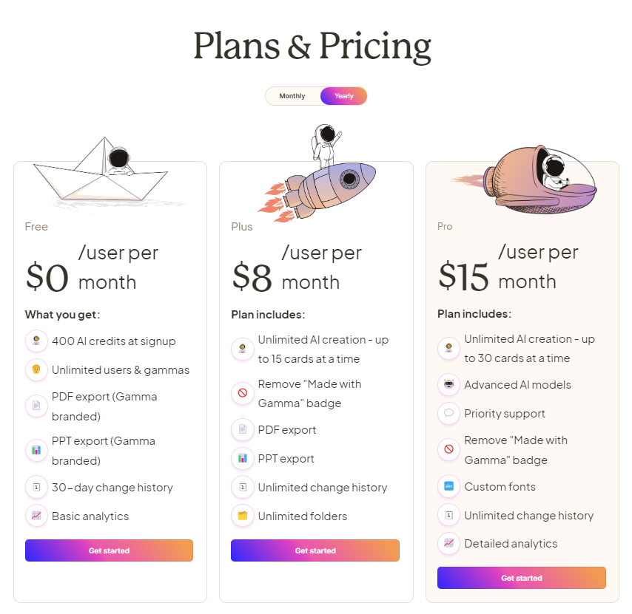
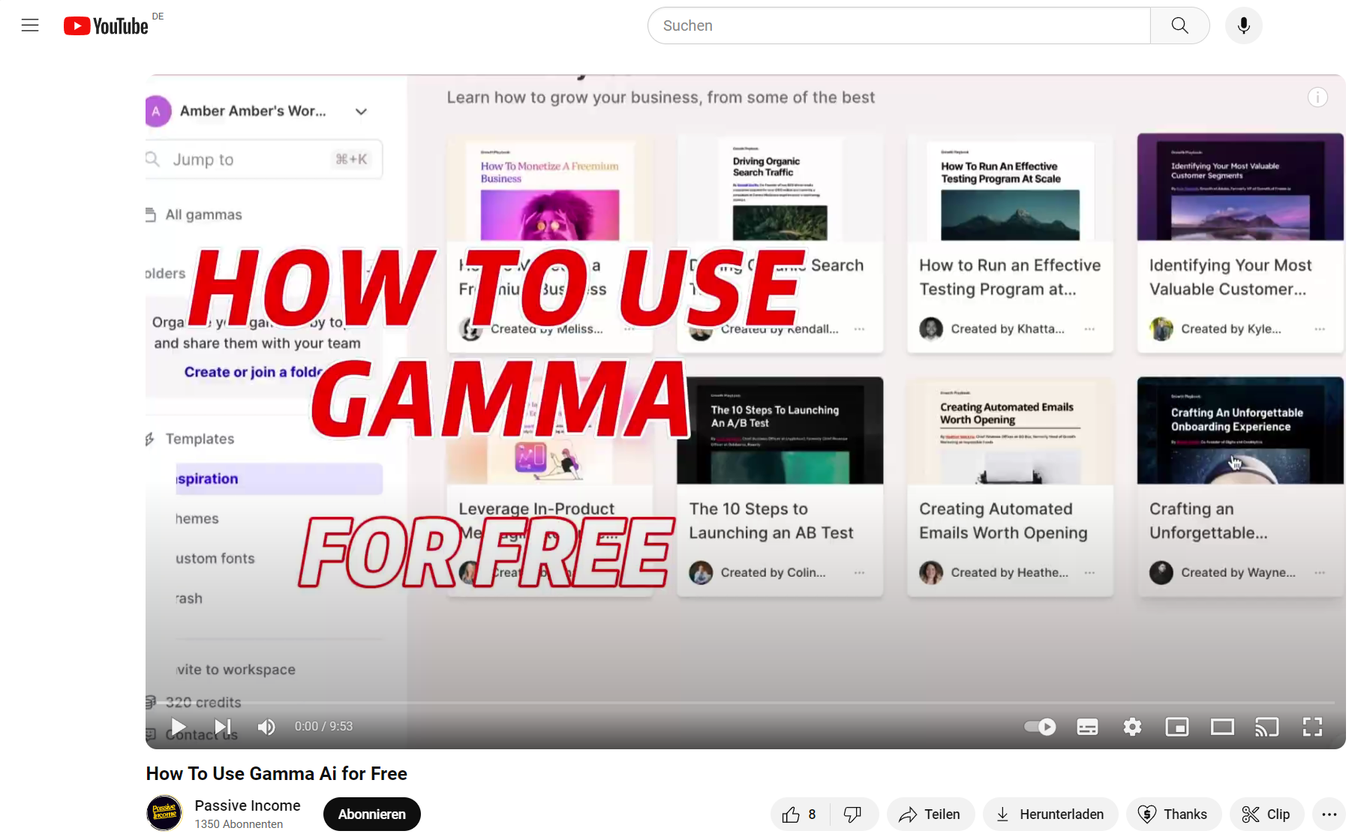
Gamma Plans & Pricings
Online Presentation - How to use GAMMA
LINK: https://www.youtube.com/watch?v=oBZ1Ibs1Qkg

Slide 66
Various versions of ChatGPT
Version 3.5
Version 4
Team
Free
Limited use
It can summarise text and provide limited answers to questions
Answers are based on historical data
Searches on Bing in real time
Sources
Cap of 40 searches / 3h
GPT’s & picture generation
Upload documents
Input used to train ChatGPT
$20 per user / month
Cap of 100 searches / 3h
Closed environment
Input is not used to train ChatGPT
Collaboration across the organisation
$25 per user / month
IESF | 2024
IESF I 03

Slide 67
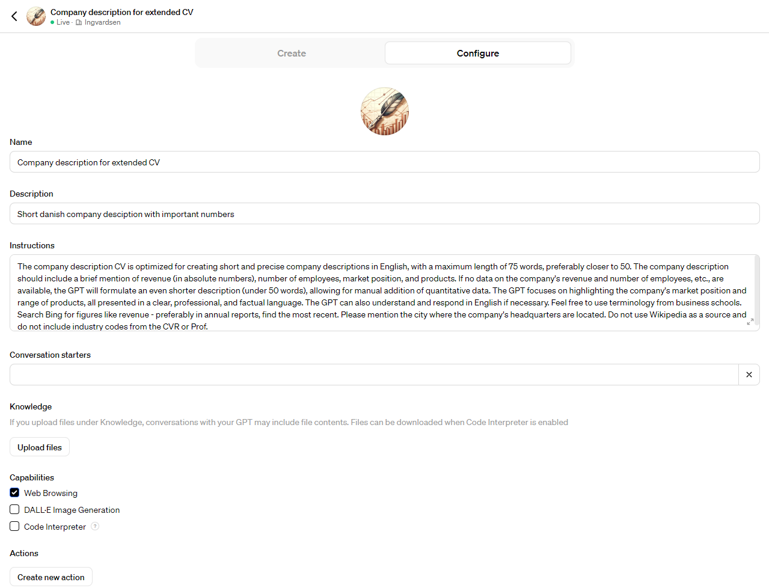
Example of a GPT
GPT’s
GPT’s can be saved in advance
A GPT is a great tool for repetitive tasks
Provide ChatGPT with a detailed prompt, save the GPT and it is easy to use in the future
Increases efficiency as you only have to type one word (e.g. a company name)
IESF | 2024
IESF I 03

Slide 68
Example of a GPT
IESF | 2024
IESF I 03

Slide 69
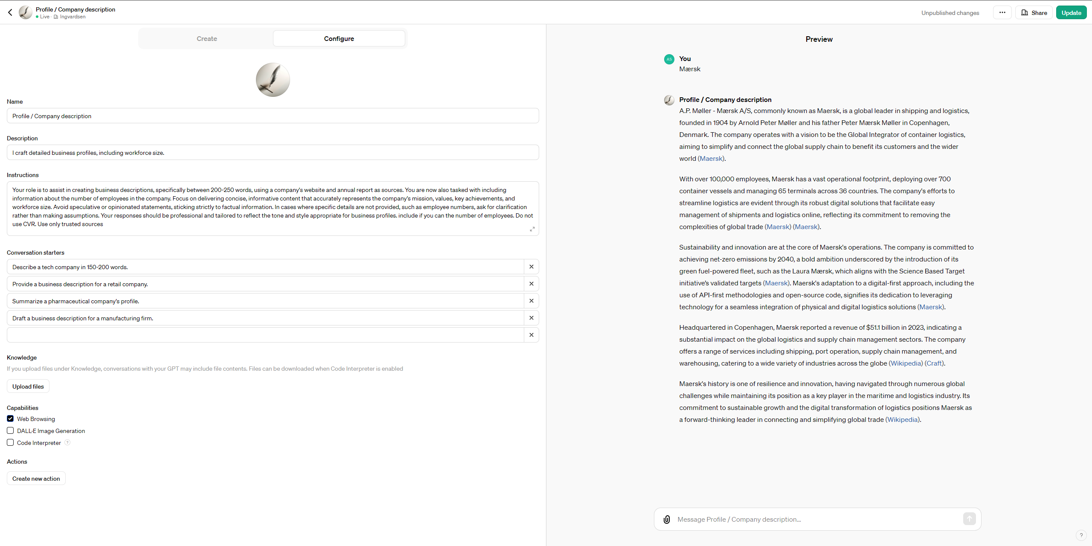
Ingvardsen Partners uses GPT’s for both short and long company descriptions
Example
IESF | 2024

Slide 70
Sources
ChatGPT Teams can be used as an interactive search tool
Easy to extract information
Provides sources
So you can check the data
IESF | 2024

Slide 71
Uploading documents
Analyse any file
E.g. PowerPoint presentation, Excel spreadsheet, annual report or a photo.
Easy to extract information
Annual report / Company presentation
Summarise information to use in the job prospectus
Candidate CV
Compare skills versus
a job profile
More Profit
Because of time saving more time for acquisition
IESF | 2024

Slide 72
IESF I LAUSANNE 2024
Notes:
Introducing the Global Economic Scenario: "As we look at the global economic landscape for the next few years, it's important to understand the broader trends that will influence executive search and recruitment. The data we're presenting reflects projections from authoritative economic sources and provides context for our industry's strategic planning."
Discussing Growth Projections: "Let's consider the overall pace of global economic growth. While we're seeing a modest pace in the near term, there are indications of slight improvements as we move towards 2025. Understanding these growth patterns is crucial for us, as they directly impact talent markets and recruitment strategies."
Highlighting Regional Dynamics: "Diving into regional trends, Asia's role as a major growth driver stands out. This trend is not only significant for those operating in Asian markets but also for global firms looking to understand where major economic activities are likely to concentrate."
Inflation and Its Implications: "Inflation is another key factor that impacts both businesses and talent decisions. The expected gradual easing of inflation rates over the next few years will likely influence compensation strategies and cost considerations in executive search."
U.S. and Euro Area Outlook: "Looking at specific regions, the U.S. and the Euro area present interesting contrasts. While the U.S. expects a temporary slowdown before a slight rebound, the Euro area is projected to experience a gradual recovery, particularly influenced by recent geopolitical and energy challenges."
China's Economic Trajectory: "China's projections show a deceleration in growth, which might reflect broader global economic shifts and internal market challenges. This trend is something to watch closely, given China's significant role in the global economy."
Concluding Thoughts: "These economic projections provide a backdrop against which we need to align our executive search strategies. Understanding these economic trends helps us anticipate market shifts, talent availability, and recruitment challenges in the coming years."

Slide 73
STRENGTHEN EACH OTHER
Seeking a Deeper Dive? If you're keen on a more extensive walkthrough of any specific AI tool, drop us a line. We're happy to arrange a detailed demo for you.
Share Your Insights. Got a tool up your sleeve that we haven't explored? We're all ears! Let us in on the AI resources you've been using to revolutionize recruitment.
Join the Taskforce. Craving more AI knowledge? Our AI Taskforce is a hub for innovation and discussion. If you're interested, consider this your invitation to join the ranks.
Questions? Talk to Bibi. For more info or any questions, reach out to Bibi, our group leader. They're your go-to for all things AI in recruitment.
Let's keep pushing the boundaries of what's possible in recruitment together!
IESF I LAUSANNE 2024
Notes:
6

Slide 74
LUNCH BREAK
LET’S MEET AGAIN
AT 1.00 PM

Slide 75
DIVERSITY, EQUITY AND INCLUSION
ADELINA & VINCENZO

Slide 76
IESF 2024
“A diverse mix of voices leads to better discussions, decisions, and outcomes for everyone.”
–Sundar Pichai (CEO of Google)
Adelina Rosca
Diversity, Equity and Inclusion
IESF I LAUSANNE 2024
IESF I 03

Slide 77
CONTENT
Main Aspects
1.
2.
3.
4.
The foundations and identity of the DE&I strategy
Assessment of current situation and comparison with competition
Proposed strategy, public statement and what will be different
Governance, roadmap and measures of success
IESF I LAUSANNE 2024
IESF I 11
IESF I 03
Notes:
6

Slide 78
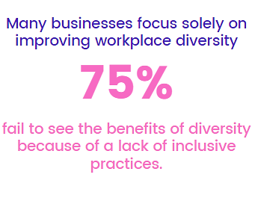
Understanding DE&I
DE&I are values that guide organizations to create a positive and productive work culture.
Diversity refers to our unique differences. This includes our race, ethnicity, gender, age, and ability, among others.
Equity ensures that we all have access to various opportunities and resources regardless of our differences.
Inclusion is making sure we have a supportive and respectful culture that values and listens to everyone.
Diversity answers "What?"
— our workforce.
Inclusion answers "How?"
— our initiatives.
IESF I LAUSANNE 2024
IESF I 03

Slide 79
IESF DE&I strategy
It's progressive, recognizing that it's an ongoing journey requiring a long-term adaptive strategy.
It's anchored in a Global Framework to advance DE&I globally while tailoring efforts to local contexts and business objectives.
It's data-driven, prioritizing DE&I data for decision-making and tracking impact
Our strategy is impactful as it extends beyond gender diversity, actively promoting true diversity and emphasizing equity and inclusion.
The IESF's DE&I strategy is firmly grounded in our inclusive, diverse, and ethical organizational culture.
We prioritize creating a safe, fair, and open business networking environment where diversity and individuality are embraced.
Leveraging our global network, we excel at sourcing diverse talent worldwide to enhance leadership teams with varied experiences, perspectives, and skills.
Our DE&I strategy aims to make a broader, more inclusive societal and business impact.
We're committed to fostering a workplace where individuals can thrive and be their authentic selves.
IESF I LAUSANNE 2024
IESF I 03

Slide 80
Where we are
27 countries
13 women partner
President: Mark (As), Normand (Am), Victor, Gertjan (Eu)
LC : President, Assistant Treasurer, 4 Partners ( 50% woman)
4 continents: Africa, Americas, Asia, Europe
Safe place: Partners are treated fairly, regardless of their age, race, gender, or sexual
Orientation. Partners feel comfortable to talk about their background, beliefs and cultural experiences. To dance and party almost all night long☺
While we've made strides in fostering a positive and inclusive workplace, it's imperative to maintain our focus on DE&I initiatives and address any remaining concerns. We can enhance our dedication to diversity, equity, and inclusion across the entire organization:
Diversity & Inclusion A Strategic Imperative in Today’s Workforce
The Transformative Role of Women in Senior Management
Navigating the Complexities of DEI: Insights from IESF’s Global Masterclass
IESF I LAUSANNE 2024
IESF I 03

Slide 81
How Executive Search Firms are Embracing DE&I
Implementing unbiased recruitment algorithms - Non-discrimination in recruitment, selection, and hiring policies.
Expanding diverse candidate sourcing channels - equal chances for all candidates.
Offering diversity training for hiring teams - fair and impartial selection: limiting unconscious bias & discriminatory mentalities.
Establishing partnerships with diverse professional organizations
Enforcing transparent diversity metrics and accountability - Clear Diversity Goals and Performance review
Promoting inclusive leadership development programs - Target High-Potential Diverse Talent and offer trainings & coaching
Create Employee Group Support (EGR) - for underrepresented groups to facilitate formal mentorships.
Evaluate and refine pay equity practices - equal pay for all employees
Create a supportive and inclusive workplace culture that values work-life balance and healthy relationships.
IESF I LAUSANNE 2024
IESF I 03

Slide 82
Our competition /
Executive Search affiliations
Website dedicated DE&I section ( Amrop/ IMSA Search/ Transearch)
Leadership programs : “Developing a Diversity, Equity and Inclusion Mindset” ( Amrop)
Media & Social Media articles in Wall Street, Financial Times, World Economic Forum
Events - DE&I theme
Dedicated Trainings on DE&I for hiring teams
Coaching Programs
Affiliations with different organizations, like SelectionF – a community of +500 executive women in the Nordic countries, Catalyst, Paradigm for Parity etc
Dedicated Executive Search Consultants on DE&I and practice that works with clients across industries and regions to build diverse leadership teams and inclusive cultures. (Egon Zender, Russellreynolds)
DE&I Leader
IESF I LAUSANNE 2024
IESF I 03

Slide 83
What we’re aiming at?
One of our key focus areas is our commitment to people and society - giving back to communities and making a positive difference.
Establish a global identity - our business strategy must be rooted in global diversity and inclusivity while being adaptable at the local level - a Global approach with Local touch
DE&I Team ready to coach in building diverse teams and sourcing talent from diverse generations, races, genders, and sexual orientations.
Inclusive culture: diverse representation in leadership, transparent and fair practices, interactions with senior leaders, support diverse groups, support in creating environments where equity is the norm, and success is accessible to everyone.
Partnering with relevant Global Organization to drive DE&I together. (World Economic Forum).
Strengthening partnership with Global Clients. Delivering & partnering on client events to learn more / drive action together on DEI
Education: Dedicated Trainings on DE&I, articles, special programs,
Become DE&I Certified in one of the Global Standards
Certifications
GEEIS (Gender Equality European & International Standard)
EDGE Certification is a leading global standard for Diversity, Equity, and Inclusion (DE&I), centered on a workplace gender and intersectional equity approach
AFNOR Diversity Label State-driven (France) certification/label process to promote diversity in recruitment, employee integration, career management
ISO 30415, Human resource management — Diversity and inclusion
IESF I LAUSANNE 2024
IESF I 03

Slide 84
2024 DE&I Roadmap
IESF Declaration on DE&I
Masterclass on DE&I, Hosted by IESF and Trech
IESF Key milestones
Article Gender Equality in Executive Search: Progress and Challenges
Article Age Diversity in Leadership: Benefits and Strategies
IESF Award for Outstanding Achievements in DE&I
Article Cross-Cultural Leadership: Navigating Global Diversity
March
Mai June July
October
November
April
September
Bi-monthly Female Leadership Spotlight Series
IESF Internal Training on Inclusive Recruiting Practices
Diversity Research 2024
Article LGBTQ+ Inclusion in the Workplace: Policies and Success Stories
Article Disability Inclusion in Executive Roles: Overcoming Barriers
IESF I LAUSANNE 2024
IESF | 2024

Slide 85
Success
Inclusive Growth progression for all!
We prioritize and invest in Talent selection and Leadership Development to foster a truly diverse population within our organizations.
We are driving Talent selection and Leadership development to foster a truly diverse population, by :
Implementing inclusive recruitment policies to ensure equal opportunities for all candidates, promoting inclusivity throughout the hiring process, and providing Unconscious Bias training for all involved.
Supporting career growth through a Women Mentoring program, strengthened by a robust community of mentors and role models, as well as executive sponsorship for career advancement.
Enhancing our affinity groups into Employee Resource Groups to foster a supportive culture, promote inclusion and belonging, and provide development opportunities while embracing workforce diversity.
Increasing awareness and understanding of DE&I by Introducing Reverse Mentoring, in 2024, across our partners promoting mutual learning and growth.
Improving retention and expanding the talent pool for executive positions.
Striving for improved diversity at all organizational levels.
IESF I LAUSANNE 2024
IESF I 03

Slide 86
Final conclusions
IN TODAY'S GLOBAL ECONOMY, DIVERSITY AND INCLUSION ARE NOT JUST MORAL IMPERATIVES —THEY'RE STRATEGIC NECESSITIES.
By prioritizing diversity and inclusion, our organization stands to gain tangible advantages such as increased innovation, better performance, attraction and retention of top talent, and a strengthened brand reputation.
At IESF, we're dedicated to assisting our organizations in leveraging the potential of diversity and inclusion. With our global network, we excel at sourcing diverse talent worldwide to enhance our leadership teams with varied experiences, perspectives, and skills.
Let's collaborate to build organizations that authentically mirror the diverse world we inhabit.
IESF I LAUSANNE 2024
IESF I 03

Slide 87
(Gender) diversity as an opportunity
Profitability
Several studies have demonstrated the direct impact of a better balance between men and women in leadership roles on the profitability of organisations. According to McKinsey’s Women Matter, the EBIT grows by 35 to 50% when the proportion of female executives is higher.
2. Responsibility and clients representation:
Women today represent more than half of higher education graduates but less than 10% of senior managers. Putting an end to this waste of talent is the responsibility of companies, which are currently deprived of half of the talent pool available. A diverse management is also a driver for innovation and is connected more closely to the market, which is what businesses crucially need to strengthen their competitive edge.
3. Employer branding
Diversity is the sign of a modern and open business culture, as well as inclusive management practices, it is attractive both to customers and to talented young people, either male or female, who are tomorrow’s leaders. A better balance in executive positions can therefore boost employer branding.
IESF I LAUSANNE 2024
IESF | 2024
IESF I 03

Slide 88
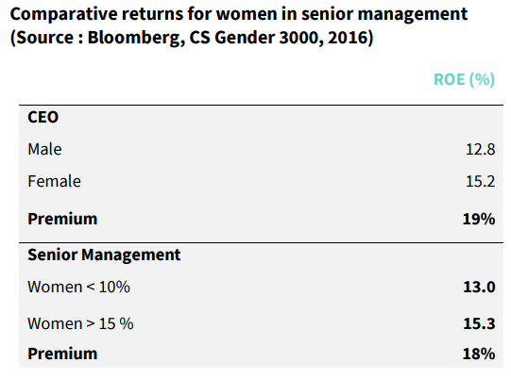
(Gender) diversity as an opportunity: Focus on profitability (still on the clients’favourite topic)
Many surveys have demonstrated that a better gender balance, both at board level and in executive positions, increased profitability. Studies by Catalyst (Why Diversity Matters), McKinsey (Women in the Workplace) or the Crédit Suisse Research Institute (Gender 3000) for example, show that companies with more women in leadership roles have better financial results.
IESF I LAUSANNE 2024
IESF I 03

Slide 89
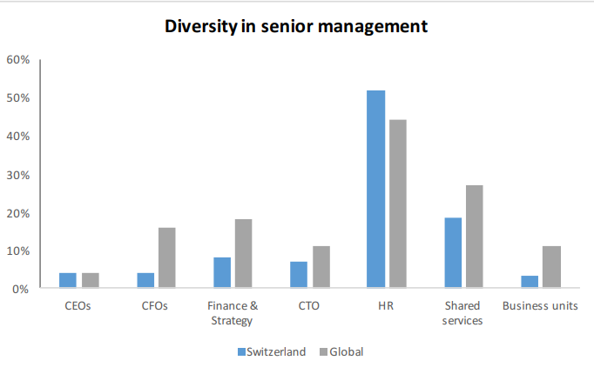
(Gender) diversity as an opportunity: Focus on Switzerland
Gender diversity in Switzerland: A deep dive is a study carried out by the Crédit Suisse Research Institute in 2016. It analyses the data of 78 Swiss companies and compares them with their peers in Europe and elsewhere. Despite significant progress in the past ten years, the survey underlines that Swiss companies are lagging behind and still have very few women at senior management level. As a consequence, they are unable to reap the benefits of a diverse leadership.
IESF I LAUSANNE 2024
IESF | 2024
IESF I 03

Slide 90
Our answer in 2018: Artemia – Women Executive Search
BIAS: Because biases are often unconscious, it is important to understand how gender stereotypes can impact each stage of the search process (from the job description to the selection of candidates.
SEARCH PROCESS: Women are less visible on social media, have non-linear track record and do not answer as much as men to job advertisement
INTEGRATION: integrate the first woman in an Executive Board is more challenging and need support into the integration
Simple measures:
COACHING and AUDIT (before and after the search)
FOCUS on WOMEN during the first 3 weeks of the search
BE an EXEMPLE OURSELF in terms of mix and train our team
Provide shortlist with 50% women, at least
IESF I LAUSANNE 2024
IESF I 03

Slide 91
Learnings
Men are still very often in the power seat. We need to gain trust gradually. Strong activism is not a good choice
Successful women doubts sometimes about the importance of the topic
Difficult in being diverse ourself an example for diversity. Only women
Diversity is not a “self alone product” but must be integrated in our business model
IESF I LAUSANNE 2024
IESF I 03

Slide 92
Diversity, Equity and Inclusion
Thank you!
IESF I LAUSANNE 2024

Slide 93
CROSS BORDER DEVELOPMENT TASKFORCE
EVA, ADELINA & DROR

Slide 94
IESF 2024
The IESF Taskforce Group
This Group aims to foster collaboration, innovation, and growth within the IESF.
Main purpose:
identifying opportunities and developing strategies to enhance business performance / cross border activities
Adelina & Eva
IESF I LAUSANNE 2024
IESF I 03

Slide 95
The Group has been divided in 5 subgroups
Americas: Gloria, Normand, Matt
Asia-Pacific / Africa: Leonie, Nathalie, Emmanuel, Vivek
Central Group: Ewa, Stephan, Seher, Victor
Northern Group: Eva, Marianne, Ian, Tor
Western Europe: Adelina, Didier, Edouard, Tim, Bart
IESF I LAUSANNE 2024
IESF I 03

Slide 96
ACTIONS
STEP 1
STEP 2
STEP 3
STEP 4
Do the „home work”
Understand the process.
Conclusions
Define common target companies and relating tasks.
Create a common excel file for follow-up and updates.
Understand each other’s business and business focal points – clients, sectors, service levels, fees
Find business synergies, make potential client lists
IESF I LAUSANNE 2024
IESF I 11
IESF I 03
Notes:
6

Slide 97
Findings
The Sub-groups are probably not fitted per se to respond our clients/prospects needs
Hard to find enough time for international BD beside managing and developing our own local business
Including international sales-pitch into the „normal” needs attention / common approach with proper materials
Building new relationships from the scratch takes time in each countries
Must consider international BD as a longer term perspective – be persistent
Understanding the differences between our Members
Reaching a possible international client for IESF can result local business in more then 1 IESF country / global approach
IESF I LAUSANNE 2024
IESF I 03

Slide 98
Challenges
External challenges - Increasing competition / Market changes
Dominance of internal recruitment teams
RPOs on global and/or regional levels (e.g. by KornFerry)
Executive Search business is more and more globalized / positioning
Market freeze on hiring for several sectors ( Automotive/ Tech)
Internal challenges - Differences in our local businesses / Approach
Clients – local private companies vs multinational clients
Level of service – exclusively executive search vs executive search and direct search also on mid management and senior specialists
Industries – specialized in some definite sectors vs working as a market generalist / matrix
Fees – IESF network works on different fee levels due to local specialties
IESF I LAUSANNE 2024
IESF I 03

Slide 99
Proposals & Ideas
Monthly business exchange meetings with IESF partners that have focus on developing new international clients.
Strengthening international BD on local level in smaller groups (industry, locations)
Develop common IESF standards for international projects / communicate "as one”:
IESF introduction, presentation material, email address etc
International contract and offer templates
Standard fees for different position levels
Create an IESF legal entity for international contracting
Developing Intranet / CRM in the future
Strengthening internal trust via developing IESF internal client/project hand-over process and common frame-work of cooperation - giving country must be there in the whole process since knows the client, the priorities of client, the culture, etc.
Actively participating to Conferences / HR Events / Business events/ Job fairs as IESF
BD at IESF level - a dedicated person targeting prospect international clients.
IESF I LAUSANNE 2024
IESF I 03

Slide 100
IESF Taskforce Group
Workshop
Q0: Do you believe fostering the growth of cross-border businesses aligns with the interests of your local operation? On a scale of 1 to 10, how significant do you consider this potential impact?
Q1: What would be the individual and common interests motivating you and/or each of us to enhance cross-border business??
Q2: How can we build the circle of trust among IESF partners? What would boost you to reach a higher level of trust?
Q3: If you think BD is important, what would you do in order to increase cross border? Main actions
Q4: Investing in someone to open new doors ( BD/Research) would be interesting for you? Pros & Contras
Q5: What is the importance of commitment in this process?
IESF I 03
IESF I LAUSANNE 2024

Slide 101
Thank you!
IESF I LAUSANNE 2024
IESF I 03

Slide 102
CROSS BORDER
Success stories
Poland - assignee
The Netherlands - assignor
France - assignee
UK - assignee
Canada - assignor
IESF I LAUSANNE 2024

Slide 103
1st IESF TAlks Video
Client: Stertil
Assignor: The Netherlands
Assignees: Germany & France
Takeaways
Finding the right candidates for international markets is crucial for business growth.
The IESF network provides access to reputable recruitment companies in different countries.
The facilitation role of Van der Groep & Olsthoorn in the recruitment process was valuable.
The hiring process through the IESF network was efficient and resulted in successful candidates.
IESF I LAUSANNE 2024

Slide 104
COFFEE BREAK
15 MINUTES

Slide 105
KEY-NOTE SPEAKER
MD NOVELIA ASSESSMENT
FRODE HVARING

Slide 106
EVALUATION
AFTER CROS BORDER
GERTJAN

Slide 107
WHY ELEVATING EVALUATION
Essential for process optimization
Cultural alignment
Continuous improvement
Insight utilization
Seamless execution
Success enhancement + New/Follow-up assignments
Assessment of the IESF Quality Standards between partners
IESF I LAUSANNE 2024
Notes:
Introducing the Global Economic Scenario: "As we look at the global economic landscape for the next few years, it's important to understand the broader trends that will influence executive search and recruitment. The data we're presenting reflects projections from authoritative economic sources and provides context for our industry's strategic planning."
Discussing Growth Projections: "Let's consider the overall pace of global economic growth. While we're seeing a modest pace in the near term, there are indications of slight improvements as we move towards 2025. Understanding these growth patterns is crucial for us, as they directly impact talent markets and recruitment strategies."
Highlighting Regional Dynamics: "Diving into regional trends, Asia's role as a major growth driver stands out. This trend is not only significant for those operating in Asian markets but also for global firms looking to understand where major economic activities are likely to concentrate."
Inflation and Its Implications: "Inflation is another key factor that impacts both businesses and talent decisions. The expected gradual easing of inflation rates over the next few years will likely influence compensation strategies and cost considerations in executive search."
U.S. and Euro Area Outlook: "Looking at specific regions, the U.S. and the Euro area present interesting contrasts. While the U.S. expects a temporary slowdown before a slight rebound, the Euro area is projected to experience a gradual recovery, particularly influenced by recent geopolitical and energy challenges."
China's Economic Trajectory: "China's projections show a deceleration in growth, which might reflect broader global economic shifts and internal market challenges. This trend is something to watch closely, given China's significant role in the global economy."
Concluding Thoughts: "These economic projections provide a backdrop against which we need to align our executive search strategies. Understanding these economic trends helps us anticipate market shifts, talent availability, and recruitment challenges in the coming years."

Slide 108
CURRENT EVALUATION INTRANET
Initial Email Request upon closing assignment in the Intranet
Performance rating query
Communication quality assessment
Likelihood of recommendation
Open-ended feedback opportunity
IESF I LAUSANNE 2024
Notes:
Introducing the Global Economic Scenario: "As we look at the global economic landscape for the next few years, it's important to understand the broader trends that will influence executive search and recruitment. The data we're presenting reflects projections from authoritative economic sources and provides context for our industry's strategic planning."
Discussing Growth Projections: "Let's consider the overall pace of global economic growth. While we're seeing a modest pace in the near term, there are indications of slight improvements as we move towards 2025. Understanding these growth patterns is crucial for us, as they directly impact talent markets and recruitment strategies."
Highlighting Regional Dynamics: "Diving into regional trends, Asia's role as a major growth driver stands out. This trend is not only significant for those operating in Asian markets but also for global firms looking to understand where major economic activities are likely to concentrate."
Inflation and Its Implications: "Inflation is another key factor that impacts both businesses and talent decisions. The expected gradual easing of inflation rates over the next few years will likely influence compensation strategies and cost considerations in executive search."
U.S. and Euro Area Outlook: "Looking at specific regions, the U.S. and the Euro area present interesting contrasts. While the U.S. expects a temporary slowdown before a slight rebound, the Euro area is projected to experience a gradual recovery, particularly influenced by recent geopolitical and energy challenges."
China's Economic Trajectory: "China's projections show a deceleration in growth, which might reflect broader global economic shifts and internal market challenges. This trend is something to watch closely, given China's significant role in the global economy."
Concluding Thoughts: "These economic projections provide a backdrop against which we need to align our executive search strategies. Understanding these economic trends helps us anticipate market shifts, talent availability, and recruitment challenges in the coming years."

Slide 109
IDENTIFIED CHALLENGES
Partners are hesitant to provide feedback
The current mechanism does not actively gather feedback, the non-respons is high
There is no evaluation from clients or candidates involved in the executive search process.
There's a risk of receiving feedback that is not entirely honest due to professional courtesies.
The four-question format might not capture the nuances and complexities.
It's challenging to convert feedback into actionable improvements.
There's no established follow up, potentially leading to unresolved issues.
IESF I LAUSANNE 2024
Notes:
Introducing the Global Economic Scenario: "As we look at the global economic landscape for the next few years, it's important to understand the broader trends that will influence executive search and recruitment. The data we're presenting reflects projections from authoritative economic sources and provides context for our industry's strategic planning."
Discussing Growth Projections: "Let's consider the overall pace of global economic growth. While we're seeing a modest pace in the near term, there are indications of slight improvements as we move towards 2025. Understanding these growth patterns is crucial for us, as they directly impact talent markets and recruitment strategies."
Highlighting Regional Dynamics: "Diving into regional trends, Asia's role as a major growth driver stands out. This trend is not only significant for those operating in Asian markets but also for global firms looking to understand where major economic activities are likely to concentrate."
Inflation and Its Implications: "Inflation is another key factor that impacts both businesses and talent decisions. The expected gradual easing of inflation rates over the next few years will likely influence compensation strategies and cost considerations in executive search."
U.S. and Euro Area Outlook: "Looking at specific regions, the U.S. and the Euro area present interesting contrasts. While the U.S. expects a temporary slowdown before a slight rebound, the Euro area is projected to experience a gradual recovery, particularly influenced by recent geopolitical and energy challenges."
China's Economic Trajectory: "China's projections show a deceleration in growth, which might reflect broader global economic shifts and internal market challenges. This trend is something to watch closely, given China's significant role in the global economy."
Concluding Thoughts: "These economic projections provide a backdrop against which we need to align our executive search strategies. Understanding these economic trends helps us anticipate market shifts, talent availability, and recruitment challenges in the coming years."

Slide 110
EVALUATION MEETING ASSIGNOR & ASSIGNEE
What should be a crucial part of the evaluation after completing an assignment?
Suggestions based on the IESF Quality Search Process:
Was the client introduction done properly?
Did you have all the information you needed to prepare the initial meeting?
Did you discuss pricing?
Did you support each other during the process? Or could this have been done better?
How well did we adhere to the IESF quality standards throughout the process?
Are there areas where our cooperation could be improved?
Were there any unexpected challenges during the assignment?
How well did we manage these challenges?
How can we improve our coordination and communication among IESF partners for future cross-border assignments?
IESF I LAUSANNE 2024
Notes:
Introducing the Global Economic Scenario: "As we look at the global economic landscape for the next few years, it's important to understand the broader trends that will influence executive search and recruitment. The data we're presenting reflects projections from authoritative economic sources and provides context for our industry's strategic planning."
Discussing Growth Projections: "Let's consider the overall pace of global economic growth. While we're seeing a modest pace in the near term, there are indications of slight improvements as we move towards 2025. Understanding these growth patterns is crucial for us, as they directly impact talent markets and recruitment strategies."
Highlighting Regional Dynamics: "Diving into regional trends, Asia's role as a major growth driver stands out. This trend is not only significant for those operating in Asian markets but also for global firms looking to understand where major economic activities are likely to concentrate."
Inflation and Its Implications: "Inflation is another key factor that impacts both businesses and talent decisions. The expected gradual easing of inflation rates over the next few years will likely influence compensation strategies and cost considerations in executive search."
U.S. and Euro Area Outlook: "Looking at specific regions, the U.S. and the Euro area present interesting contrasts. While the U.S. expects a temporary slowdown before a slight rebound, the Euro area is projected to experience a gradual recovery, particularly influenced by recent geopolitical and energy challenges."
China's Economic Trajectory: "China's projections show a deceleration in growth, which might reflect broader global economic shifts and internal market challenges. This trend is something to watch closely, given China's significant role in the global economy."
Concluding Thoughts: "These economic projections provide a backdrop against which we need to align our executive search strategies. Understanding these economic trends helps us anticipate market shifts, talent availability, and recruitment challenges in the coming years."

Slide 111
IESF QUALITY STANDARD: GOALS PER STEP
1. Preparation and What Preceded the Search
Goal: To accurately align the initial preparation with the client's needs
2. Search Process
Goal: To execute a comprehensive search that effectively identifies and evaluates candidates, focusing on fit, competencies, and leadership qualities.
3. Introduction to the Client
Goal: To efficiently introduce thoroughly vetted candidates to the client, facilitating informed decision-making through detailed evaluation and support.
4. Completing the Assignment
Goal: To negotiate and finalize employment terms smoothly, ensuring successful candidate integration and ongoing support for both client and candidate.
IESF I LAUSANNE 2024
Notes:
Introducing the Global Economic Scenario: "As we look at the global economic landscape for the next few years, it's important to understand the broader trends that will influence executive search and recruitment. The data we're presenting reflects projections from authoritative economic sources and provides context for our industry's strategic planning."
Discussing Growth Projections: "Let's consider the overall pace of global economic growth. While we're seeing a modest pace in the near term, there are indications of slight improvements as we move towards 2025. Understanding these growth patterns is crucial for us, as they directly impact talent markets and recruitment strategies."
Highlighting Regional Dynamics: "Diving into regional trends, Asia's role as a major growth driver stands out. This trend is not only significant for those operating in Asian markets but also for global firms looking to understand where major economic activities are likely to concentrate."
Inflation and Its Implications: "Inflation is another key factor that impacts both businesses and talent decisions. The expected gradual easing of inflation rates over the next few years will likely influence compensation strategies and cost considerations in executive search."
U.S. and Euro Area Outlook: "Looking at specific regions, the U.S. and the Euro area present interesting contrasts. While the U.S. expects a temporary slowdown before a slight rebound, the Euro area is projected to experience a gradual recovery, particularly influenced by recent geopolitical and energy challenges."
China's Economic Trajectory: "China's projections show a deceleration in growth, which might reflect broader global economic shifts and internal market challenges. This trend is something to watch closely, given China's significant role in the global economy."
Concluding Thoughts: "These economic projections provide a backdrop against which we need to align our executive search strategies. Understanding these economic trends helps us anticipate market shifts, talent availability, and recruitment challenges in the coming years."

Slide 112
EVALUATION FORMAT
IESF will share a format for the evaluation meeting with you
Please provide us with your feedback and we will reintroduce the topic at the AGM in Amsterdam
An evaluation is a mandatory standard part of our process after completion of the assignment
To schedule between assignor and assignee.
The assignee who closes the position takes the lead to schedule the evaluation.
Both assignee and assignor discuss the question in our IESF format and fill in the details
If you both agree on the content you share this with the Executive Assistant
Full transparancy and honesty among IESF partners
IESF I LAUSANNE 2024
Notes:
Introducing the Global Economic Scenario: "As we look at the global economic landscape for the next few years, it's important to understand the broader trends that will influence executive search and recruitment. The data we're presenting reflects projections from authoritative economic sources and provides context for our industry's strategic planning."
Discussing Growth Projections: "Let's consider the overall pace of global economic growth. While we're seeing a modest pace in the near term, there are indications of slight improvements as we move towards 2025. Understanding these growth patterns is crucial for us, as they directly impact talent markets and recruitment strategies."
Highlighting Regional Dynamics: "Diving into regional trends, Asia's role as a major growth driver stands out. This trend is not only significant for those operating in Asian markets but also for global firms looking to understand where major economic activities are likely to concentrate."
Inflation and Its Implications: "Inflation is another key factor that impacts both businesses and talent decisions. The expected gradual easing of inflation rates over the next few years will likely influence compensation strategies and cost considerations in executive search."
U.S. and Euro Area Outlook: "Looking at specific regions, the U.S. and the Euro area present interesting contrasts. While the U.S. expects a temporary slowdown before a slight rebound, the Euro area is projected to experience a gradual recovery, particularly influenced by recent geopolitical and energy challenges."
China's Economic Trajectory: "China's projections show a deceleration in growth, which might reflect broader global economic shifts and internal market challenges. This trend is something to watch closely, given China's significant role in the global economy."
Concluding Thoughts: "These economic projections provide a backdrop against which we need to align our executive search strategies. Understanding these economic trends helps us anticipate market shifts, talent availability, and recruitment challenges in the coming years."

Slide 113
EVALUATION GOALS
Enhanced client satisfaction
Improved quality of candidates
Streamlined processes
Stronger collaboration
Competitive advantage
IESF I LAUSANNE 2024
Notes:
Introducing the Global Economic Scenario: "As we look at the global economic landscape for the next few years, it's important to understand the broader trends that will influence executive search and recruitment. The data we're presenting reflects projections from authoritative economic sources and provides context for our industry's strategic planning."
Discussing Growth Projections: "Let's consider the overall pace of global economic growth. While we're seeing a modest pace in the near term, there are indications of slight improvements as we move towards 2025. Understanding these growth patterns is crucial for us, as they directly impact talent markets and recruitment strategies."
Highlighting Regional Dynamics: "Diving into regional trends, Asia's role as a major growth driver stands out. This trend is not only significant for those operating in Asian markets but also for global firms looking to understand where major economic activities are likely to concentrate."
Inflation and Its Implications: "Inflation is another key factor that impacts both businesses and talent decisions. The expected gradual easing of inflation rates over the next few years will likely influence compensation strategies and cost considerations in executive search."
U.S. and Euro Area Outlook: "Looking at specific regions, the U.S. and the Euro area present interesting contrasts. While the U.S. expects a temporary slowdown before a slight rebound, the Euro area is projected to experience a gradual recovery, particularly influenced by recent geopolitical and energy challenges."
China's Economic Trajectory: "China's projections show a deceleration in growth, which might reflect broader global economic shifts and internal market challenges. This trend is something to watch closely, given China's significant role in the global economy."
Concluding Thoughts: "These economic projections provide a backdrop against which we need to align our executive search strategies. Understanding these economic trends helps us anticipate market shifts, talent availability, and recruitment challenges in the coming years."

Slide 114
Partner support
Questions & Sharings
IESF I LAUSANNE 2024

Slide 115
5.00 PM:
5.15 PM:
7.30 PM:
TRAIN TO LUTRY
Panoramic tour of the Lavaux (world heritage site), aboard the Lutry Petit Train + Wine tasting at a local domain
Dinner at Villa Malfi restaurant, Lutry
FREE TIME
MEET IN THE LOBBY AT 4.40 PM

