Slide 1
IESF Corporate Presentation 2024
SUCCESSFULLY
DELIVERING LOCAL
EXECUTIVE TALENT
THROUGH A
GLOBAL NETWORK
Notes:
1

Slide 2
WHO WE ARE
The world’s most recognized international executive search association. Identifying talent and leadership in 50 offices and 26 countries.
We are globally known as “The Local Experts” because we understand regional markets and their specific needs when it comes to retained executive recruitment.
IESF I 02
Notes:
2

Slide 3
PRESIDENT
Gertjan van de Groep
NETHERLANDS
Navigating today's challenging business world involves attracting and retaining top-level leaders.
The introduction of these new leaders is crucial; it shapes market narratives, strengthens consumer trust, and revitalizes teams and the workforce.
When our clients choose an executive search partner, it's not just a decision but a fundamental strategy that will resonate in the future of their company.
That's why companies must consider what truly distinguishes a competent executive search firm—one with deep industry knowledge, local insights, up-to-date technological tools, and an understanding of candidates' evolving expectations.
This is what our clients expect from us, and what IESF seeks in each of its partners within this global network. Thus, we are at the forefront of executive search and leadership consulting, known for our global and local knowledge.
Partnering with firms that embody this professional rigor in executive search means making a choice, committing to excellence, and promising a prosperous corporate future.
IESF I 03
Notes:
3

Slide 4
ABOUT US
20+
50+
250+
250+
26
Years
Offices
Consultants
Successful Cross borders
Countries
TOP 40 WORLDWIDE BY HUNT SCALON
The most prestigious global association of executive search firms.
IESF I 04
IESF I 03
Notes:
4

Slide 5
LEADERSHIP & TALENT SERVICES
MANUFACTURING
LIFE SCIENCES
RENEWABLE ENERGY & SUSTAINABILITY
RETAIL & FMCG
BANKING & FINANCIAL
IT, MEDIA & COMMUNICATIONS
LOGISTICS & TRANSPORT
APPAREL & LUXURY
PROFESSIONAL SERVICES & GOVERNMENT
OIL, GAS & CHEMICALS
AUTOMOTIVE
LEGAL
AGRIBUSINESS
CONSTRUCTION
IESF 2024
PRESENCE IN 4 CONTINENTS
AND 15 SECTOR PRACTICES
IESF I 05
IESF I 03

Slide 6
GLOBAL NETWORK
AND LOCAL INSIGHTS
IESF was founded in 2002 by partners in Asia and Europe with a clear vision of growing a Global Group, unhidered by corporate restrictions and rigidity and as an answer to our clients’ growing needs.
OUR PARTNERS FIRMS
Business owners and representatives of local independent firms.
Only retained Search. Some with complementary services such as coaching & leadership development.
Activity across several industries and functions, with focus on C-suite & Top Executives and Management.
Every partner is exclusive for their country.
Partners meet each other at the Annual Global Meeting (AGM) in September and the Regional meeting in April each year.
AGM SINGAPORE 2023
IESF I 06
IESF I 03
Notes:
6

Slide 7
Executive Positions Filled
AN OVERVIEW OF THE CROSS BORDERS RECENTLY CONCLUDED AMONG THE PARTNERS COUNTRIES
POSITION | SECTOR PRACTICE | CROSSBORDER
General Plant Director | AGRIBUSINESS | Poland - Netherlands
Sales Representative | MANUFACTURING | USA - United Kingdom
Managing Director | AGRIBUSINESS | Poland - Germany
Country Manager | MANUFACTURING | Romania . Netherlands
Director of Finances | IT, MEDIA & COMMUNICATIONS | India - USA
Senior Corporate Manager | BANKING & FINANCIAL | India - Israel
VP Middle Market | BANKING & FINANCIAL | Spain - Romania
IESF I 07
IESF I 03

Slide 8
CROSS BORDER
ASSIGNMENTS
& AWARD WINNERS
IESF’ financial report overshows an increase in the number of cross border assignments the last three years, worldwide.
Not only the number of active and completed assignments grew. Also, the level of management and director assignments and revenue.
THE CROSS BORDER AWARD
Every year at the AGM we hand out two awards: one for the most successful partner assigning projects to the network over
the past year. And the other one for the most successful partner working on projects assigned to him/her.
IESF 2024
IESF I 03

Slide 9
Success stories
& CLIENT TESTIMONIES
“The expertise demonstrated in our CEO search was exceptional. The industry insights, combined with the extensive network, led to the identification of the perfect candidate. His outstanding credentials and alignment with our objectives solidified him as the perfect choice for the role. We eagerly anticipate the growth journey under his leadership.”
Alexander van der Lof, Chairman and CEO of TKH Group.
““The choice for the final candidate ultimately was a combination of their experience and market knowledge but not least importantly, their motivation and interest to join Morningstar and support our mission to empower investors’ success through our range of products and solutions. A great example of agile teamwork between our HR team and the support of executive search partners of IESF.”
Roxana Brahesteanu, Director Talent Acquisition EMEA at Morningstar
Case Studies
AGM SINGAPORE 2023
IESF 2024
IESF I 03

Slide 10
IESF'S COMMITMENT TO EXCELLENCE
A QUALITY SEARCH PROCESS
IESF announces the establishment of a unified global quality search process. This ensures a harmonized approach to executive search worldwide, setting new standards for service delivery and operational efficiency.
1
PREPARATION AND INITIAL CONSULTATION
2
Search
Process
3
INTRODUCTION TO
THE CLIENT
4
Completion of the Assignment
Reach Agreement
Comprehensive understanding of client needs
Market Research
Position specification document and compensation package
Job Description
Extensive research and local sourcing methodologies
Identify and evaluate potential candidates
Reference and backgrounds check
Short List
Evaluation report
Brief and prepare client/candidate
Interview
Monitor the process
Facilitate Negotiation
Maintain regular contact
Identify concerns or challenges
Evaluate
IESF I 11
IESF I 03
Notes:
6

Slide 11
IESF'S COMMITMENT TO EXCELLENCE
OUR VALUES & STANDARDS
What should our clients expect when working with an IESF Partner?
GLOBAL
AGILE
A fully customized, local approach to search projects, based on culture, regional economics and the local candidate marketplace.
Every candidate receives a personal confirmation of various stage of the process.
Facilitate negotiation.
Identify concerns and challenges.
Evaluate and monitor the process.
RELIABLE
Clear agreement.
Respect confidential information entrusted by clients and candidates.
Comprehensive understanding of client expectations.
Avoid conflicts of interest with clients and candidates.
PROXIMITY
Brief and prepare client/candidate
Professional reference and backgrounds check.
After the interview, follow up conversation with both, candidate and client.
Ensure integration of the candidate and address potential concerns.
ENTREPRENEURIAL
Customized search strategy and approach.
Contact passive and active candidates.
Extensive research with local sourcing methodologies.
IESF 2024
IESF I 03
Notes:
6

Slide 12
LEADERSHIP COUNCIL
2024
The Leadership Council was set up considering cultures and regions to be globally representative of opinions and normally comprises:
The President, plus representatives for:
Asia Pac
Eastern Europe
Western Europe
North America
Central and South America
Treasurer
AMERICAS
Claudia Montedónico
CHILE
TREASURER
Stephan Löw
GERMANY
ASIAPAC
Emmanuel White
SINGAPORE
The role of the Leadership Council is:
Advise President on Long term Strategy
Development and interpretation of Partner Charter
Resolve Partner Disputes
Resolve Partner Performance Issues
EMEA
Adelina Rosca
ROMANIA
EMEA
Dror Katabi
ISRAEL
PRESIDENT
Gertjan van de Groep
NETHERLANDS
IESF 2024

Slide 13
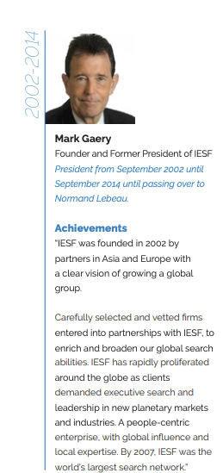
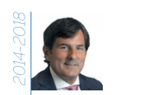
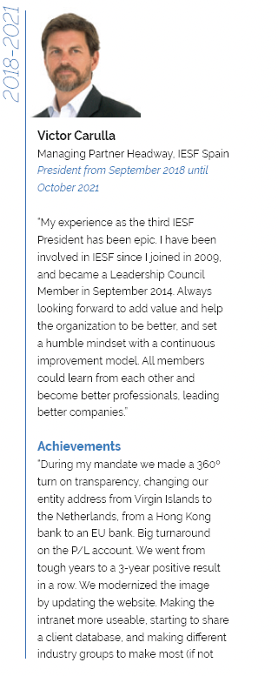
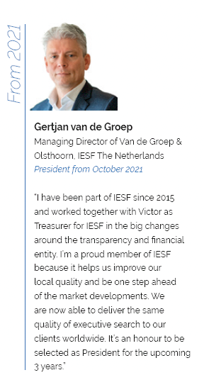
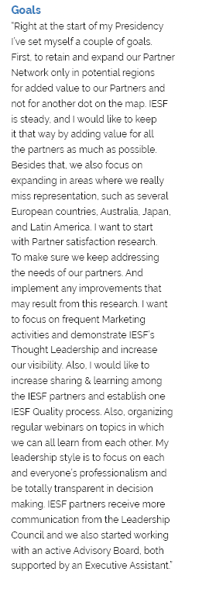
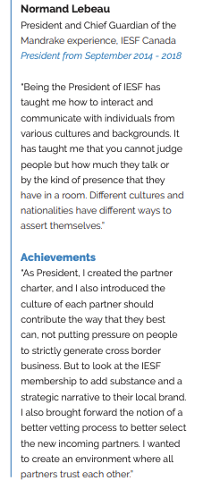
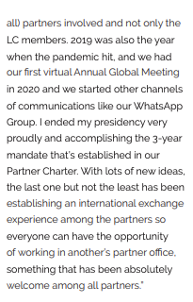
Former Presidents
Leadership through the years
At IESF the role of President rotates. As President you lead the network. Supported by a International Executive Assistant and advised by the Leadership Council, representing all parts of the world. This overview shows our leadership through the years.
IESF 2024

Slide 14
PARTNER BENEFITS
IESF partnership provides access to a wide array of benefits, business contacts, market data, resources and insights to help you succeed in today's competitive and rapidly evolving market.
GLOBAL PRESENCE
WITH QUALITY
SEARCH STANDARDS
SHARE KNOWLEDGE, BEST PRACTICES & CULTURAL COLLABORATION
BRANDING & EXPANSION OF MARKETING REACH
Work on cross border assignments with your IESF partners. Serve clients globally through an international network.
As trusted business partners, we share knowledge about best practices: industry trends, new technologies, processes, and tools.
Opportunity to reach new audiences, expanding the reach of social media, digital recruiting, and marketing campaigns
Global Network of Contacts
Extensive experience in business across different countries, continents, and cultures
Annual General Meeting (AGM)
Regional European Meeting
Webinars with Clients
Online Talks with experts
Industry Practice Groups
Specialized Publications: LinkedIn post, blog, Whitepapers
Collaborations and Sponsorships
Data and Research
IESF 2024
IESF I 03
Notes:
4

Slide 15
REQUIREMENTS
FOR NEW PARTNERS
IESF is constantly expanding its international network.
Looking for executive search consultants who share our mindset and values.
Partners must be a well established Retained Executive Search firm operating across several industrial sectors, with focus on C-level and Top Executive positions. Members are approved in a company audit based on standards of size, quality, ethical norms and financial solvency.
Become part of our international network and enjoy the diverse benefits of being one of our exclusive partners.
For more information and details visit:
www.iesf.com/join-iesf
IESF I 09
IESF 2024
IESF I 03

Slide 16
OUR OFFICES ABOUT IESF
We’re proud to partner with leading companies providing services to the executive search and leadership consulting profession.
AGM CUSCO 2022
IESF 2024
IESF I 03

Slide 17
Austria
Chile
Denmark
Belgium
China
Canadá
France
India
Mexico
Germany
Israel
Netherlands
Hungary
Italia
Norway
IESF 2024
IESF I 03

Slide 18
Panama
Singapur
Turkey
Perú
Southafrica
Poland
Spain & Portugal
United Kingdom
Romania
Switzerland
USA
IESF 2024
IESF I 03

Slide 19
OuR Partners ABOUT IESF
IESF enjoys global reach, helping international firms in mature markets while helping them forge ahead into emerging markets. Our local search consultants provide top value by finding the right talent to fit your exact needs.
IESF 2024

Slide 20
International Executive Search Federation
+34 93 238 54 86
iesf.com
info@iesf.com

