Slide 1
Annual Meeting - Thursday October 10
SUCCESSFULLY
DELIVERING LOCAL
EXECUTIVE TALENT
THROUGH A
GLOBAL NETWORK
Notes:
1

Slide 2
PLANNING DAY 3
09.00 - 09.45
09.45 - 10.10
10.10 - 10.40
10.40 - 10.55
10.55 - 11.25
11.25 - 11.55
11.55 - 12.15
12.15 - 12.30
12.30 - 12.45
13.30 - 14.30
14.45 - 15.45
15.45 - 16.45
17.00
Marketing, IESF Academy and Leadership Training Trech
Finance
Results IESF Partner Satisfaction Research & Code of Conduct
Coffee Break
Diversity, Equity & Inclusion
Brainstorming Group: New initiatives
IESF Awards 2024
Official voting on new partner(s)
Closing notes (LC rotation) and see you at the next AGM
Lunch at Polly Goudvisch
A’dam LOOKOUT and swing
This is Holland
Free time
IESF I AMSTERDAM 2024
IESF I 03
Notes:
4

Slide 3
MARKETING, IESF ACADEMY AND LEADERSHIP TRAINING TRECH
KIRSTEN

Slide 4
Marketing
&
Academy
Notes:
1

Slide 5
Looking Back at 2024: Rebranding
IESF I 01
IESF I 03
Notes:
4

Slide 6
Looking Back at 2024: New Media
IESF I 02
IESF I 03
Notes:
4

Slide 7
Looking Back at 2024: Client Webinars
IESF I 03
IESF I 03
Notes:
4

Slide 8
Looking Back at 2024: Key Achievements
IESF I 04
IESF I 03
Notes:
4

Slide 9
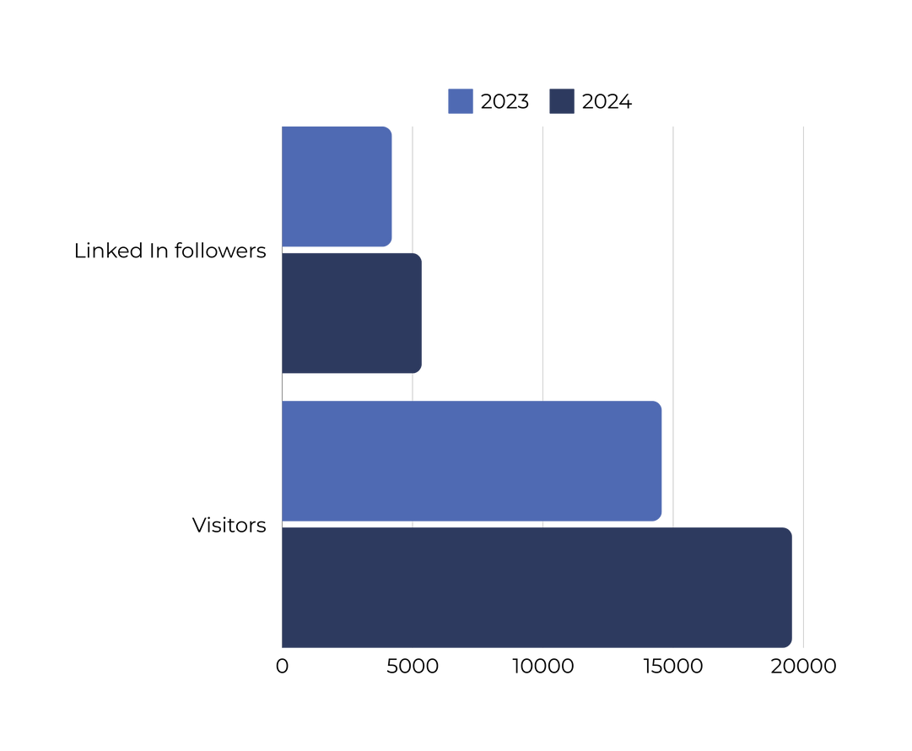
2024 Linked In: Indicators
IESF I 05
Notes:
2

Slide 10
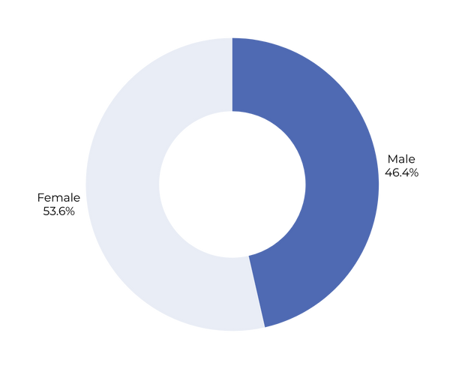
Some Indicators
ENGAGEMENT RATE LINKED IN
FROM 4 TO 5,5
WEBSITE VISITS IESF.COM
WEBSITE VISITS 2024 - 14.000

Slide 11
Global presence iesf.com

Slide 12
IESF Marketing strategy
Frequent postings from various sorts, different content types (videos, whitepapers, case studies)
Continue LinkedIn campaigns: both in (1) partner search and (2) growing our business
Both organic (1) & sponsored (2) – we really need the combination. Keep investing in Google Ads in IESF Partner countries
More diversity in types of content: more video, moving slide shows and infographics
2025
Kick -off with all marketing professionals from our partner firms to strengthen each other.
Explore other (social) media like Instagram & podcasts
Notes:
4

Slide 13
IESF Academy topics 2025
Employer Branding
Leaderhip training Trech
2025
Leading Through Crisis: Lessons from 2024
DE&I Biases in Executive Search
The Future of Leadership: New Competencies for C-suite Executives
Global Market & Talent Trends for 2025
Notes:
4

Slide 14
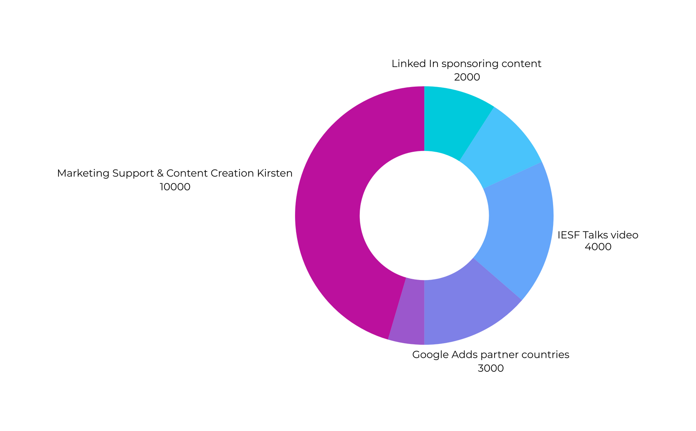
Budget
TOTAL BUDGET, SIMILAR LIKE 2023 = 22 K EUROS

Slide 15
AGILE
GLOBAL
PROXIMITY
Let’s shape
2025 together!
RELIABLE
ENTREPRENEURIAL
How do we focus our activities in 2025?
IESF I 03

Slide 16
Marketing & Academy
Interactive Session: Prioritizing 2025 Activities
Notes:
3

Slide 17
International Executive Search Federation
+34 93 238 54 86
iesf.com
info@iesf.com

Slide 31
FINANCE
IESF 2024/2025
STEPHAN

Slide 32
FINANCE
Report 2024 and Budget 2025

Slide 33
POINTS FOR DISCUSSION
FINANCE
Highlights
Current Assets & Preliminary results
Income and Expenses explained
Budget 2025
Suggested updates & Voting

Slide 34
INSPIRING WORDS
The single most important ingredient in the recipe for success is transparency because transparency builds trust.

Slide 35
Standard principles
4 eyes-principle + 2 eyes Executive Assistant (EA) | Payments processed by Executive Assistant (EA) after approval President & Treasurer | Investments always agreed upon in Leadership Council meetings with all LC members, including President & Treasurer | Small payments within approved budget are done without LC approval

Slide 36
HIGHLIGHTS
Strong current financial position
2024 does not show the expected growth in cross borders we budgetted (yet)
Cross borders are stable, comparable with 2022
Budget 2025 will be in-line with 2024
No changes in membership fee: 3000 USD

Slide 37
REMEMBER SINGAPORE?
EXTRA BUDGET IN 2024
Marketing (10K->12K)
Rebranding IESF (5K)
AGM (20K -> 25K)
Reinvesting in our partners (10K)
CROSS BORDER IN 2024
Increased predicted cross border (20K -> 30K)

Slide 38
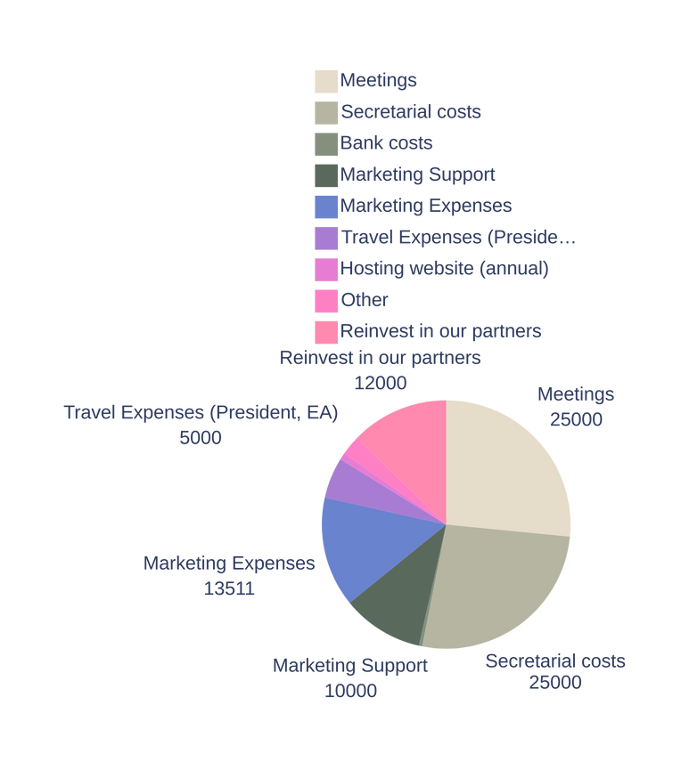
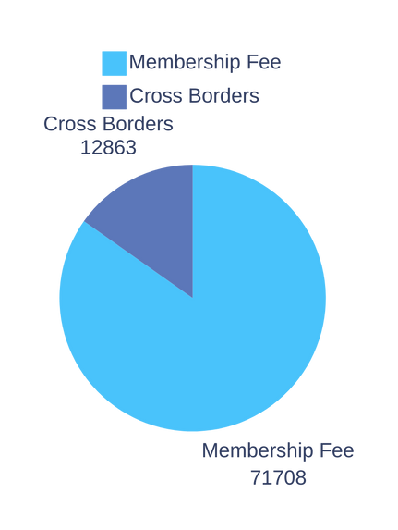
Income
Expenses
PRELIMINARY RESULTS
EXPECTED RESULT 2024
€ 84.571,00
€ 94.161,00
€ -9.590,00

Slide 39
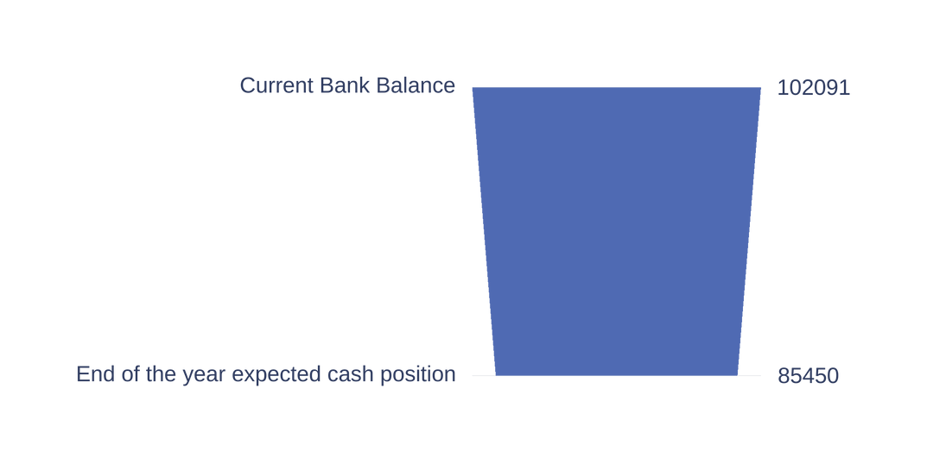
CURRENT ASSETS & PRELIMINARY RESULTS
BANK BALLANCE
€ 102.091,29
END OF YEAR EXPECTED CASH POSITION
€ 85.450,-

Slide 40
INCOME 2024 EXPLAINED
Membership fee: 26 countries x € 2.758,- =
€ 71.708,-
Cross Border Commission: € 12.863
TOTAL INCOME
€ 84.571,-

Slide 41
CROSS BORDER HISTORY
CROSS BORDER COMMISSION
5% rule
1H2024: € 12.863,- -> Cross border turnover: € 257.260,-
IH2023: € 19.847,- 2023 Total: € 35.000
1H2022: € 10.893,- 2022 Total: € 29.706,-

Slide 42
Expenses (travel) Meetings President & EA: € 2.500,-
AGM Costs € 25.000,-
Marketing € 13.511,- Marketing 2024 includes: 1 IESF Talks video, HR Core Lab, Rebranding, Corporate Presentations & Update IESF.com
Secretarial & Administration Allowance € 25.000,-
Marketing Support € 10.000,-
Website hosting (fixed) € 850,-
Other (Trech Academy, celebrations) € 2.400,-
Reinvest in our partners: € 12.000,-
EXPENSES EXPLAINED
EXPENSES
EXPLAINED

Slide 43
DISCHARGE TO THE LEADERSHIP COUNCIL FOR THE FINANCIAL POLICY PURSUED BY THE ASSOCIATION IN 2024.
WE ASK OUR MEMBERS
Over the income and expenses of 2024

Slide 44
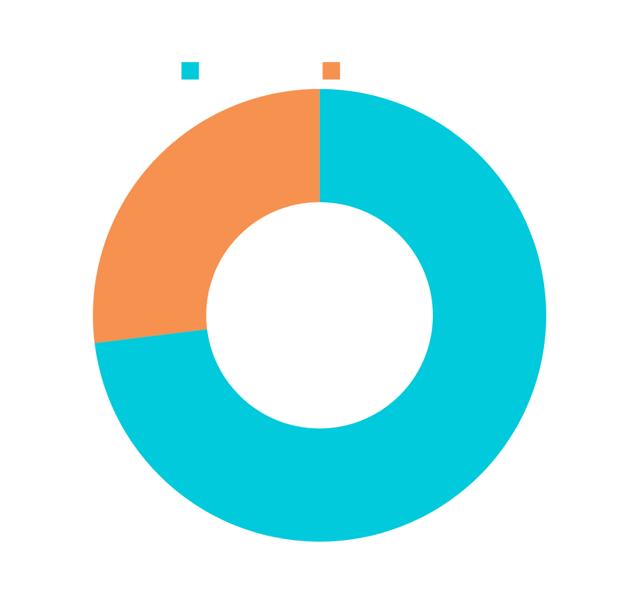
BUDGET 2025 EXPLAINED: INCOME
Membership fee: 25 countries x € 2.710,- =
€ 67.750,-
Cross Border Commission: Estimation based on 2024 = € 25.000,-
TOTAL INCOME
€ 92.750,-

Slide 45
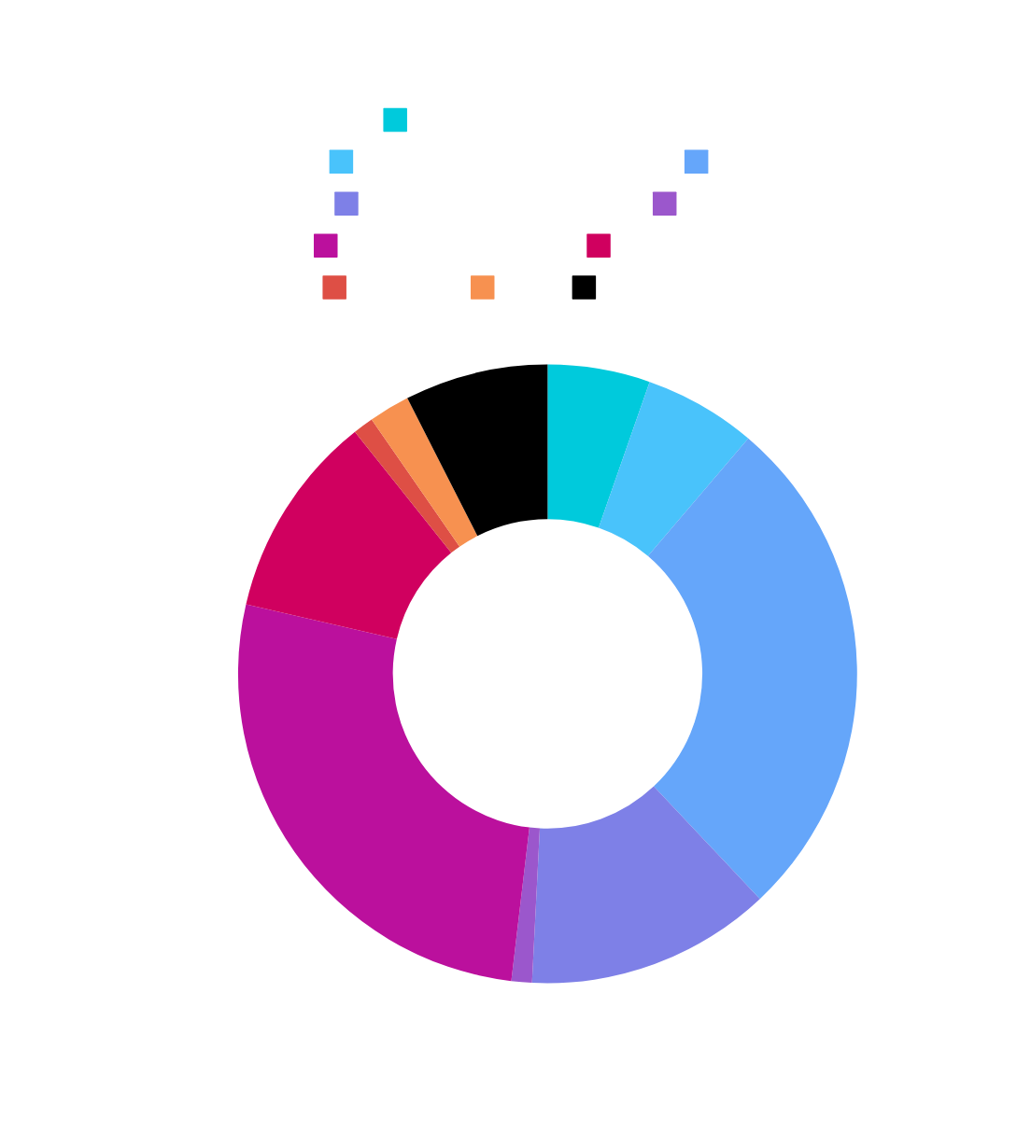
BUDGET 2025 EXPLAINED: EXPENSES
TOTAL EXPENSES
€ 93.500,-
EXPECTED RESULT 2025
- € 750,-

Slide 46
SUGGESTIONS FOR EXTRA BUDGET TO REINVEST IN OUR PARTNERS IN 2025?
Extra budget for Partnership Development Sponsoring 2 extra external Industry events Possible Business Development Project Manager Invite global clients to AGM Other suggestions?

Slide 47
DISCHARGE TO THE LEADERSHIP COUNCIL FOR THE ESTABLISHMENT OF 2025 BUDGET BY THE ASSOCIATION.
WE ASK OUR MEMBERS
For the suggested income and expenses in 2025

Slide 48
International transactions
Executive Search project is closed (completed, cancelled, 1/3 or other) Assignee (partner where the search was done) invoices the client | Once received payment by the client: Informs IESF to invoice the cross border commission of 5% in EUR. (July / December) | Once received payment by the client: 2. Informs the assignor to invoice the cross border fee in their local currency. For example 20% of the received amount in USD, or GBP or EUR. | We agreed - as IESF partners - we SPLIT the transaction/bank costs for international transfers between partners. Make sure you address this right in making the transaction.

Slide 49
TREASURER: STEPHAN LOW
THANK YOU
For all you questions, suggestions and concerns.

Slide 50
IESF Partner Satisfaction
Survey 2024
Key Insights
and Opportunities
Gertjan & Kirsten
Notes:
1

Slide 51
Introduction
Overview of the 2024 IESF Partner Satisfaction Survey.
Goals: Measure partner satisfaction, identify areas for improvement, and celebrate successes.
Focus: Long-term engagement and professional development and learnings.
Notes:
2

Slide 52
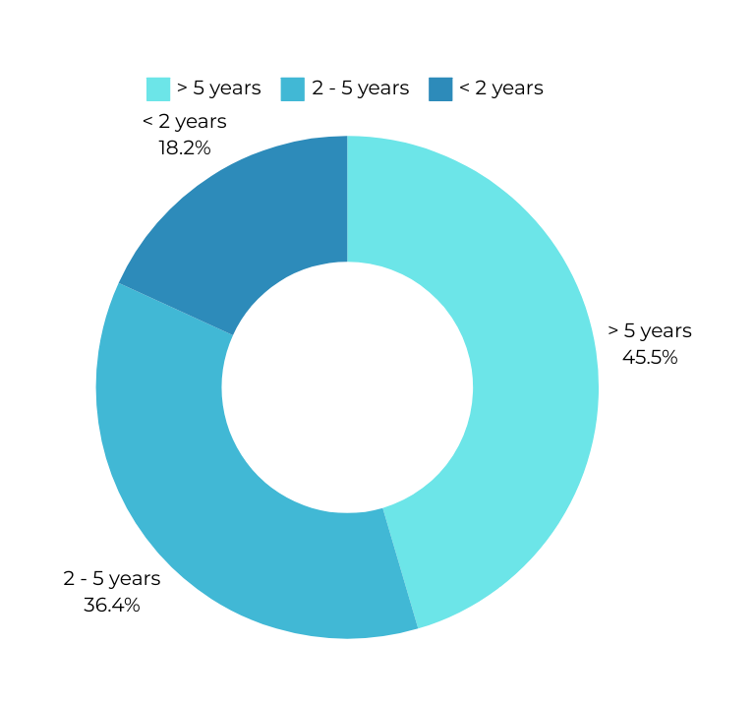
How long are the members part of IESF?
INDICates a need for continued engagement across all partners
CONTINUOUS FOCUS ON PARTNERSHIP DEVELOPMENT & REPLACEMENT
Notes:
3

Slide 53
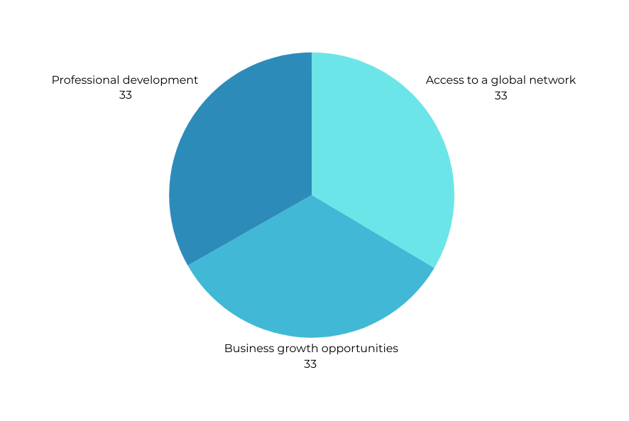
KEY REASONS FOR
BECOMING A PARTNER
AGM SINGAPORE 2023
IESF I 03
Notes:
6

Slide 54
Digital presence and support
POSITIVE ASPECTS
DIGITAL PLATFORMS
IMPROVEMENTS
Many partners, particularly long-term members, see IESF as making effective strides in digital transformation. The adoption of digital tools like AI and new technologies is recognized as a positive aspect of the organization.
Several partners, especially newer ones, have expressed neutral or mixed satisfaction with the digital platforms (intranet, website). This suggests that IESF can improve the user experience, accessibility, and functionality of its digital tools to make them more intuitive and useful, particularly for new partners.
Offer onboarding or training for new partners on how to best use the digital platforms.
Regular updates or enhancements to ensure platforms stay user-friendly and effective.
IESF I 03
Notes:
4

Slide 55
PROFESSIONAL DEVELOPMENT
OPPORTUNITIES
Professional development is highly valued by long-term partners.
Newer partners show mixed responses, suggesting the need for tailored development programs.
IESF can enhance learning resources for different tenure stages:
Develop different tracks (e.g., "New Partner Track," "Experienced Partner Track") to provide relevant content based on tenure.
Emphasize mentorship programs where long-term partners can share their experiences and knowledge with newer members.
Increase access to webinars, masterclasses, and industry-specific case studies to cater to partners at all stages of their careers.
IESF I 03

Slide 56
Networking Event Satisfaction
In-Person Events
Long-term partners rate AGMs highly.
Newer partners express more neutral responses.
Online Events
Mid-term partners show the most satisfaction, but newer partners are positive and indicate a learning curve.
AGM SINGAPORE 2023
IESF I 03

Slide 57
LEADERSHIP SUPPORT
Long-term partners value the IESF Leadership Council's support.
Newer and mid-term partners show more neutral or mixed opinions.
Mentoring and clearer communication channels can enhance leadership support for all partners:
Emphasize the Mentorship Program for New and Mid-Term Partners
Increase the frequency of leadership updates, such as bi-monthly Q&A sessions, newsletters, or direct outreach.
Create clearer channels for feedback and concerns, ensuring partners know how to engage with the leadership team.
IESF I 03

Slide 58
SUGGESTIONS FOR IMPROVEMENT
1
DIGITAL PLATFORMS
2
Leadership
Engagement
3
Professional
Development
4
Partnership
Development
Enhance usability and onboarding for new partners
Increase outreach and mentoring for newer partners.
Tailor development programs for different partner tenures.
Create space for suggestions & call to action
Create teams to work on partnership development in countries that are on the wishlist
IESF I 03
Notes:
6

Slide 59
KEY SUCCESSES
STRONG GLOBAL ES NETWORK
HIGH-QUALITY NETWORKING EVENTS
Highly valued by all partners.
AGMs are well-received by long-term partners.
LONG-TERM PARTNER RETENTION
MARKET ENGAGEMENT
Many partners have been with IESF for over 5 years.
Marketing, online and offline
IESF I 03
Notes:
6

Slide 60
Conclusion
SURVEY 2024
IESF’s global network and long-term partnerships are its key strengths.
Focusing on digital transformation, leadership engagement, and professional development will further enhance partner satisfaction.
Let’s continue building on our successes while addressing areas for growth.
Contact our leadership team with questions, ideas, suggestions for improvement
AMERICAS
Claudia Montedónico
CHILE
TREASURER
Stephan Löw
GERMANY
ASIAPAC
Emmanuel White
SINGAPORE
EMEA
Adelina Rosca
ROMANIA
EMEA
Dror Katabi
ISRAEL
PRESIDENT
Gertjan van de Groep
NETHERLANDS

Slide 61
We’re proud to partner with leading companies providing services to the executive search and leadership consulting profession.
AGM CUSCO 2022
IESF I 03

Slide 62
PARTNER CHARTER UPDATE: CODE OF CONDUCT
OVERVIEW
As part of our commitment to professionalism and integrity, we have introduced a Code of Conduct into the IESF Partner Charter.
This update strengthens our values of inclusivity, respect, and ethical behavior across our global network.
KEY ELEMENTS
Respecting diversity and cultural differences
Ensuring transparent and professional communication
Upholding integrity and confidentiality
Promoting ethical technology use, including AI fairness
NEXT STEPS
All partners are requested to review and sign the updated charter at the AGM in October 2024.
IESF I 03
Notes:
6

Slide 63
COFFEE BREAK
15 MINUTES

Slide 64
DIVERSITY, EQUITY AND
INCLUSION
CLAUDIA & GLORIA

Slide 65
IESF DIVERSITY JOURNEY
IESF I 02
Notes:
2

Slide 66
Kick off: Laussane 2024
IESF DIVERSITY JOURNEY
In the latest regional meeting, Adelina and Vicenzo delivered a presentation that invited all partners to reflect on the following key questions
What do we understand by DEI
It requires a strategy for gradual implementation.
Where does IESF currently stand in this area?
How are executive search firms and our competitors progressing in DEI efforts?
What are our goals moving forward?
IESF I03
Notes:
2

Slide 67
IESF DIVERSITY JOURNEY
IESF I 04
Notes:
2

Slide 68
AGE
GENDER
DiSABILITY
CULTURE
SEXUAL ORIENTATION
RACE
IESF I 04
Notes:
2

Slide 69
IESF DIVERSITY JOURNEY
Where does
IESF partners
currently stand
in DEI?
IESF I 05
Notes:
2

Slide 70
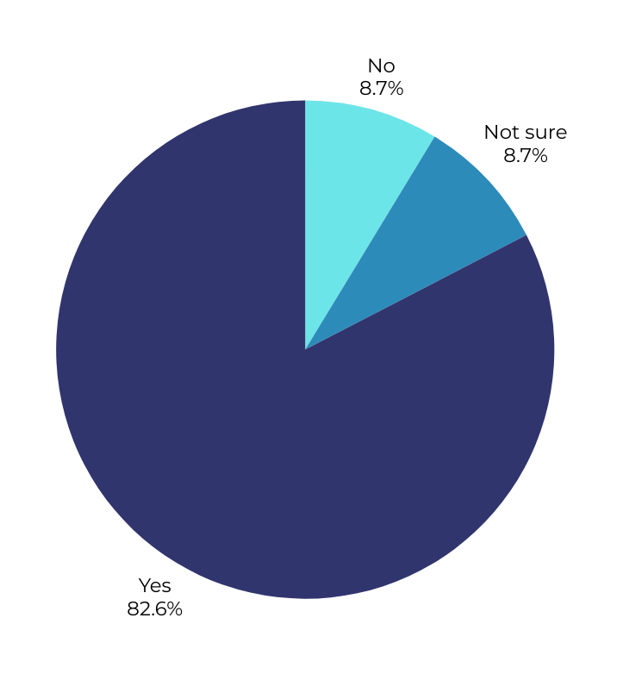
Diversity Survey 2024
In recent years, has your organization taken steps to conduct selection processes free of bias?
21 responses
IESF I 06
Notes:
3

Slide 71
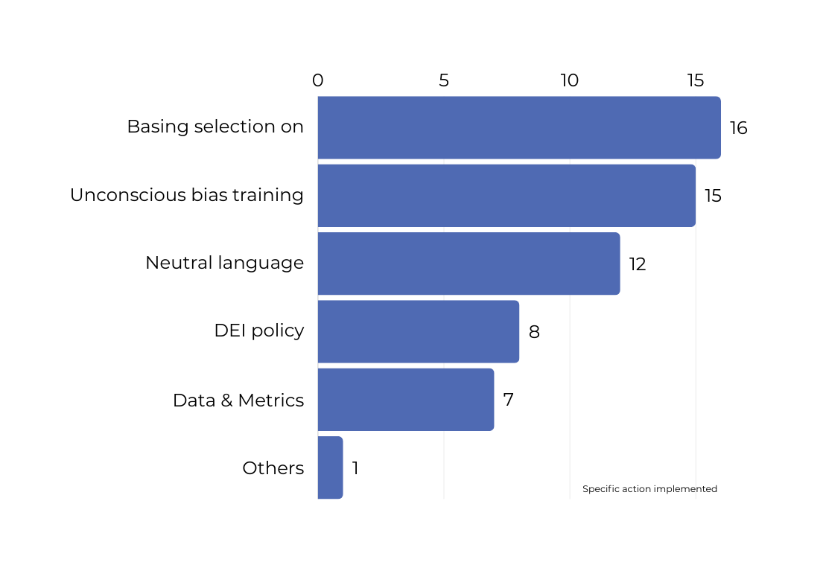
Which Actions have IESF partners Implemented
If affirmative, which specific actions have been implemented to ensure selection impartiality? Please select all applicable:
Basing candidate selection solely on technical experience, required competencies, and skills.
Providing unconscious bias training to recruiters and consultants.
Using data and metrics to review equity at all stages of selection.
Developing and implementing a Diversity, Equity and Inclusion (DEI) policy.
Others.
IESF I 07
Notes:
3

Slide 72
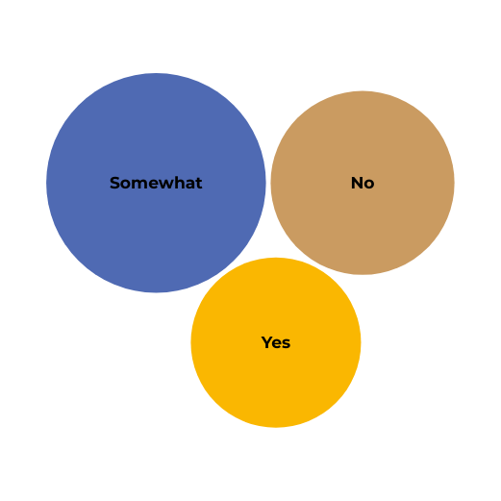
Impact of these actions
On a scale of 1 to 5, how effective do you believe these measures are in promoting diversity and inclusion in leadership roles?
Since implementing these measures, have you noted any substantial changes in the Long List or Short List compositions?
Not at all
Extremely
“The progressive advancement and development of knowledge in DEI topics have allowed us to be more attentive to potential acts of discrimination, whether from ourselves or from others. It also enables us to advise our clients”.
0%
0%
52.2 %
39.1 %
8.7 %
“The team has developed a greater awareness of the importance of their role in guiding and educating clients on conducting
bias-free processes”.
IESF I 08
Notes:
3

Slide 73
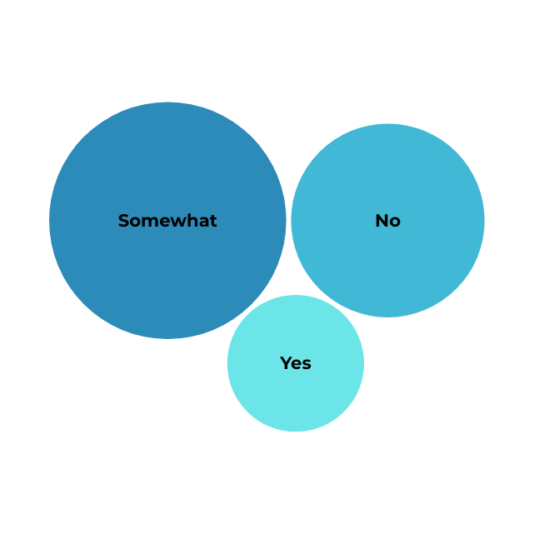
Clients Needs
“In some cases DEI is a specific question, it is slowly changing!”.
Do your clients request that selection processes be conducted without any bias?
“Our clients
trust us on this
matter”.
“There is no place for bias in our business related to age, gender, race, ethnicity, religion, sex, or disability. Put the best candidates in front of the client no matter what! ”.
IESF I 09
Notes:
3

Slide 74
How could we further enhance the effectiveness of selection processes to promote greater diversity and inclusion in leadership and top talent?
“It would be very interesting to share the experience and what is culturally (or legally) acceptable and not acceptable in each country. This would provide us with more tools to advise our clients when they want to conduct a search in another country”.
“Each country experiences a different reality. I believe it is important that, as partners, we share a commitment to reduce implicit and explicit bias in the executive search assignment from beginning to end. This not only helps us attract better talent but also retain it within our own teams”.
“We could share and draw inspiration from the good practices of all the partners.”
“Making sure that the selection process will be based solely on technical experience, required competencies, and skills - according to the client's requirements”.
“DEI is very important, however, the main goal is to find the best candidate for the role. We try to present a diverse shortlist as much as possible”.
“Although the reality in each country differs, we need to make a joint statement and reinforce IESF's commitment to implementing practices that enable bias-free selection processes”.
IESF I 10
IESF I 03
Notes:
4

Slide 75
NEXT
STEPS
OCT 2024
IESF Declaration: Commitment to Diversity, Equity and Inclusion.
Masterclass:
Dedicated Trainings to recognize and mitigate bias and share best practices about DEI in hiring processes.
Partnering:
With relevant Global Organization to drive DE&I
Establish a identity rooted in global diversity.
Content on:
Cross-Cultural Leadership
Gender Equality in Executive Search
Age Diversity in Leadership
Disability Inclusion in Executive Roles
Inclusive Leadership 2025
IESF I 11
IESF I 03
Notes:
Build IESF as a brand that is built on embracing and integrating diverse cultures, perspectives, and experiences from around the world.
This approach highlights the value of inclusivity and promotes a global outlook, where diversity is not just acknowledged but celebrated and incorporated into the core identity of an organization or individual.
It reflects an openness to different viewpoints, backgrounds, and practices, fostering a more inclusive and globally connected environment.

Slide 76
IESF's Commitment to Diversity, Equity and Inclusion
At IESF, we firmly believe that diversity in all its forms—whether in gender, culture, race, age, sexual orientation, or abilities—not only enriches the workplace but also enhances organizational performance. Diverse organizations are more innovative, adaptable, and resilient, thriving in an ever-evolving competitive landscape.
We recognize that diversity must be viewed through a global lens, while respecting the unique cultural and social contexts of each country and region. Our commitment is to tailor DEI practices to local realities, ensuring alignment with global standards of excellence.
Our primary focus is on identifying the best candidates for our clients, while fully integrating DEI principles into every executive search. We are dedicated to upholding these practices in a way that fosters inclusivity and fairness.
At IESF, we strive to create an environment where every partner, candidate, and client feels heard, valued, and respected. We emphasize the importance of ongoing education for leaders and employees about DEI, fostering awareness, and driving sustainable change within organizations.
By doing so, we help our clients attract, develop, and retain top talent, ensuring their long-term success.
IESF I 012
Notes:
3

Slide 77
Brainstorm Group
Stephan

Slide 78
Introduction
Initiative of AGM 2019
Goal is develop tools or services that are useful for most of the IESF Partners
Use of our knowledge / know how within IESF
Proposals for external development of tools when they benefit the group

Slide 79
Brainstorming projects so far
The rebranding of IESF
General IESF Search standard/unified proposal
AI Taskforce
Cross border development Taskforce
Break-out sessions in Lausanne & Amsterdam

Slide 80
Brainstorm for 2025
Select themes & ideas
(Group) Brainstorm
Voting/Ranking
The ideas so far:
Business Events Taskforce
Partner Development working group
IESF investments working group
AI Act working group
Other suggestions
Each group presents their findings (5-7 minutes per group).
Encourage other groups to build on these ideas by asking questions or adding suggestions.
Each participant can vote on the most impactful ideas for both internal and external development.

Slide 81
Selecting top 3 ideas
Topic 1
Topic 2
Topic 3
Additional information
Additional information
Additional information

Slide 82
Form task forces or working groups to explore the highest-priority ideas
Next steps
Set timelines for follow-up discussions and implementation plans.

Slide 83
IESF
AWARDS 2024

Slide 84
CROSS BORDER AWARD ASSIGNOR: 2023 / 2024
CANADA
9 ASSIGNMENTS
1
THE NETHERLANDS
8 ASSIGNMENTS
ISRAEL
7 ASSIGNMENTS
2
3
IESF I AMSTERDAM 2024
Notes:
3

Slide 85
CROSS BORDER AWARD ASSIGNEE: 2023 / 2024
THE UNITED STATES
5 ASSIGNMENTS
1
CHINA
4 ASSIGNMENTS
GERMANY
3 ASSIGNMENTS
2
3
IESF I AMSTERDAM 2024
Notes:
3

Slide 86
OFFICIAL VOTING
ON NEW PARTNER(S)

Slide 87
LET’S VOTE!
Scan the QR code and let us know!
IESF I AMSTERDAM 2024
Notes:
3

Slide 88
CLOSING NOTES
& SEE YOU AT THE NEXT AGM!

Slide 89
Closing Notes
LC Rotation - Thank you Dror
Dutch present for all our guests
Next Regional Meeting - Oslo. 10 & 11 April 2025
Notes:
3

Slide 90
AGM 2025 - Mexico City
Next AGM - Mexico City! 22 - 25 September 2025
Notes:
3

Slide 91
1.30 PM:
2.45 PM:
5.00 PM:
LUNCH AT ‘POLLY GOUDVISCH’
THIS IS HOLLAND & A’DAM LOOKOUT
FREE TIME!
FREE TIME
MEET IN THE LOBBY AT 1.30 PM

Slide 92
International Executive Search Federation
+34 93 238 54 86
iesf.com
info@iesf.com

