Slide 1
Navigating change

Slide 2
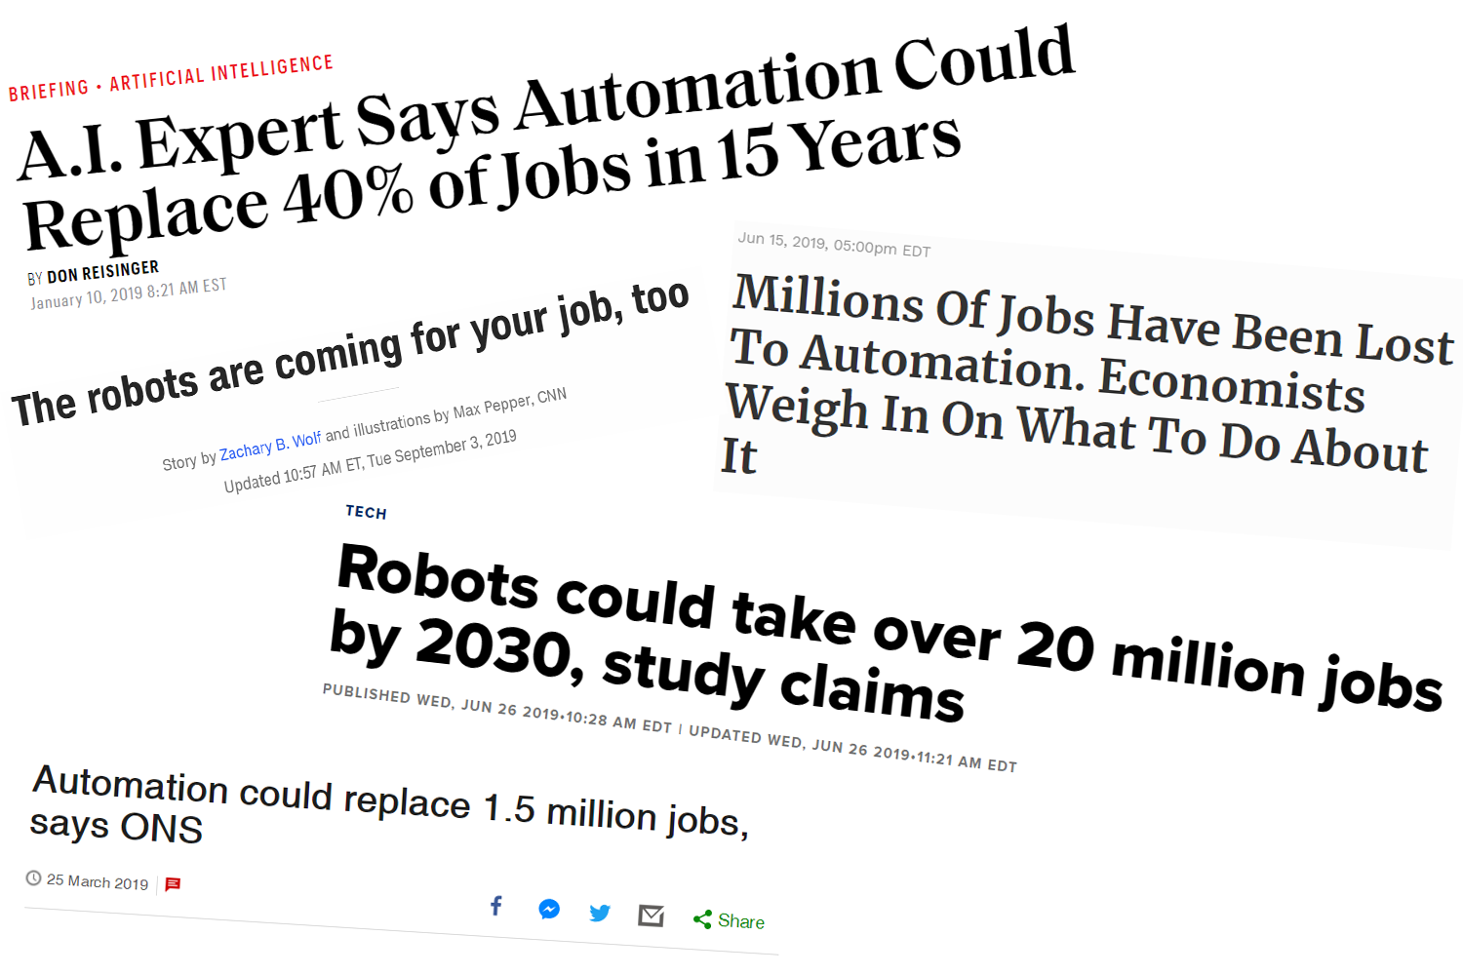
AI is taking all the jobs

Slide 3
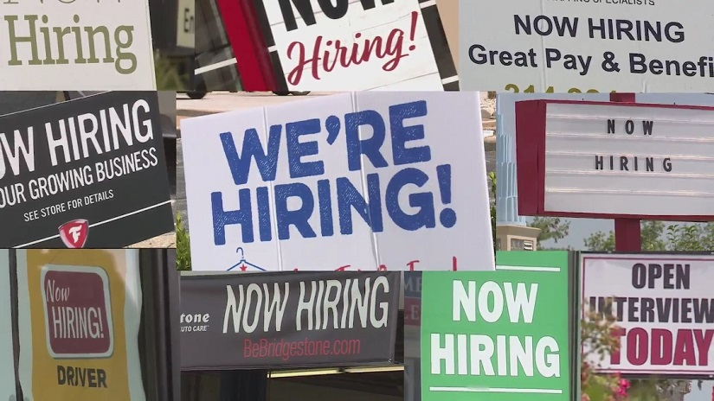
Yet we have massive labor shortages

Slide 4
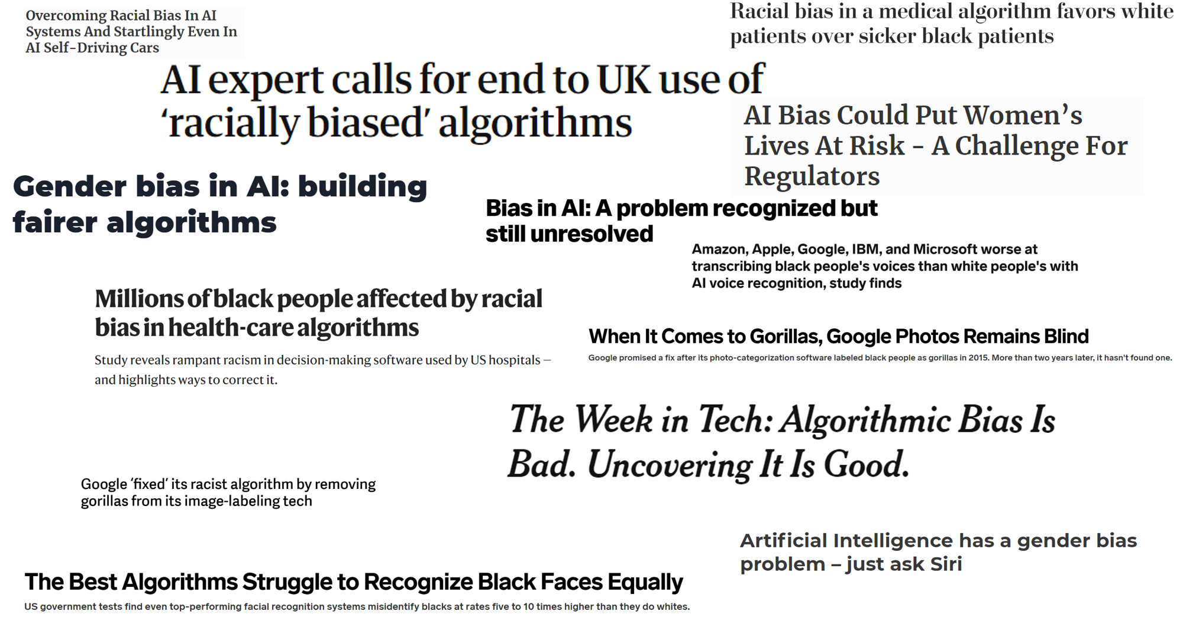
And then there’s the bias in training data

Slide 5
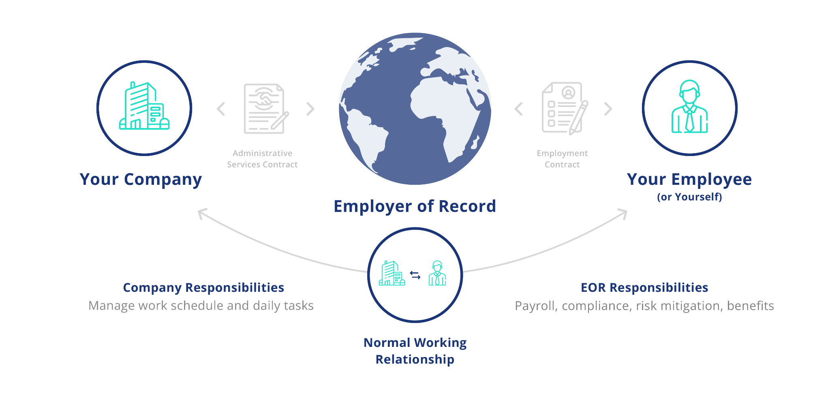
Globalizing

Slide 6
De-globalizing

Slide 7
1971

Slide 8
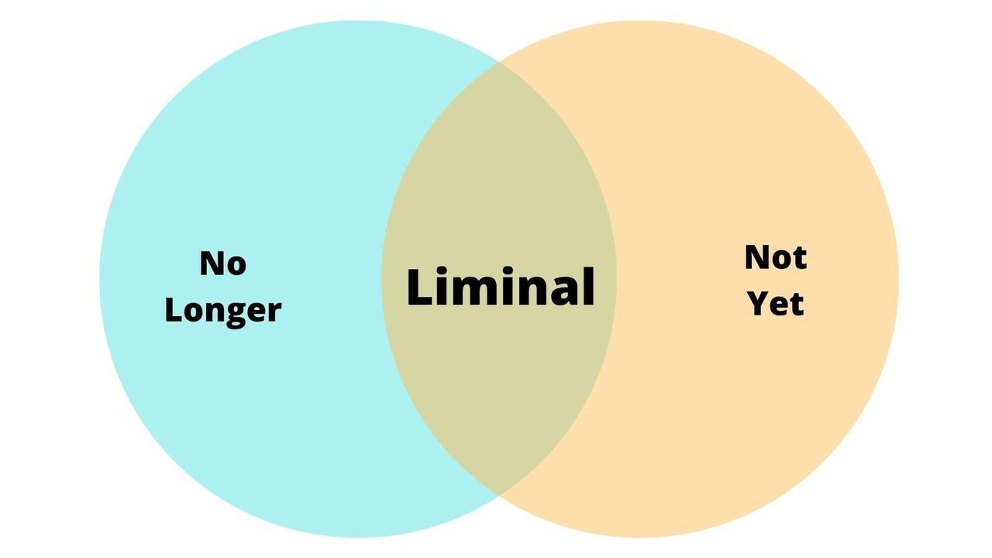

Slide 10
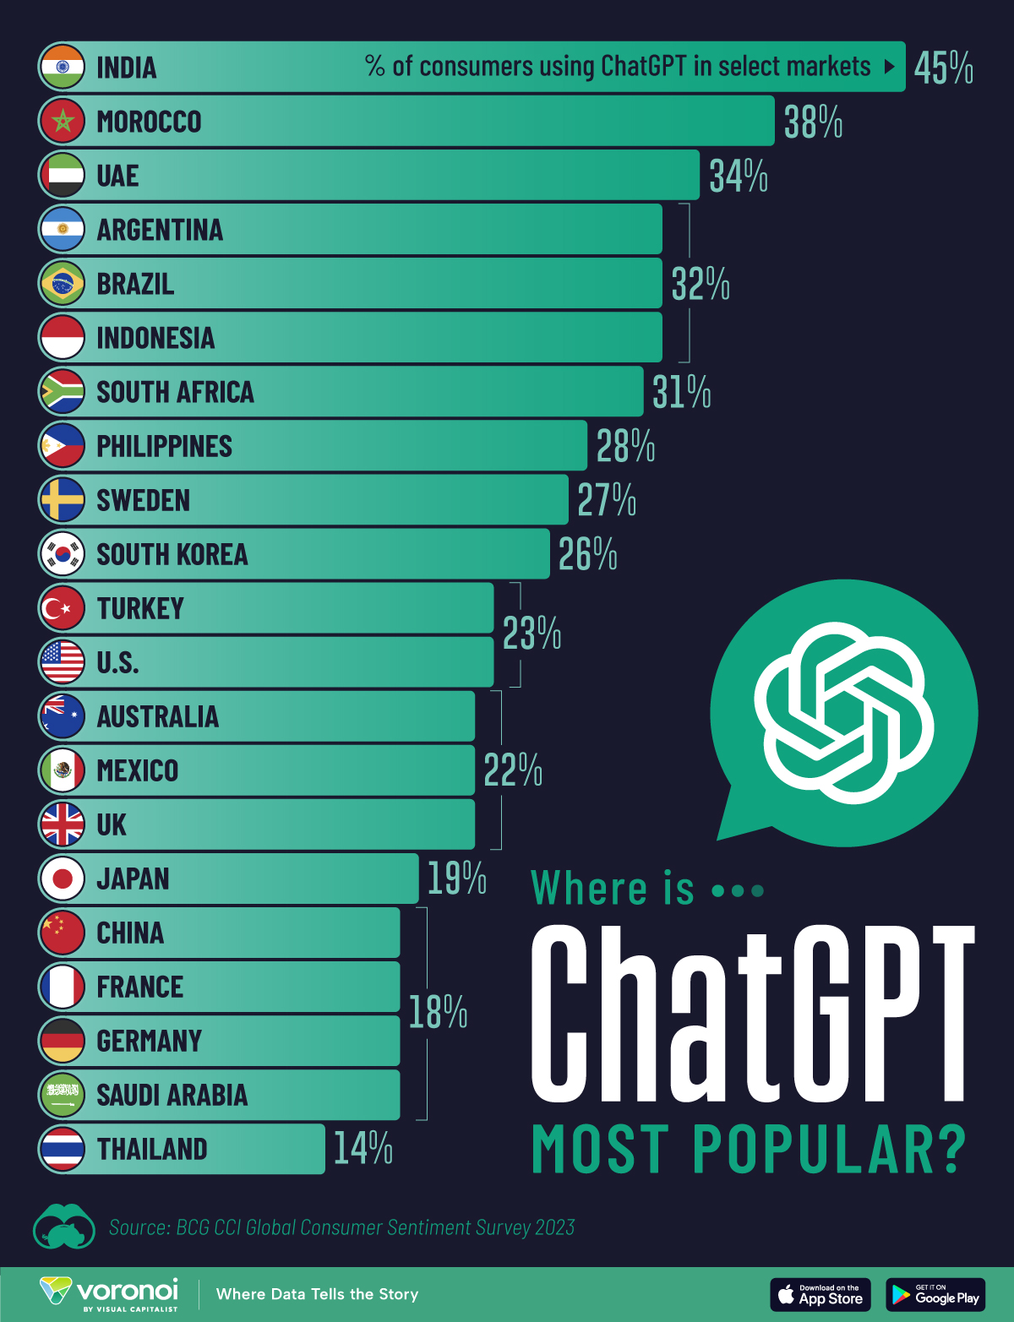
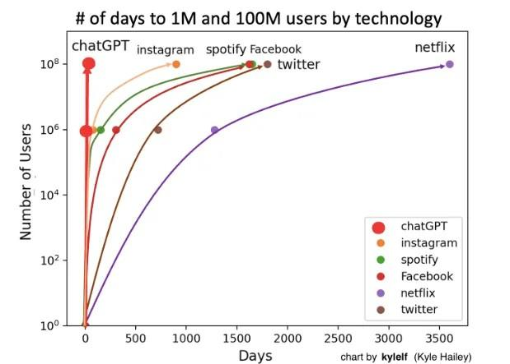

Slide 11
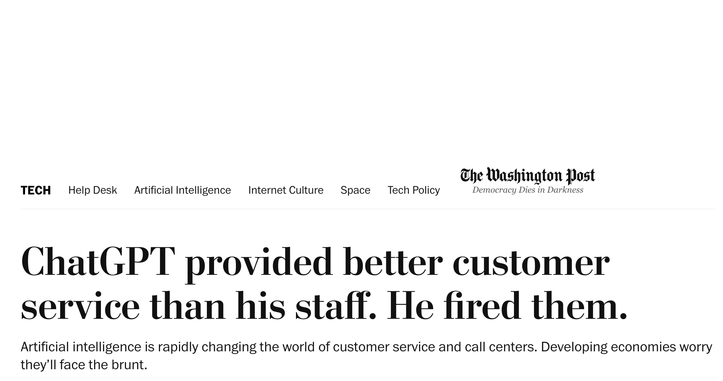
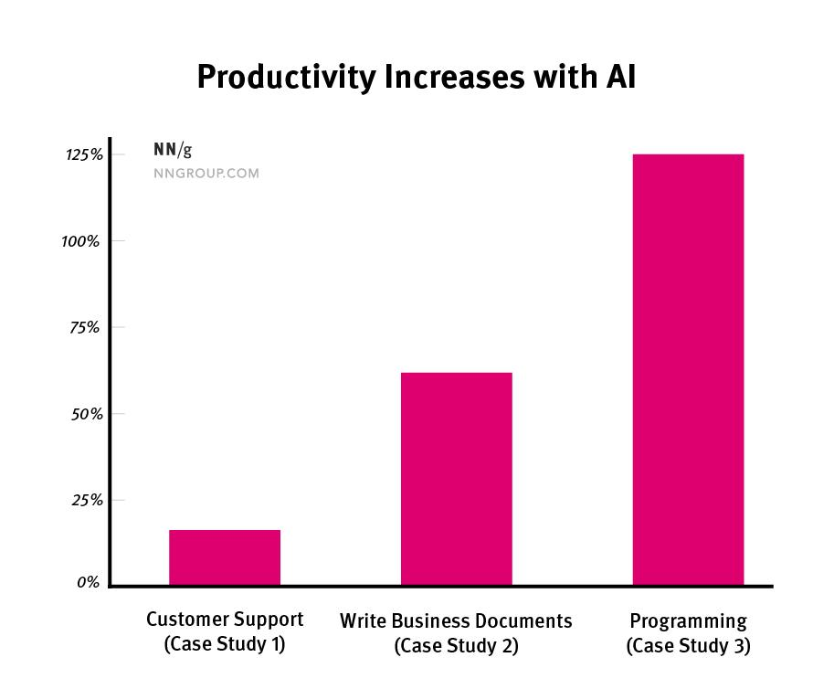

Slide 12
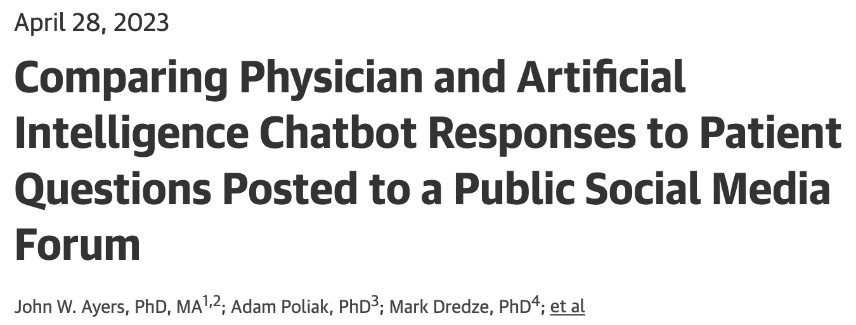
195 randomly drawn patient questions from Reddit
Answered by real physicians and by ChatGPT
Team of 3 licenced health care professionals as judges
Which was better
Quality rating 1 - 5
Empathy rating 1 - 5
78,6% of the chatbot answers were preferred
Quality rating good / very good (4 or 5): Chatbot 78,5%, Physicians 22,1%
Empathy rating good / very good (4 or 5): Chatbot 45,1%, Physicians 4,6%

Slide 13
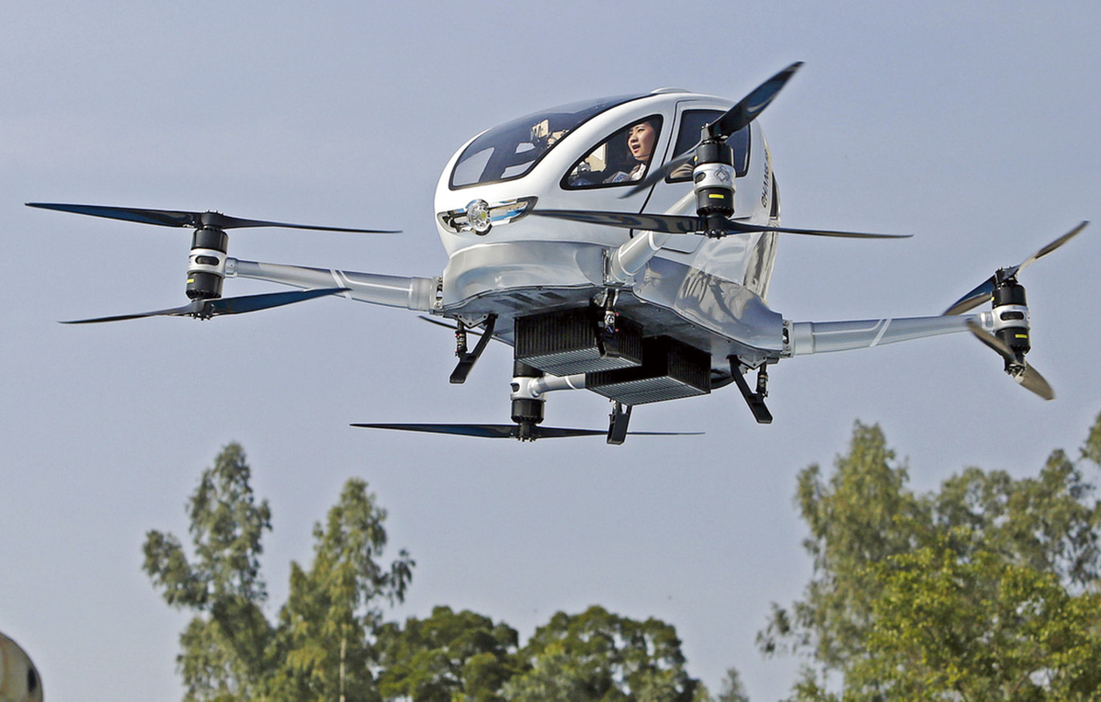
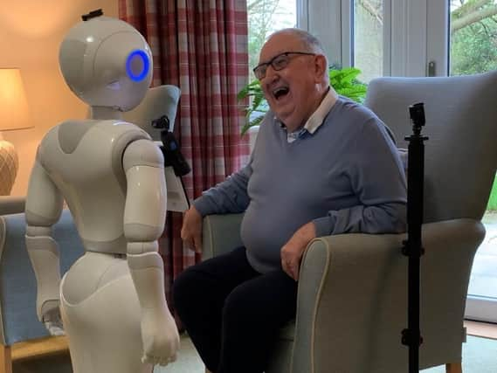
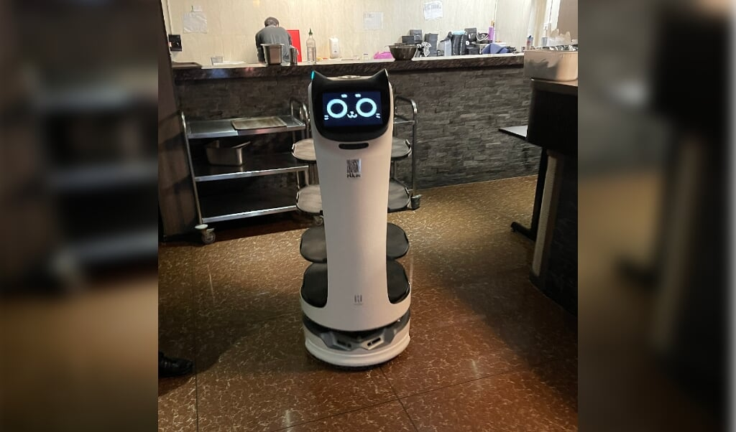
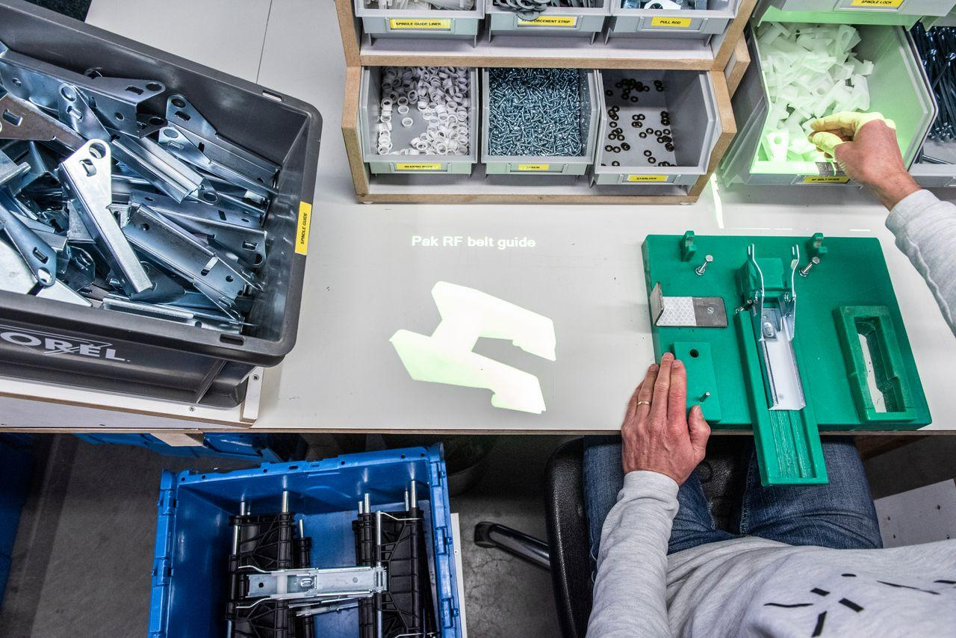

Slide 14
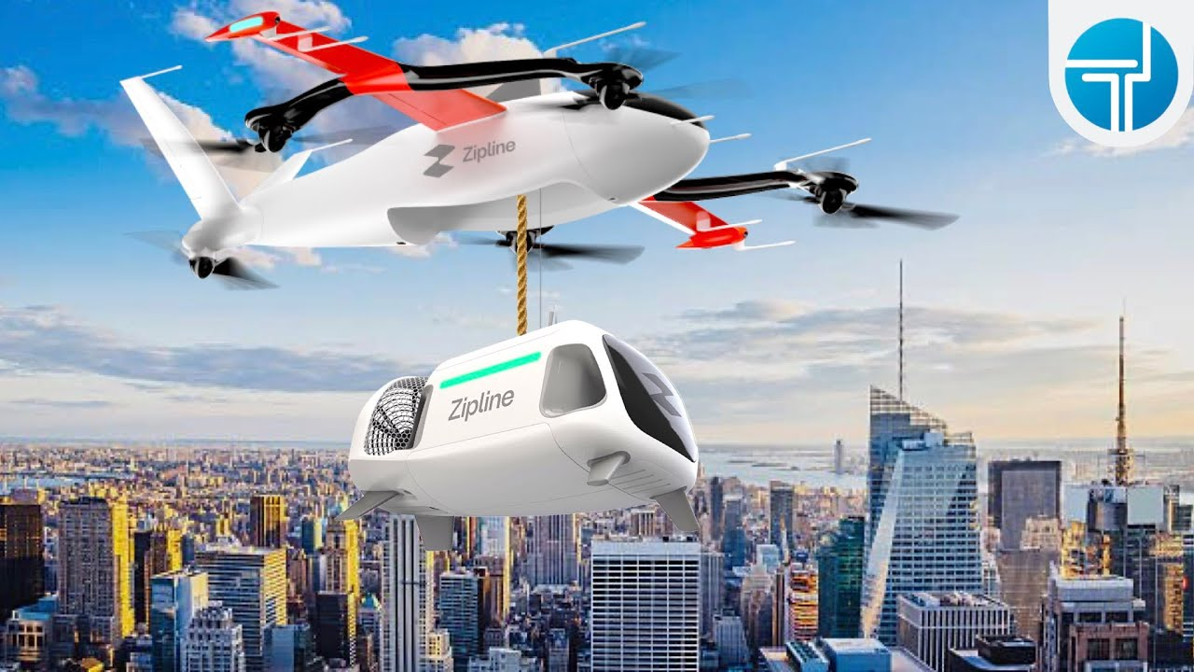
1.200.000 autonomous deliveries
Ghana: 17% increased vaccination rate & 30% less waste
Rwanda: 51% less preventable deaths at childbirth
In the US now also groceries & food delivery

Slide 15
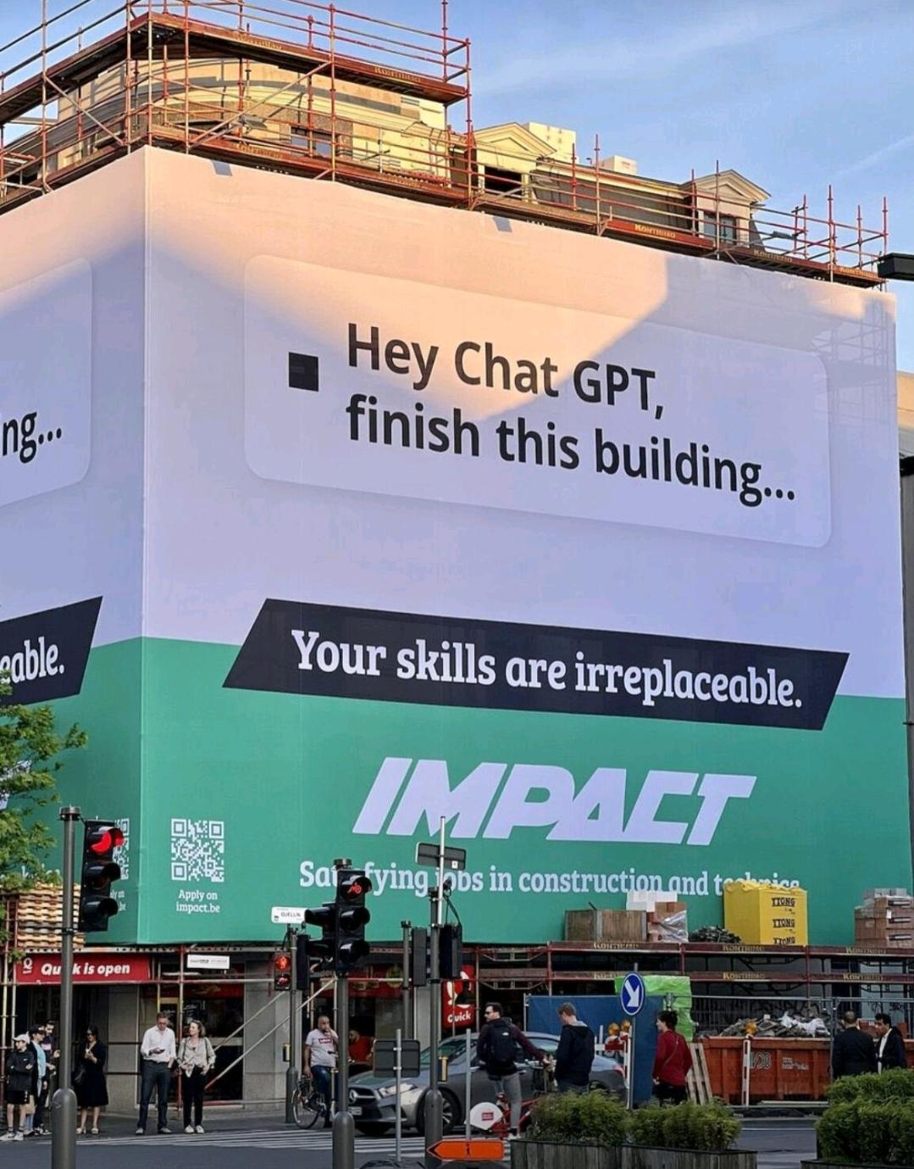

Slide 16
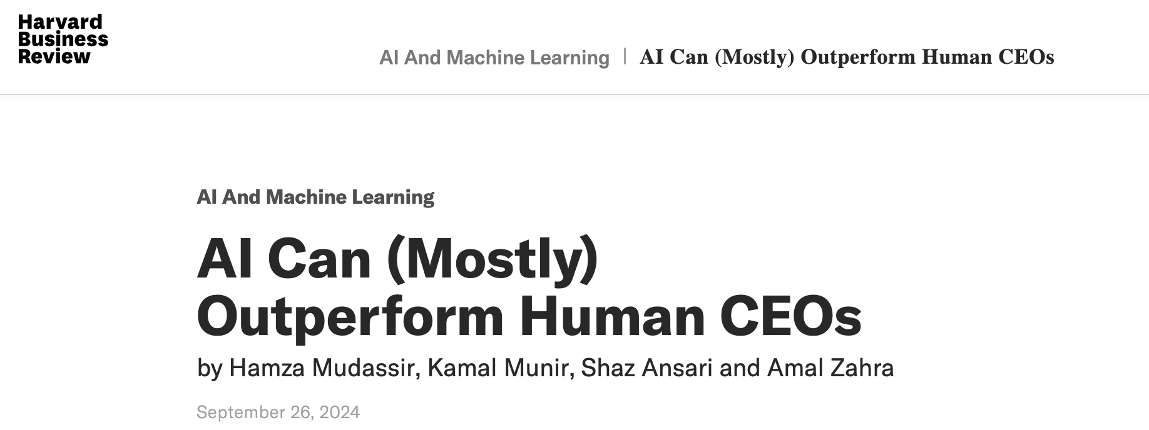
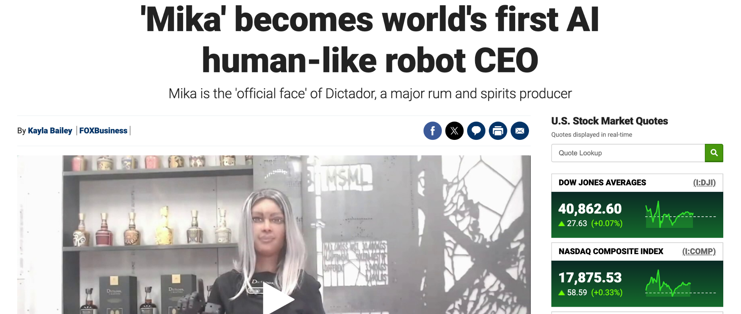

Slide 17
AI in
Talent Acquisition

Slide 18
AI call robot
Dutch post, automatically calls every applicant within minutes: Conversion & candidate experience ratings up.
YoungCapital called and screened 7.000 candidates within 4 hours. Leaving more time for interested candidates leading to 66% lower early attrition.

Slide 19
AI Chatbot
Dutch Engineering temp agency: Thousands of candidates every month from many different countries.
Dozens of placements every month.
Team of 3 recruiters.

Slide 20
AI Analyses
Online supermarket Picnic was able to:
Cut 80% of advertising channels for recruitment.
Optimize recruitment funnel and increase conversion with AI attribution models.

Slide 21
AI Analyses & testing
Several major retail focussed organizations:
Try out 1.000 different ads and many channels for the same position and optimize.
Attract thousands of candidates per month with a team of less than 5 people.

Slide 22
Interviews
Men who interview a woman speak 30% more of the time than when interviewing a man.
Women are asked different questions and more ‘proof of qualifications’ than men (10% more).
Women get 20% more questions and have 25% less time to answer them.
So hello AI interview intelligence

Slide 23
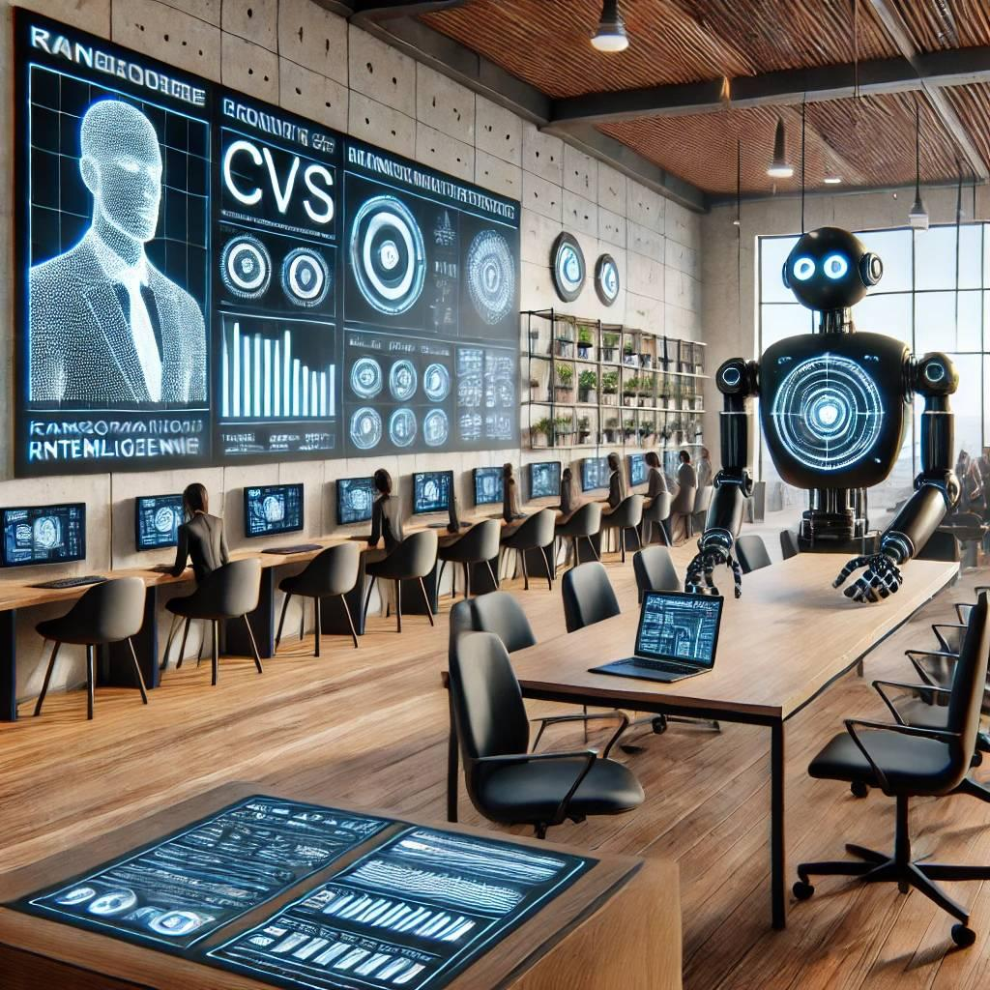
AI screening
In firms led by executives whose personal spending was excessive, academic research found both more fraud and more unintentional reporting errors.
CEO’s with a criminal conviction are much more likely to be personally implied at company fraud as well.
Firms with CEO’s with minor infractions (such as traffic violations) had a significantly higher chance to experience fraud than at those with CEO’s that don’t have them.

Slide 24
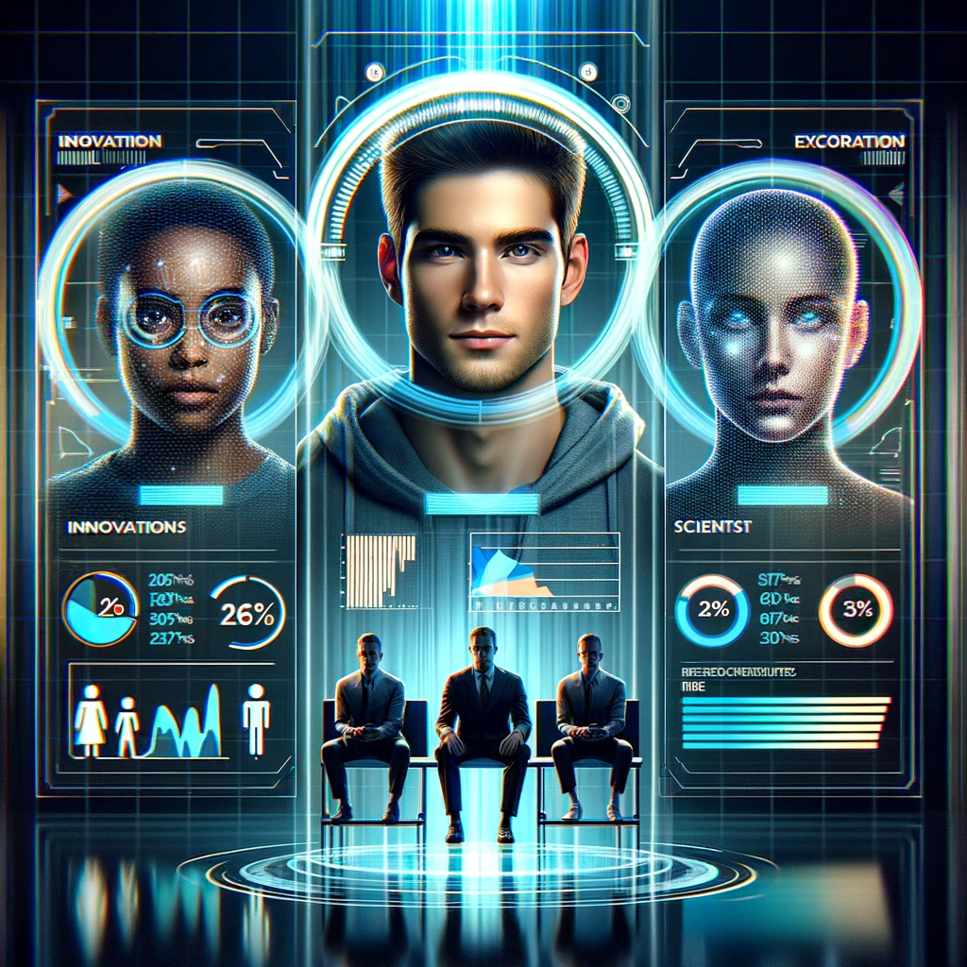
AI assessment
Depending on the measurement, between 30% and 50% of all hires fail.
The higher the position, the higher the fail rate.
Fit, drivers and soft skills are said to be the main reason for failing.

Slide 25
AI assessment
Unilever claims AI assessments got them to 50/50 male/female management.
Using AI assessment in management traineeships helps identify the management style and assign the projects accordingly.
Toronto Raptors claim they won the NBA in part of their AI hiring tool assisting them in finding players with good team fit.

Slide 26
GPT: I’m a blunt and direct Dutchman that writes short and to the point e-mails. My clients are middle aged american men. Please rewrite my e-mails for this audience.

Slide 27
Now: AI Assistant can you please find me a hotel to my liking in New York?
Early next year: AI Assistant build me a list of 10 potential directors of operations with at least 10 years of experience in machine building
Late next year: AI Assistant find me four suitable candidates for operations directors, check if they are interested in the job and if so schedule four interviews with these candidates in person, book their flights and overnight stay in Berlin if needed.

Slide 28
Future skills
Editor / improver → Tim Cook
Pitbull researcher → Elon Musk
True creative / oddball → Steve Jobs

Slide 29
The future of executive search
The last to go within the Talent Acquisition realm
Confidentiality
High risk hires
Personal touch

Slide 30
The future of executive search
Important factors moving forward
Trust
Transparent unbiased procedures & analyses
With the data to prove it
Personal touch at scale

Slide 31
Thank you for your attention

